Slide 1
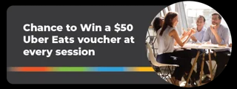
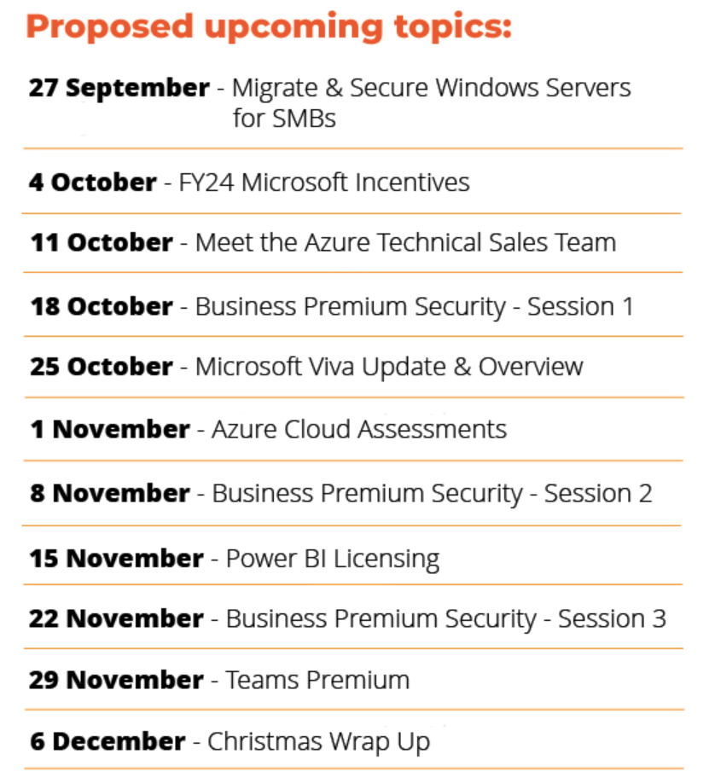

Slide 2
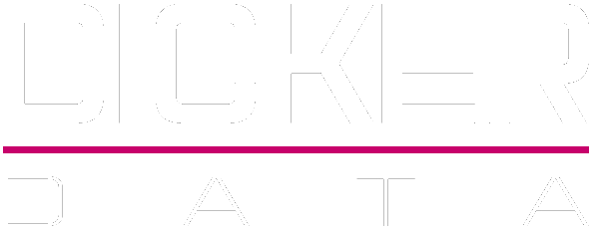
Microsoft Teams Premium

Slide 3

AGENDA
News
Microsoft Teams Premium
Questions
Close & Prize Draw

Slide 4


Dicker Data & Microsoft News

Slide 5
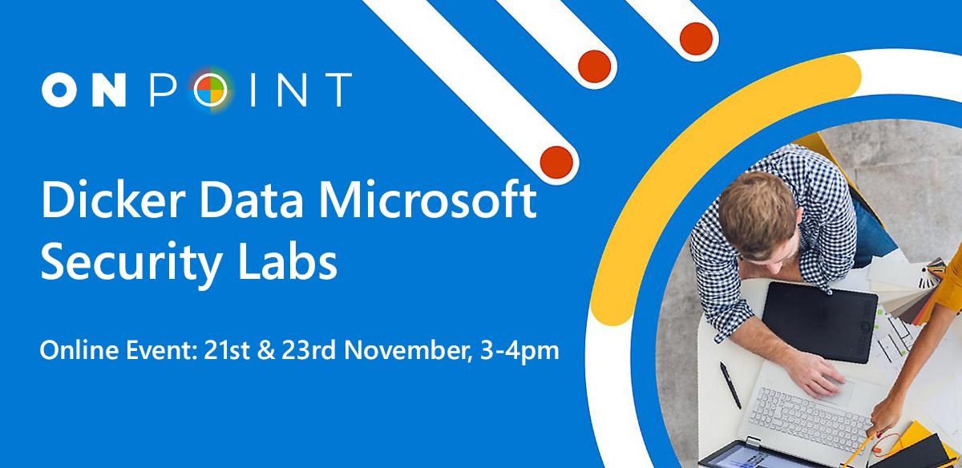
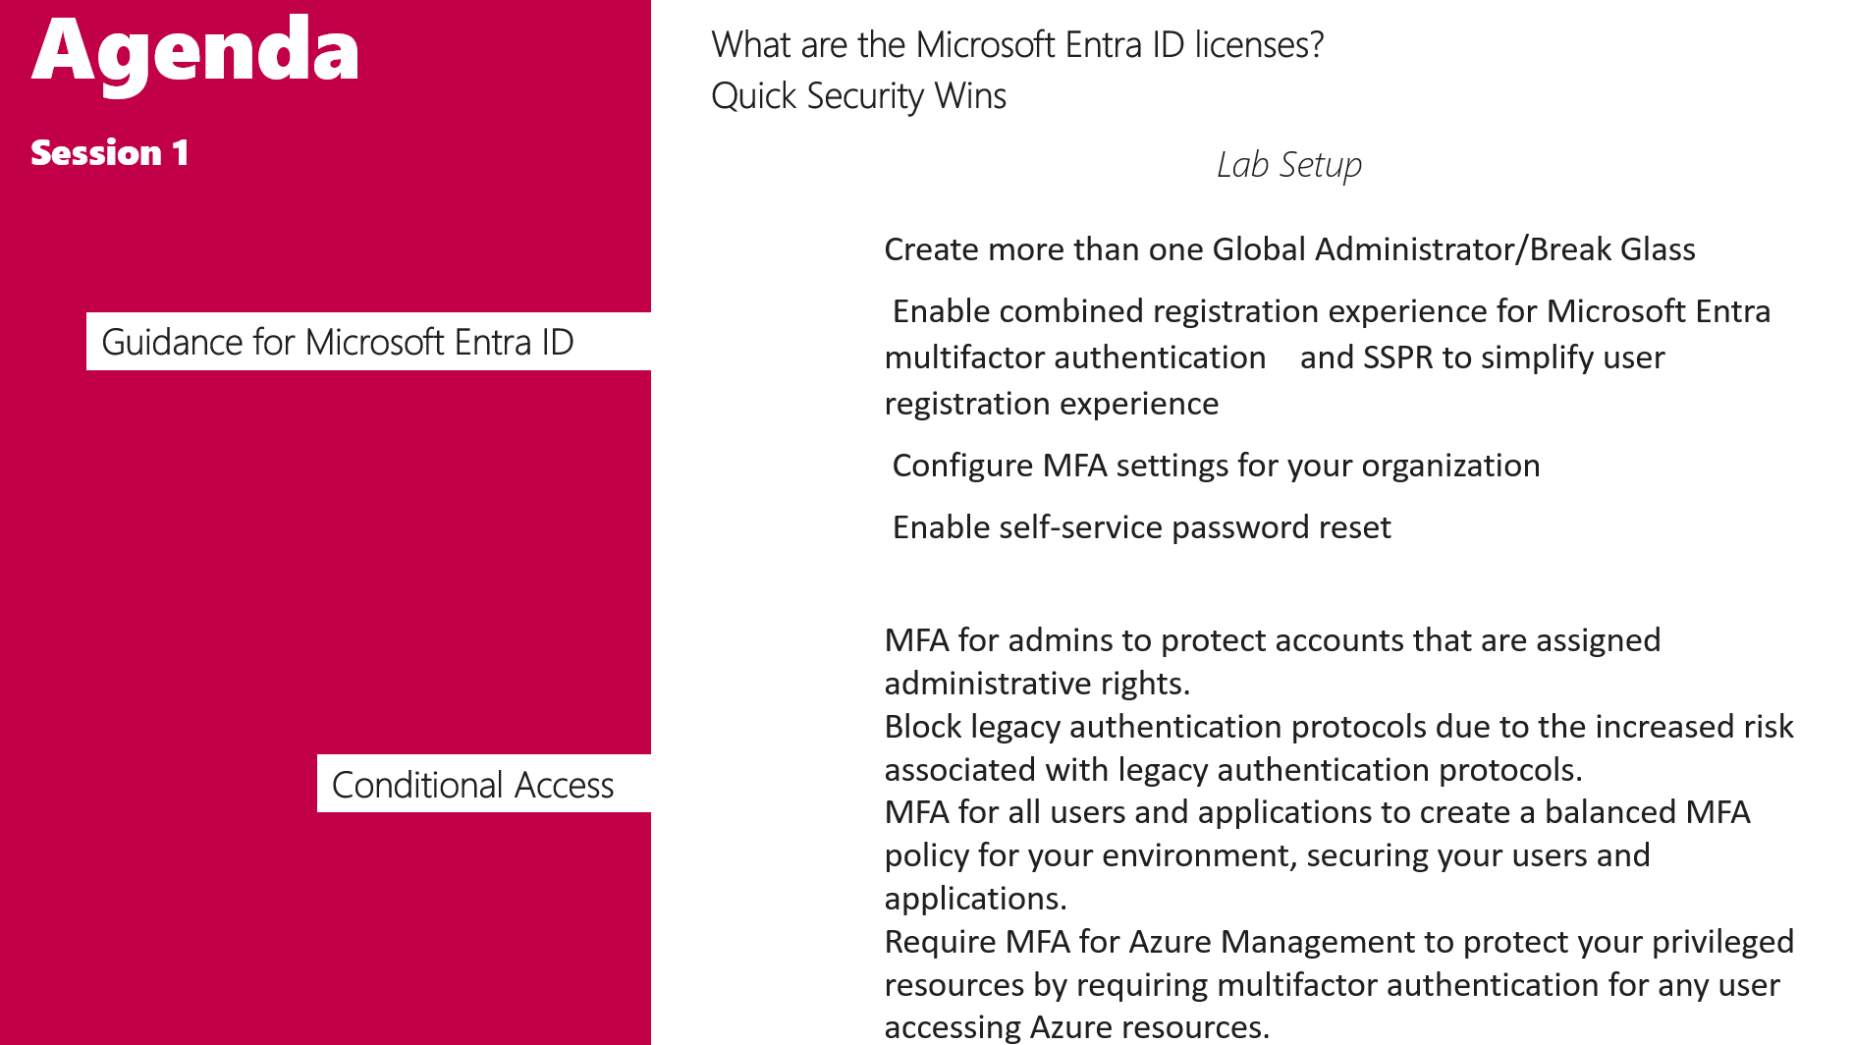
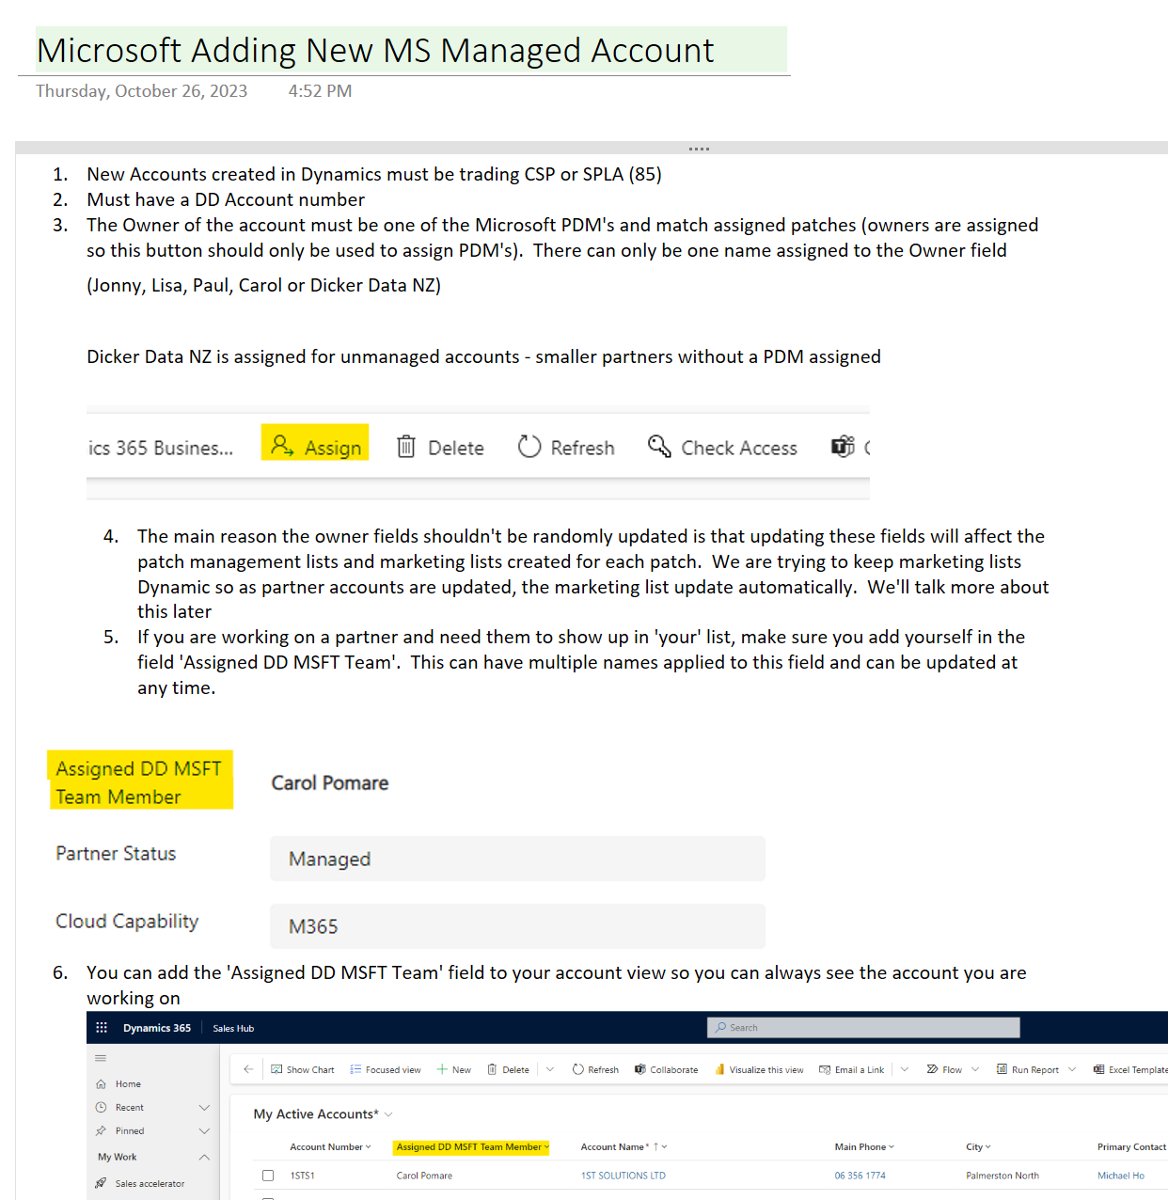
These introductory sessions will demonstrate Microsoft best practice to set up key security features across both the Entra ID suite, and the Defender Suite of security services.
Register Now
These sessions will then be followed by instructions on setting up a lab within a demo tenant for you to set up a test environment, accompanied by a knowledge check document.
Notes:
Yours truly will be doing 2x labs on best practise setups for customer and partner tenants using M365 Business prem
Labs will be recorded demos with documentation so you can get some hands-on experience

Slide 6

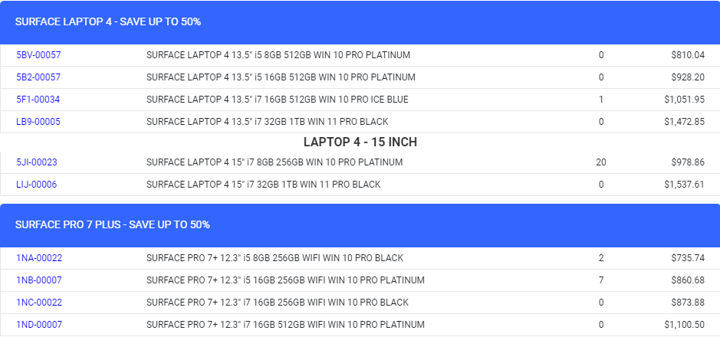
Notes:
Sarah is channelling The Briscoes lady with an up to 50% off Laptop4 and Pro7 Plus models

Slide 7

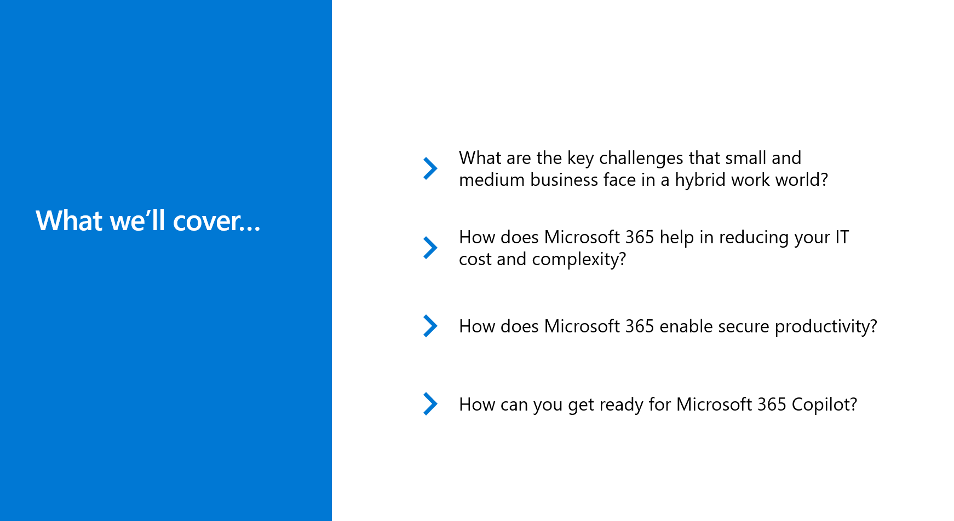
Do More with Microsoft 365
Microsoft SMB Briefing
Notes:
Workshops FEB/MARCH 24 taking bookings
Spend 5 minutes to introduce yourself and ask each attendee in the beginning.
Ask questions such as Name, Role, expectations from the workshop, ask if they are interested in Teams or Security or MDM or all of them.

Slide 8

Dicker Data would like to personally invite you to Microsoft's ‘Cloud Discovery Day – Empowering Partners for the NZ Cloud Region’ event. Microsoft’s hyperscale datacenter region launch will accelerate New Zealand’s digital transformation, providing a unique opportunity for our partners. Join us on 4th December at Auckland’s Park Hyatt to learn more about what the Microsoft Cloud, the opportunity for your business - and how it will help your customers achieve more.
Notes:
During this invite-only event, you’ll have the opportunity to:
Discover how the Microsoft cloud will help you – and your customers - capture the AI opportunity
Hear from local and global Microsoft experts, as well as from our customers
Discover learnings from other cloud regions and how partners are driving change
Attend role-specific breakout sessions to deep-dive on the benefits of partnering with Microsoft, building with Microsoft and architecting for customer success.
The datacenter region launch represents a more secure, productive and resilient future for New Zealand, and we look forward to working alongside you to build this future.
You will have a choice to attend one of the below three breakout sessions as part of this event.
Sales, Marketing and Leadership Breakout - Partnering with Microsoft
Learn more about the mission and strategic imperatives, how to accelerate partner growth, the Go-To-Market archetypes, the big partner opportunity and the insights and best practices.
Technical Breakout - Architecting for customer success
Learn more about the upcoming region launch, how to design for availability zones, connectivity between your on-premises resources, and moving resources between regions.
ISV Breakout - Building with Microsoft
Learn more about the opportunity to partner with Microsoft, how our partners are accelerating growth and innovation with GenAI and key things for SaaS Partners to consider when deciding to leverage the Microsoft Cloud.

Slide 9
Modern Work News
Copilot Overview Session w/ DD
DD running Copilot Overview sessions over December that will cover what Copilot is, what all the different Copilots do, use cases, licensing, availability, adoption etc – book here
CSP Masters Training
Keen to understand whether you are more interested in sales or technical – please fill out this form
New Copilots
  Copilot for Sales
  Copilot for Service
  Copilot Studio
Bing Chat Enterprise
Renamed to Copilot
Will be included in M365 F3 – 1st Dec 2023
Notes:
Talk about compliance - MS are tightening up on compliance with Partner Centre so any weird shite happening to give us a call to remediate with them and they shouldn't ignore MS emails.
like 1

Slide 10
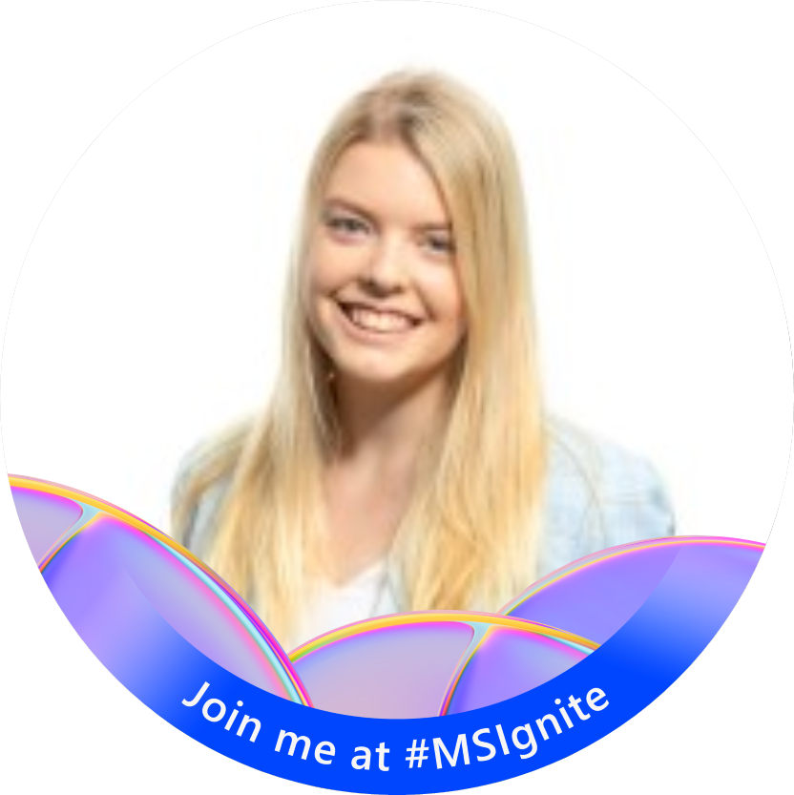
Today's Presenter
LAUREN NOBBS
Modern Workplace BDM

Slide 11

Microsoft Teams Premium

Slide 12



Agenda
What is Teams Premium
Teams Premium Features
Identifying Customers
Licensing
New Features

Slide 13

The way we’re meeting isn’t sustainable
#1
Disruptor of productivity is inefficient meetings
3X
More Teams meetings
& calls a week
since Feb 2020
68%
of employees don’t have enough uninterrupted focus time
62%
Spend too much time
searching for info
Notes:
Potential stats for talk track:
* 85% of leaders say the shift to hybrid work has made it challenging to have confidence that employees are being productive (I have to check with Alex if we can use this stat)
* 68% of people say they don’t have enough uninterrupted focus time during the workday
As noted in Microsoft’s 2023 annual work trend index report, some of the meeting trends we’ve seen develop are unsustainable:
The #1 disruptor of productivity is having inefficient meetings
People are in 3x more teams meetings and calls a week since February 2020
68% of employees feel they don’t have enough uninterrupted focus time in their day
And 62% feel they spend too much time searching for information
When you add these all together: workers don’t feel like they have enough focus time in their day, likely being driven by finding themselves in more meetings than before – some of which are inefficient uses of their time. We believe that there’s a way to help remediate these unsustainable trends with Teams Premium

Slide 14
What is Teams Premium?
Intelligent productivity
Focus on what matters most with meetings powered by AI, including GPT from OpenAI
Advanced protection
Collaborate more securely with advanced protection and customized Teams management
Richer engagement
Create deeper engagements with personalized experiences that help grow your business and brand
Notes:
Teams Premium is an add-on to Teams designed to make Teams meetings more intelligent, personalised, and protected. As we spend more and more time in online meetings, customers needs for meetings are evolving, and Teams Premium addresses some of these needs by integrating AI, Microsoft compliance features, and enhanced customisations into the Teams meeting experience.

Slide 15

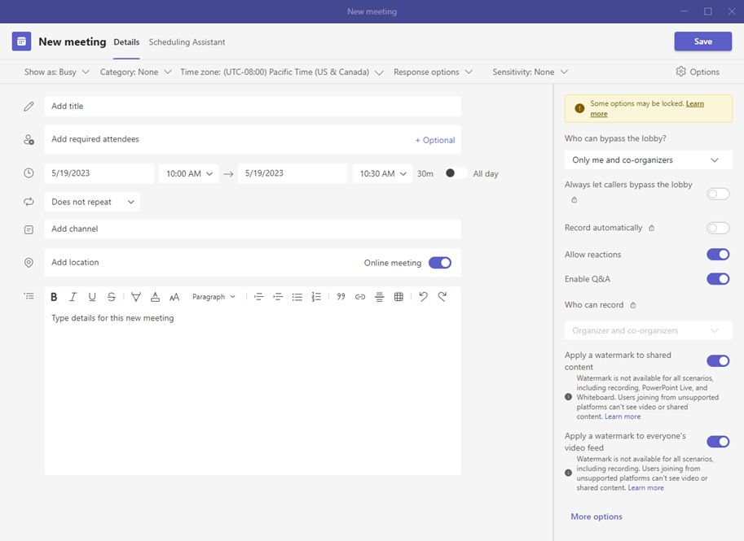
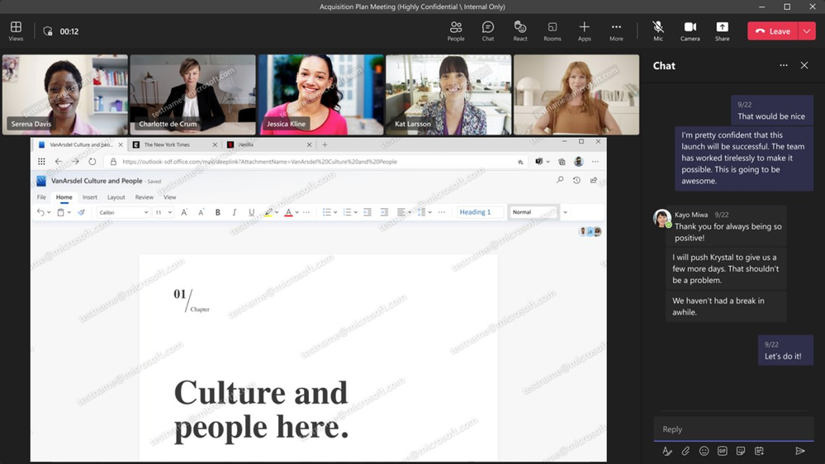
Protected Meetings
Increase meeting security by enabling the end-to-end encryption option for meetings that need additional protection
Protect sensitive information by applying sensitivity labels to help protect sensitive meetings – this feature requires a Microsoft 365 E5, E5 Compliance, F5 Compliance, or F5 Security + Compliance subscription
Help prevent against data leaks with in-meeting watermarking over
screen shares and video feeds and by controlling who can record meetings
Notes:
*Teams protects your data with encryption in transit and at rest for all meetings
End to end encryption??
Use the previously mentioned meeting template to set the meeting options/controls – e.g. who can bypass lobby, watermark for screenshare or video, end to end encryption, who is able to record the meeting etc

Slide 16
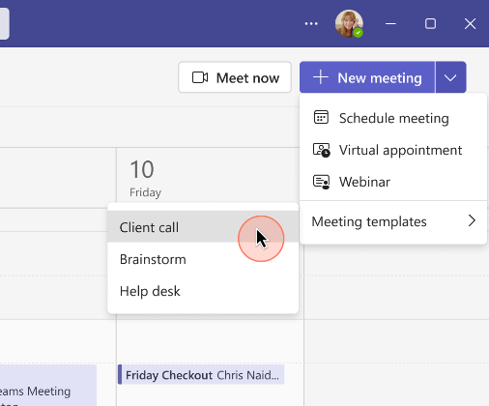
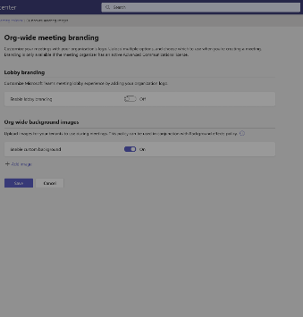
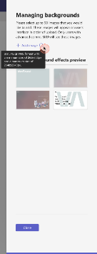
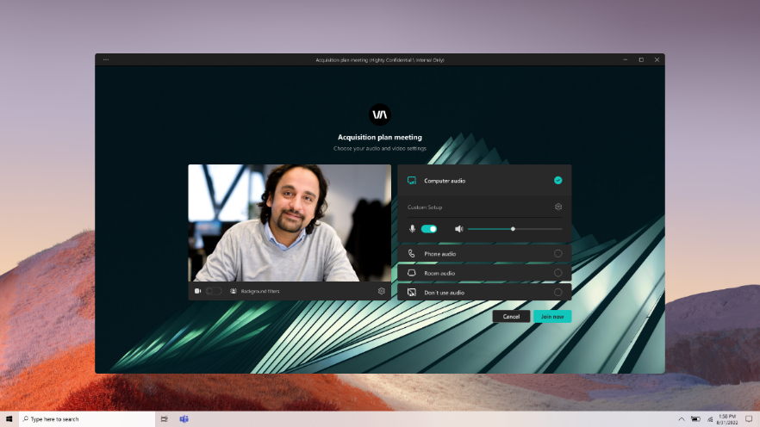
Personalised Meetings
Create pre-configured meeting templates
Configure custom meeting branding with branded lobby, custom org-wide backgrounds, and customer together mode scenes
Notes:
Pre-configured meeting templates
These are configured by admins and then users can select them when they are setting up meetings
Meeting options include who can bypass lobby, watermark for screenshare or video, end to end encryption, who is able to record the meeting etc
Uniform branding looks professionals and enables the company to have consist branding with logos, colours for all client engagements
The meeting templates are configured in the TAC

Slide 17
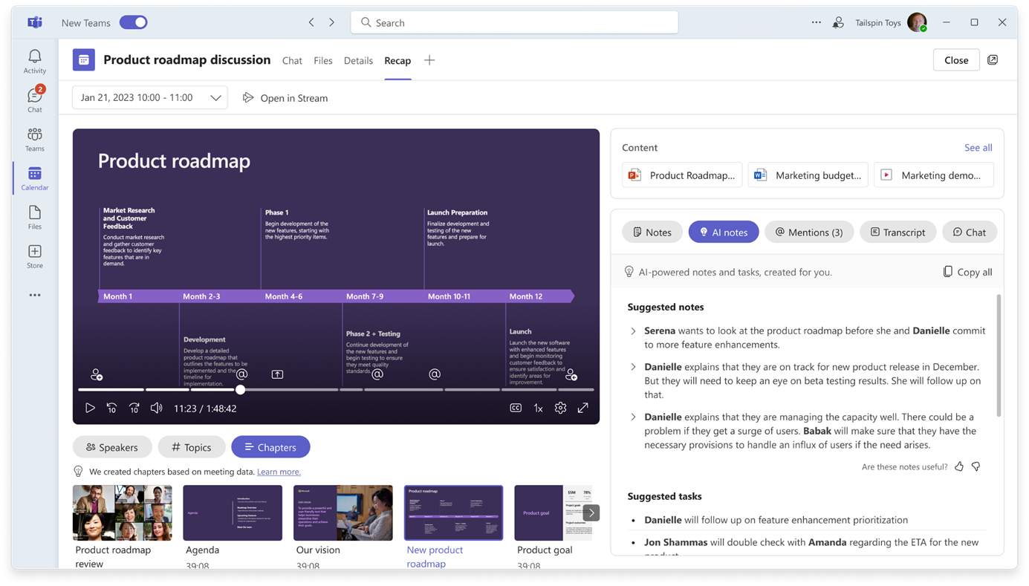
Intelligent Meetings
Intelligent Recap leverages the power of AI to make meetings more productive and save you time by generating meeting notes and tasks.
It records when you’ve been mentioned, action items, and generates chapters and topics so you can skip to the parts that are most relevant to you.
Live translation allows individual users to enable captions in their preferred language.
Notes:
Intelligent Recap brings the power of AI into your teams meetings.
AI-generated meeting notes - generates a ‘recap’ of the meeting with notes about what was discussed & by who. You can easily copy these notes as well to send them to someone/use in a follow up/update CRM. It also suggests follow up actions from the meeting.
Records when you’ve been mentioned during the meeting
Auto-generated topics and chapters so you can quickly jump to the parts of the recording that are most relevant to you
You can see a breakdown of the speakers, how long and when during the meeting they spoke

Slide 18
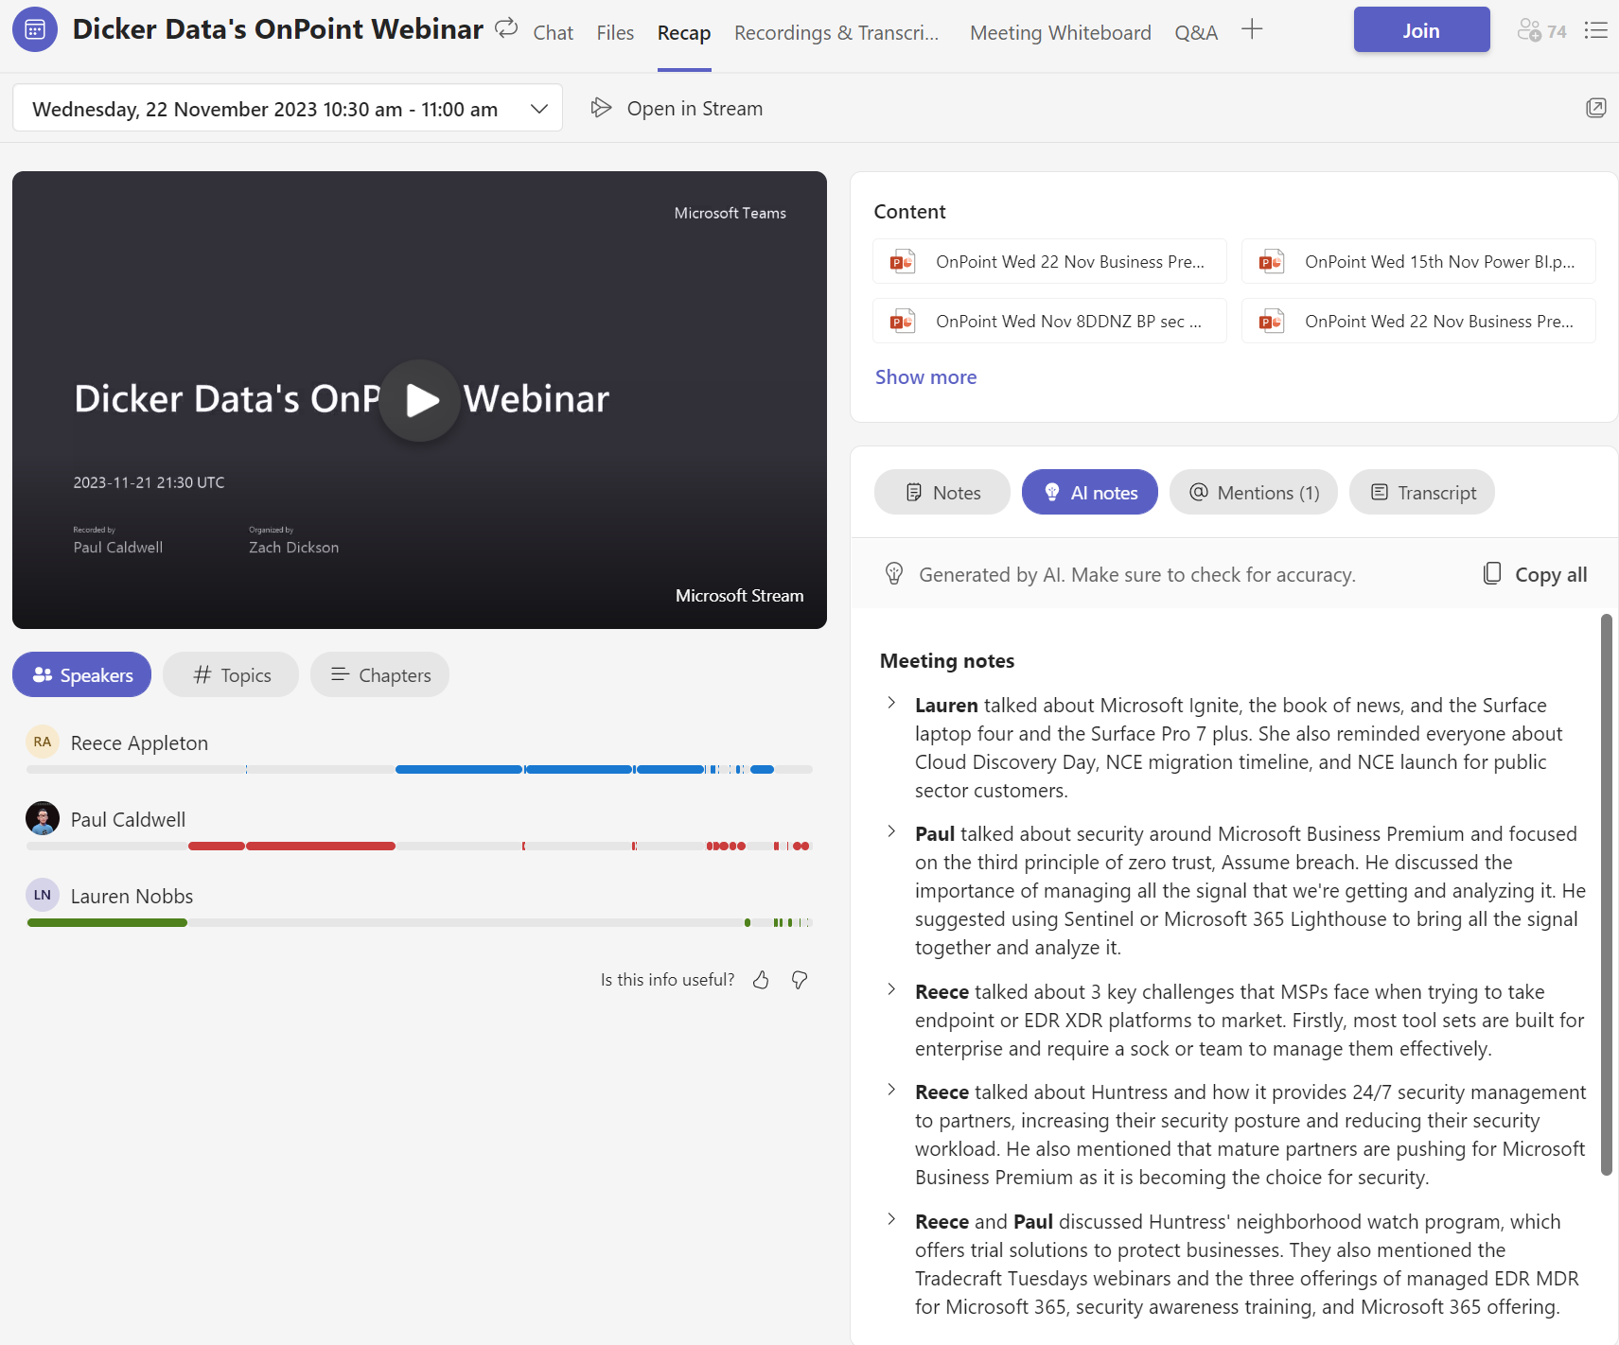
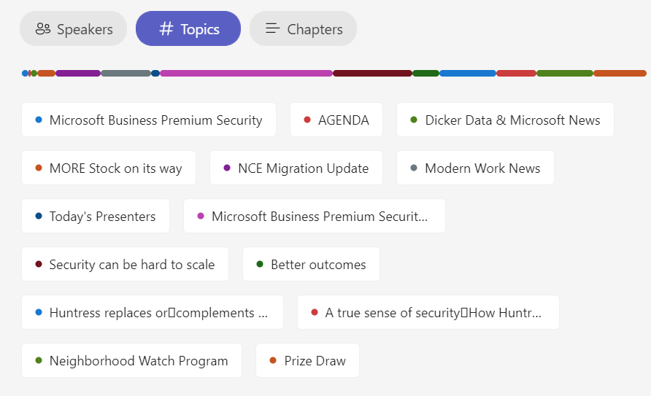
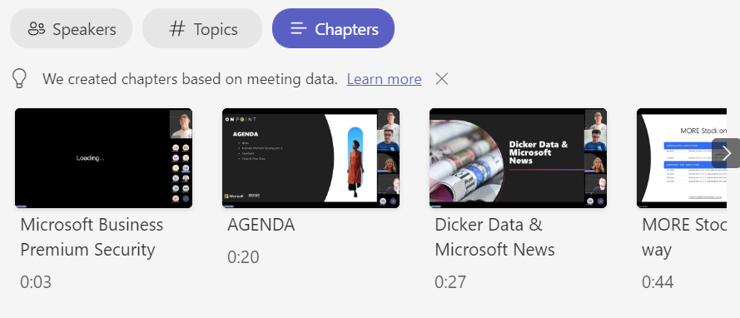
Recap Example – On Point

Slide 19
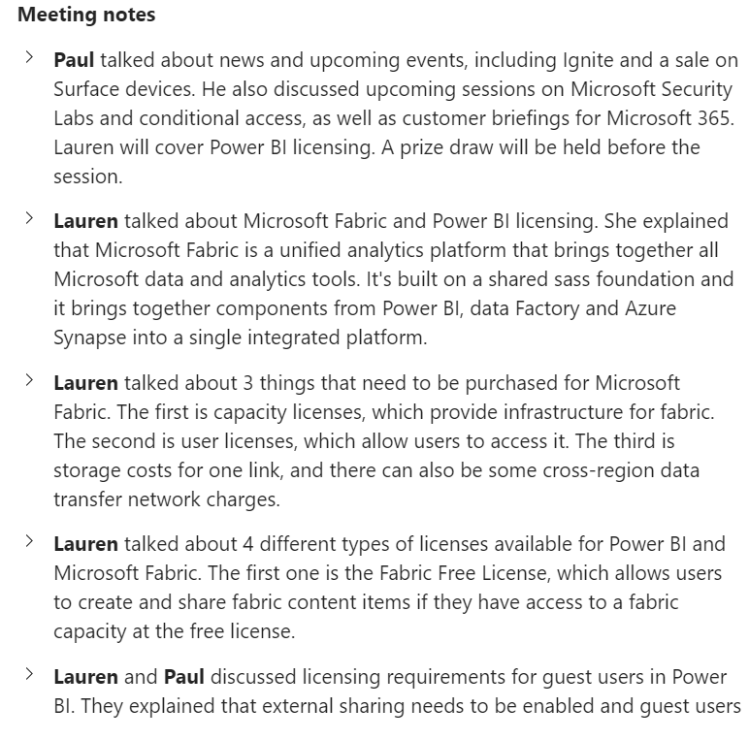
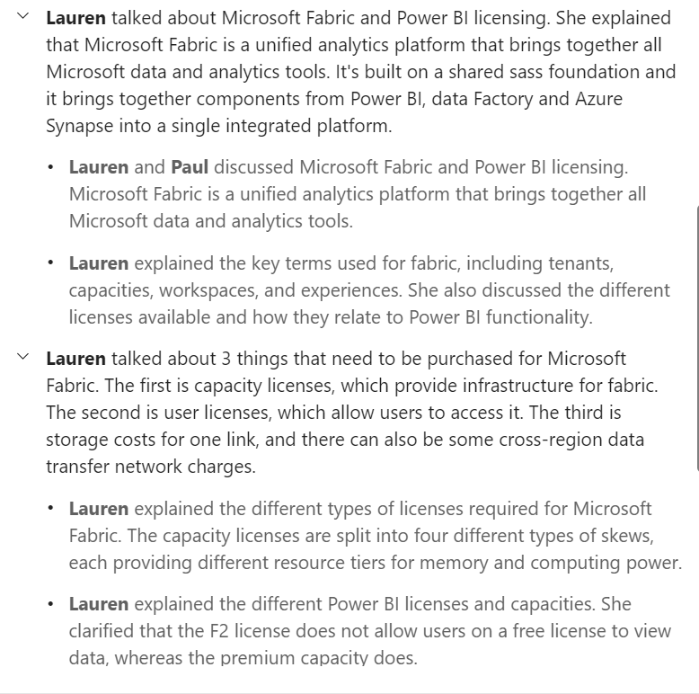
Recap Example – On Point

Slide 20

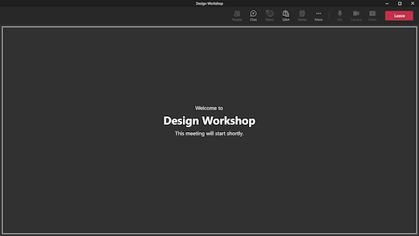

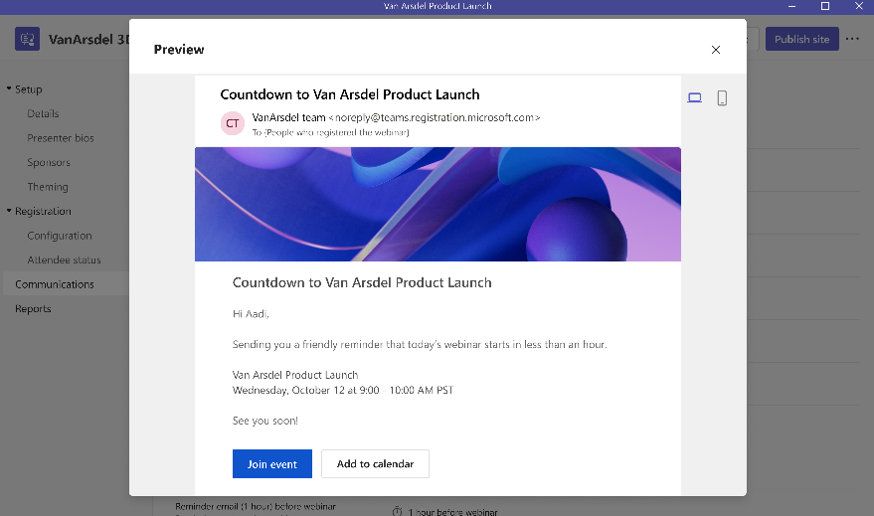
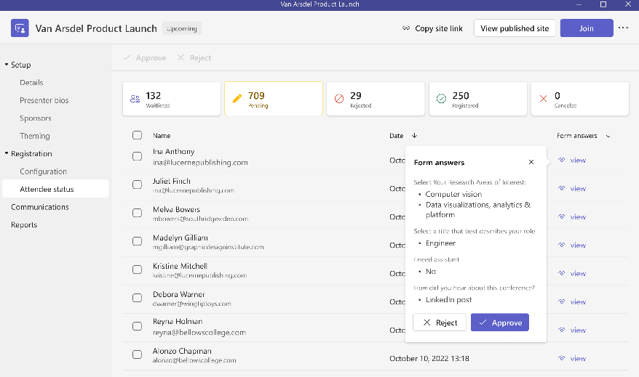
Advanced Webinars
With Advanced Webinars you can deliver high-quality and engaging webinars
Enable a waitlist and registrant approval to help manage demand
Get ready with other presenters in the virtual green room
Lobby bypass for registered users
Automated reminder emails
Notes:
The green room allows you and other presenters to prepare for the meeting before it starts – you can test audio/video, practise sharing content, check in with the other presenters etc before the attendees join.
You can also access the chat, turn on captions, add apps to the meeting like Q&A, manage participants, see reactions, access notes etc. turning on recording or transcription must be done when the meeting starts.
Attendees can join the meeting while the green room is active and they’ll see the waiting screen – they won’t be able to see/hear presenters or turn on their audio/video, but they can access the chat.

Slide 21
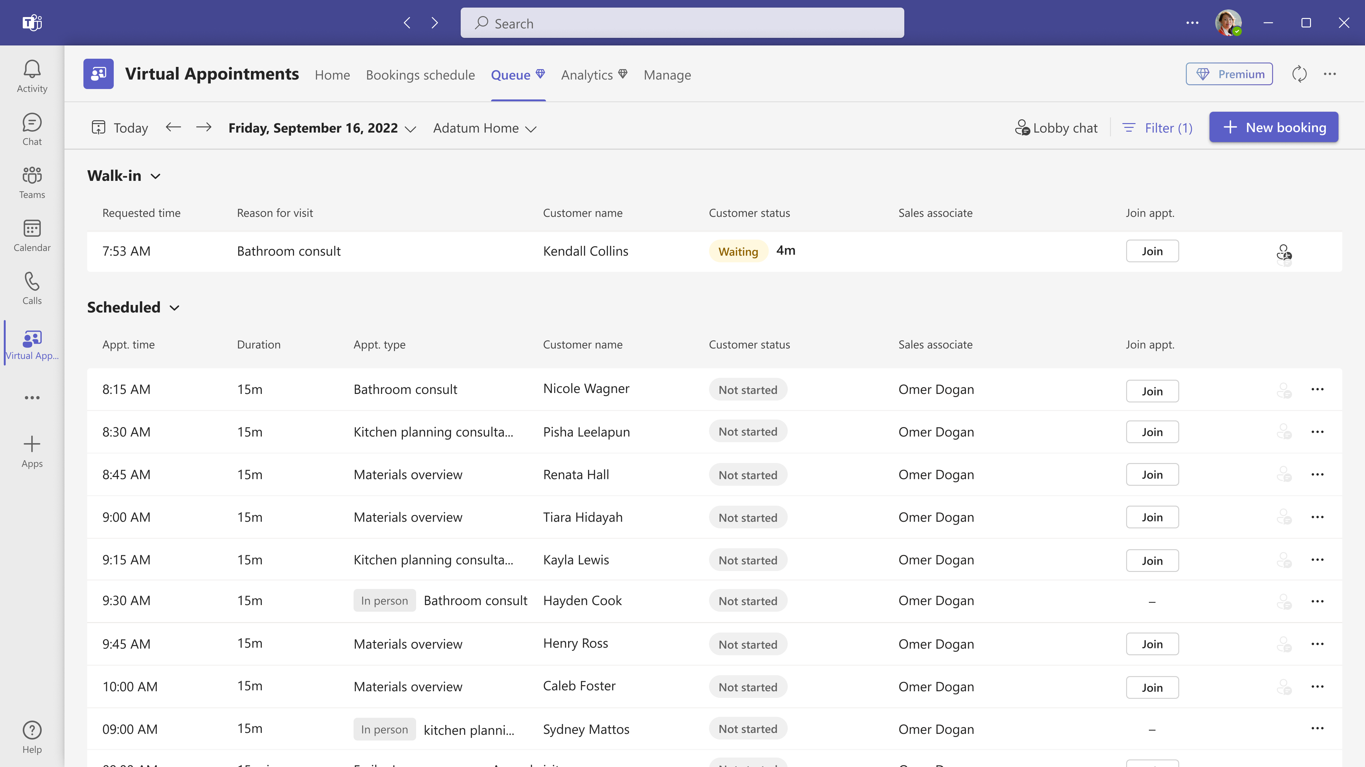
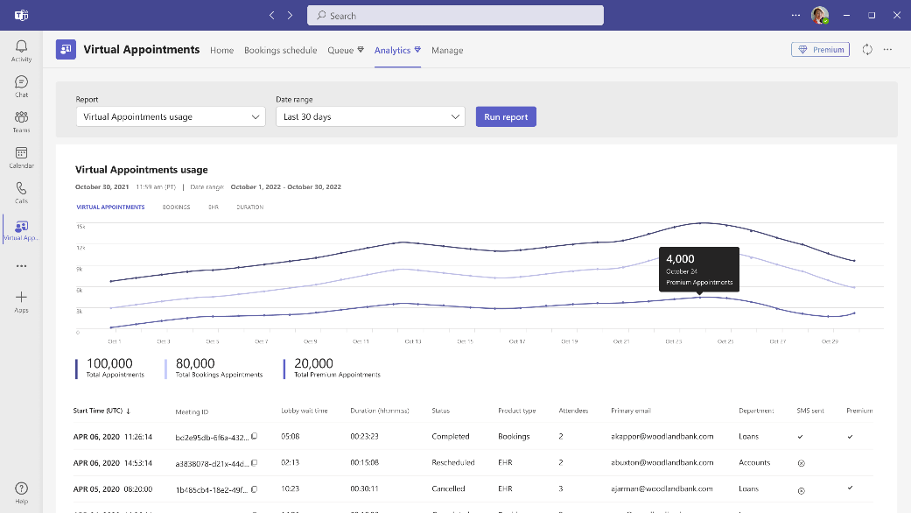
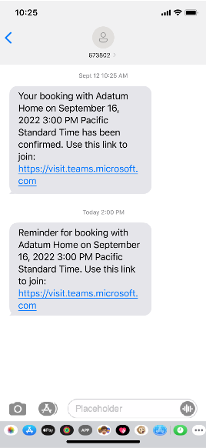
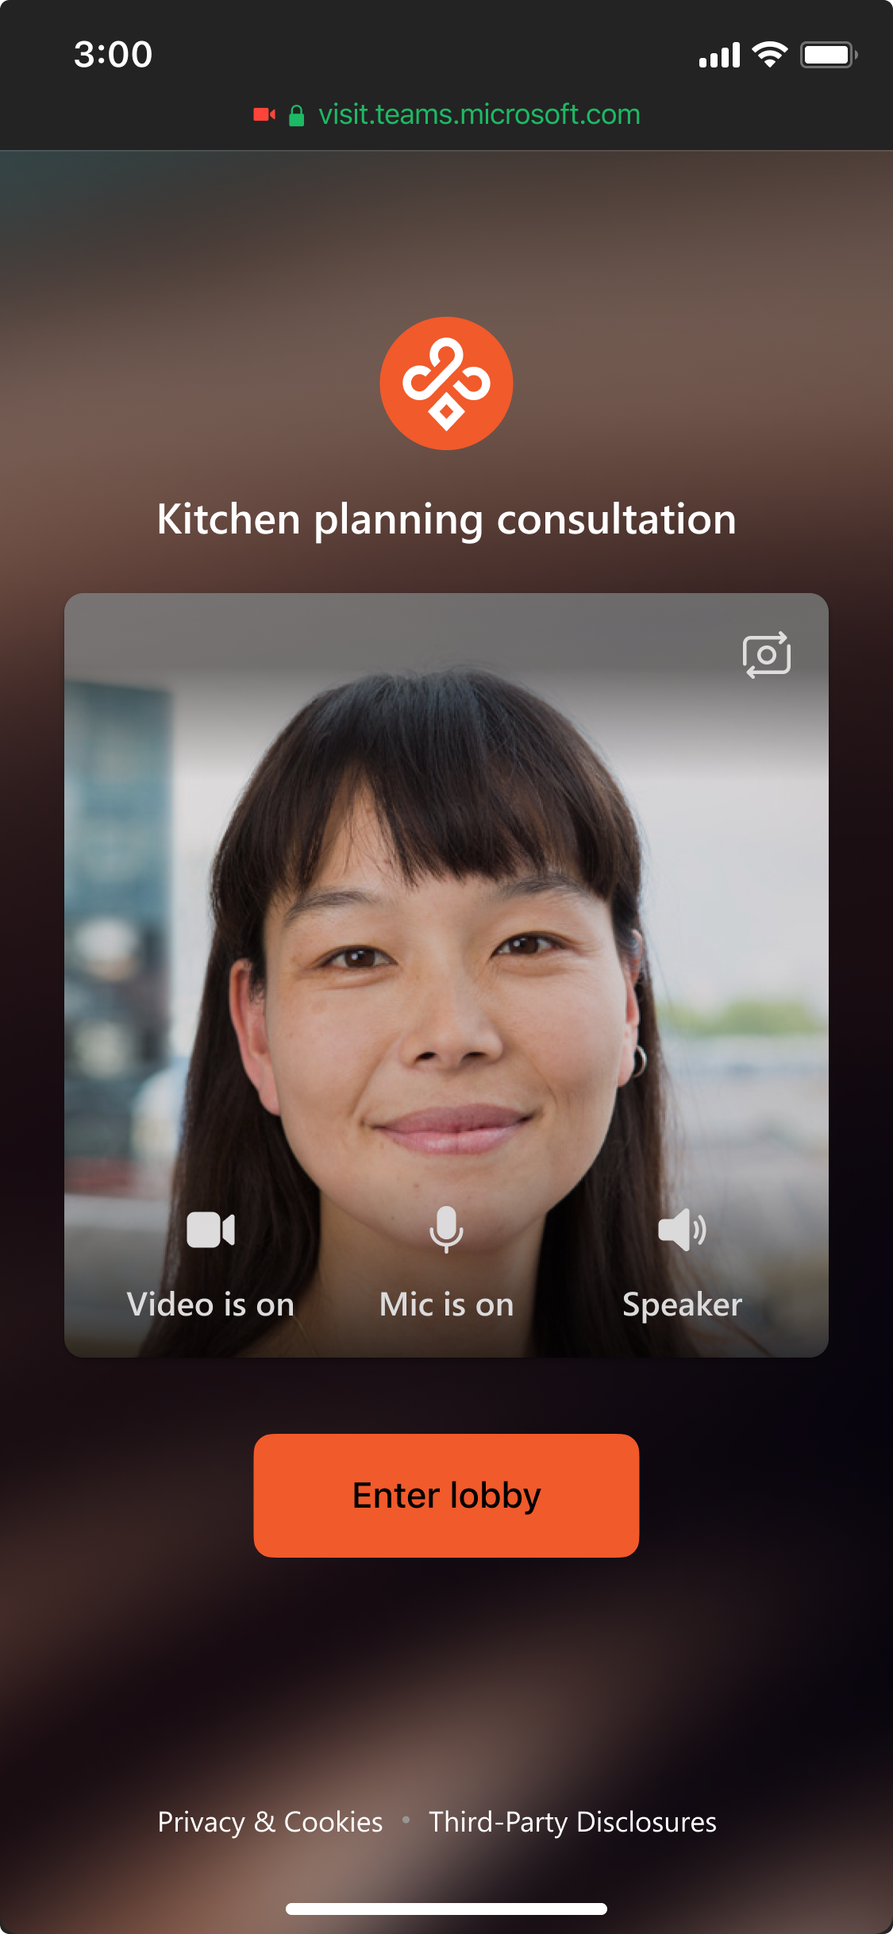
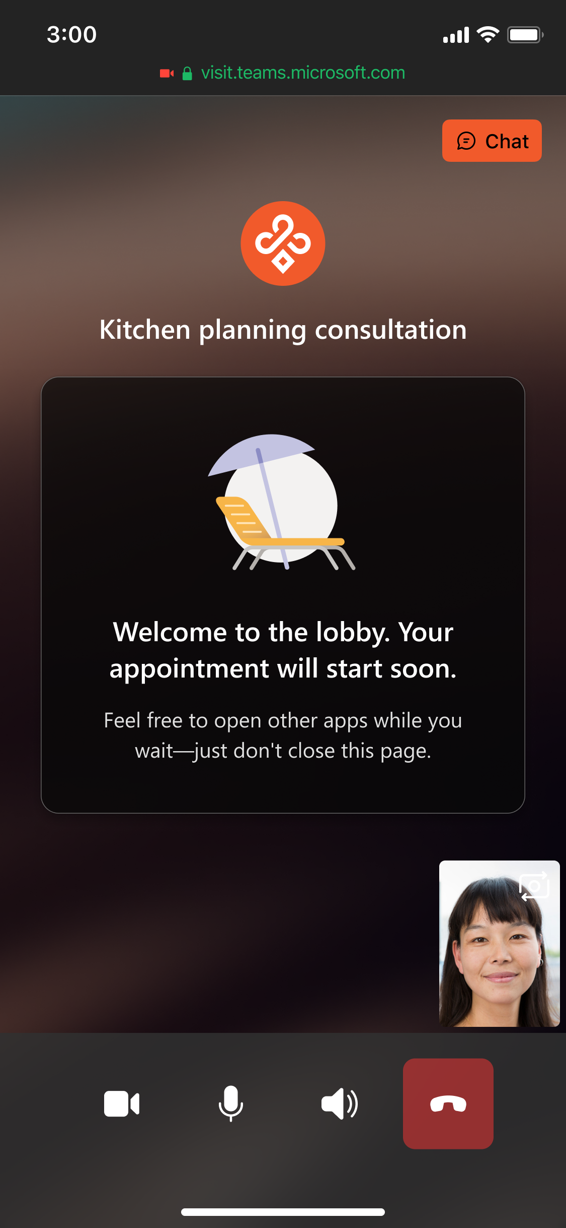
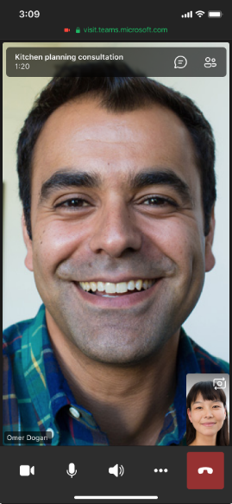
Advanced Virtual
Appointments
Provide customers personalised virtual appointment experience with automated pre-appointment SMS reminders (UK/US) and custom lobby room with branding and logos
In the Virtual Appointments Teams app view all your appointments in one place
Reports and analytics to provide insights into appointment trends – wait times, no shows etc
Easy joining experience from mobiles
Notes:
SMS – requires a US, Canada or UK phone numbers to receive the reminders
Virtual Appointments app – view scheduled and on demand appointments and get access to the pre-appointment chat
No need to download the teams app to join the meeting

Slide 22
Identifying customers who will benefit from Teams Premium
High meeting participation and meeting fatigue
Who spends more than 3 hours of their day in meetings?
Who runs rhythm of business, monthly review, or key meetings that have high discussion engagement?
Who schedules a lot of meetings and would benefit from automation?
Presents sensitive business information in meetings
Who works with and presents sensitive information in meetings?
Who do you already provide advanced security and compliance capabilities for?
Manages and runs company webinars
Who leads the company’s digital events strategy and tooling?
Who hosts and manages webinar events?
Client-facing and hosts 1:1 virtual visits
Who is regularly interacting with customers or engaging prospective clients?
Who conducts 1:1 engagements - consultations, help desk, customer support, interviews?
Notes:
Strategic SKU – qualify for additional rebates with a SPD / legacy competency
Introductory pricing offer

Slide 23

Licensing
A teams-inclusive base license is required as a prerequisite
There must be at least one Teams Premium license in the tenant for admins to manage the Teams Premium features
Sensitivity labels for meetings is only available to customers with ME5, ME5 Comp, MF5 Comp, or MF5 Sec & Comp
There is a discounted CHTY Teams Premium license
It’s a per user license, every user who needs the features should be licensed
Some standard Teams Features moved to being Teams Premium only features when in went GA in February, this includes:
  Live translation of meeting captions.
  PPT live chapters.
  Timeline markers in Teams meeting recordings for when a user left or joined meetings.
  Custom organization Together mode scenes.
  Virtual Appointments: SMS notifications.
  Virtual Appointments: Organizational analytics in the Teams admin center.
  Virtual Appointments: Scheduled queue view.
Introductory pricing offer – 30% discount – available till June 30th, 2024
Licensing guidance: Microsoft Teams Premium licensing - Microsoft Teams | Microsoft Learn
Notes:
Who should be assigned licenses
When the organizer of a Teams meeting, webinar, or town hall is licensed for Teams Premium, the Live translation (for captions), advanced Meetings protection, and advanced Webinars features are extended to all meeting participants, including external and guest users.
External participants in Virtual Appointments don't require a Teams Premium license to benefit from Teams Premium advanced Virtual Appointments.
All meeting participants must be licensed for Teams Premium to benefit from the Intelligent recap feature.
Teams Premium is currently on introductory pricing
Setup
The following list indicates Teams Premium features that require admin configuration in the Teams admin center before users can access the feature:
Using end-to-end encryption on meetings up to 50 participants.
Adding watermarks to meetings.
Adding sensitivity labels.
Preventing copy and paste in meeting chats.
Using organization customized backgrounds.
Using organization customized Together mode scenes.
Admin must create the custom Together mode scene.
Being assigned a custom policy package.
Using organization customized meeting templates.
Seeing organization customized branding.
Using eCDN for webinars and town halls.
Using RTMP-In.
Customizing Virtual Appointment lobby rooms with branding.

Slide 24
New Features
Create channel announcements with custom backgrounds by adding images (your own generated ones) and typing a description a personalised background will be generated. Will also be available with Copilot for M365.
  Available end of 2023
Decorate your background uses the power of AI to generate a background that enhances and decorates their real-world room (e.g. clearing clutter, adding plants)
  Available early 2024
New meeting option – ‘Turn off copying or forwarding for meeting chat’, disables copying and forwarding of meeting chat messages
  Available early 2024
Microsoft Mesh enables you to create custom immersive experiences specific to your business – e.g. spaces for events, training, product showcases etc
  Available January 2024
Ability to choose how watermarks are displayed – single watermark or repeated watermark
Support for watermarked meetings to be recorded
  Both available early 2024
Ability for organisers to hide attendee names in Webinars & Town Halls
  Available early 2024
Full list of updates can be found in this blog: What’s New in Microsoft Teams | Microsoft Ignite 2023 - Microsoft Community Hub

Slide 25
Copilot in Teams vs Teams Premium

Slide 26
Configuring Teams Premium
Notes:
The following list indicates Teams Premium features that require admin configuration in the Teams admin center before users can access the feature:
Using end-to-end encryption on meetings up to 50 participants.
Adding watermarks to meetings.
Adding sensitivity labels.
Preventing copy and paste in meeting chats.
Using organization customized backgrounds.
Using organization customized Together mode scenes.
Admin must create the custom Together mode scene.
Being assigned a custom policy package.
Using organization customized meeting templates.
Seeing organization customized branding.
Using eCDN for webinars and town halls.
Using RTMP-In.
Customizing Virtual Appointment lobby rooms with branding.

Slide 27
Prize Draw

Slide 28
Thank you
Contact Us:
microsoft.sales@dickerdata.co.nz
onpoint@dickerdata.co.nz

