Slide 1
Notes:
Thank you for joining will start shortly
MAKE SURE RECORDING IS ON

Slide 2
Agenda
1
News
2
Main Topic: Copilot Governance
3
Close
5
Code of Conduct
Notes:
Welcome to Opoint 2024, Happy New year. If you are joining for the first time welcome and thank you, we hope that you find the next 30 mins informative and possibly a little entertaining.
If you have attended our previous onpoints welcome back and thanks for all your support. You will find this year we are doing things a little different this year. More about that in a moment.
Then we do a quick catchup on our carefully hand curated Microsoft relevant news for the previous week,
Followed by the subject de semaine (week in English) today we will explain on why you should choose Dicker Data as your Distributor and the benefits of being a Dicker Partner.
Then we close out with an open Q&A session /prize draw
For those of you new to Powerpoint live. A quick familiarisation, We welcome your reactions using the emotion icon at the top right of your screens. Please ask questions in the chat window during the call. We will invite you to come off mute at the end of the call if you would prefer to ask your question out loud. During the call, please ensure you are on mute, and your video is turned off.
All links to sites are available by clicking on the link in the slide or will be posted to the chat window. We recommend you click on all relevant links and then review post call.
Calls will be recorded and made available post call, The teams generated recording will not be available external so don’t panic we will make the recording available to you later .
Participation in these calls means that you agree to Microsofts terms and conditions for digital meetings a link is available on this slide should you wish to review these. or to test the live link feature
Introduce speakers Role and location

Slide 3

News
What you need to know
Content credentials
Generated with AI ∙ June 17, 2024 at 3:58 PM
Notes:
But First The News. This is the section which is a concise update of relevant information, or opportunities compiled by Dickers subject matter experts. Who attend those early morning calls, wade through endless emails, yammer messages etc so you don’t have to

Slide 4
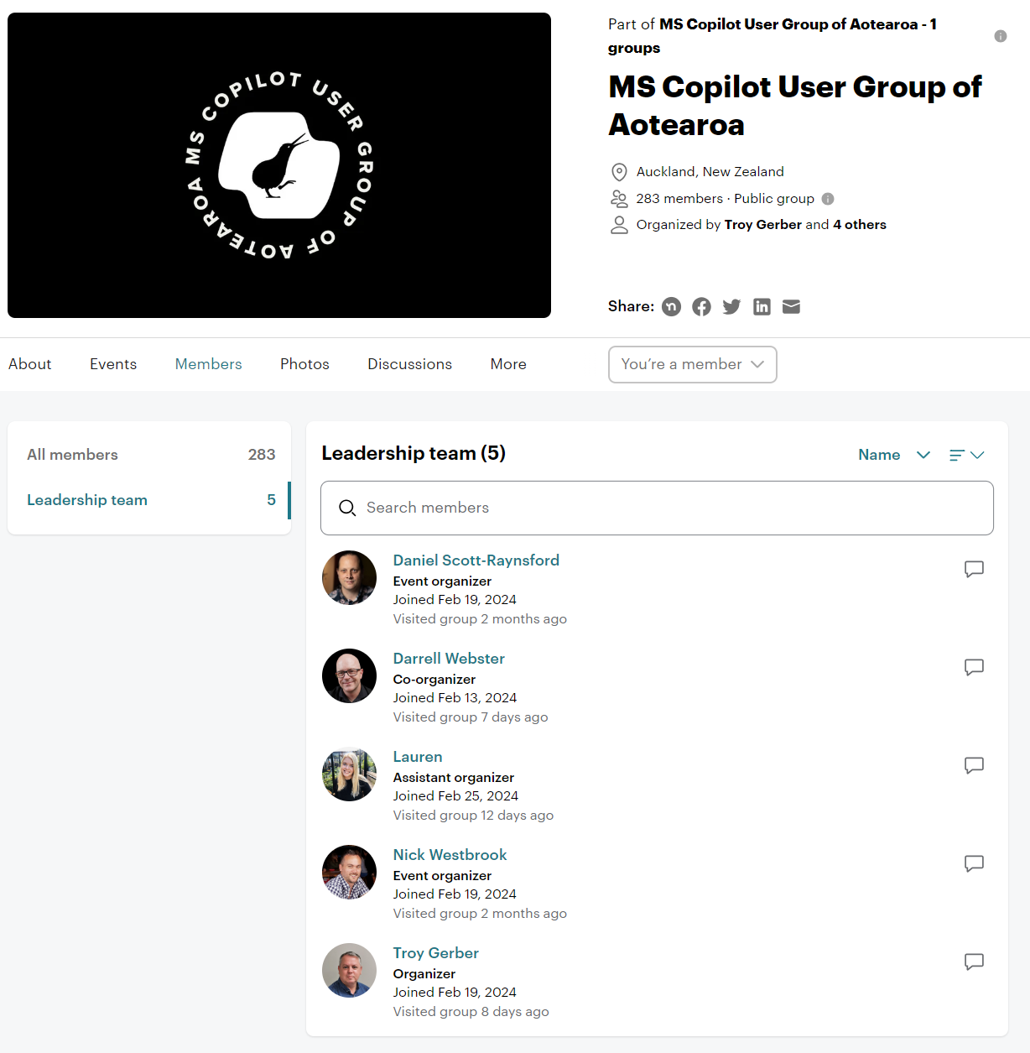
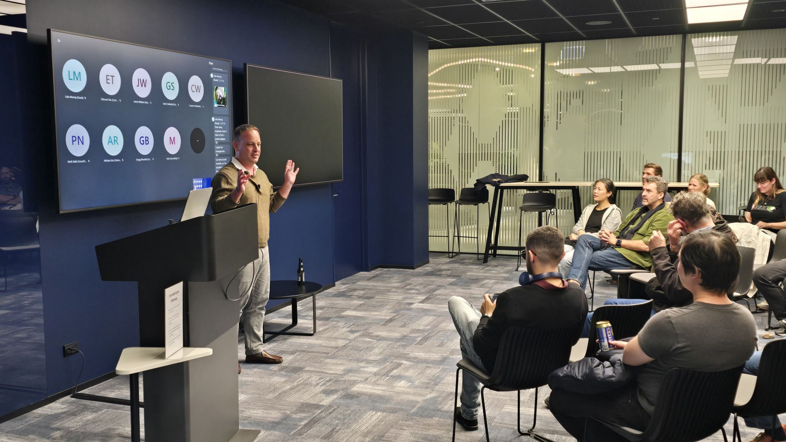

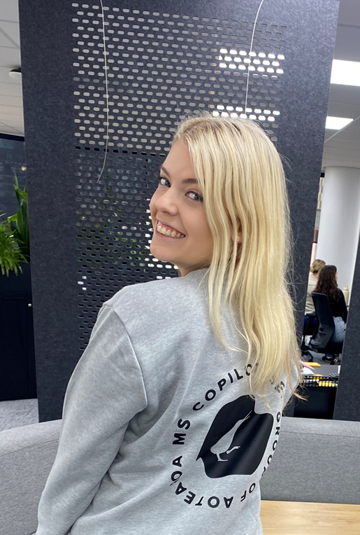
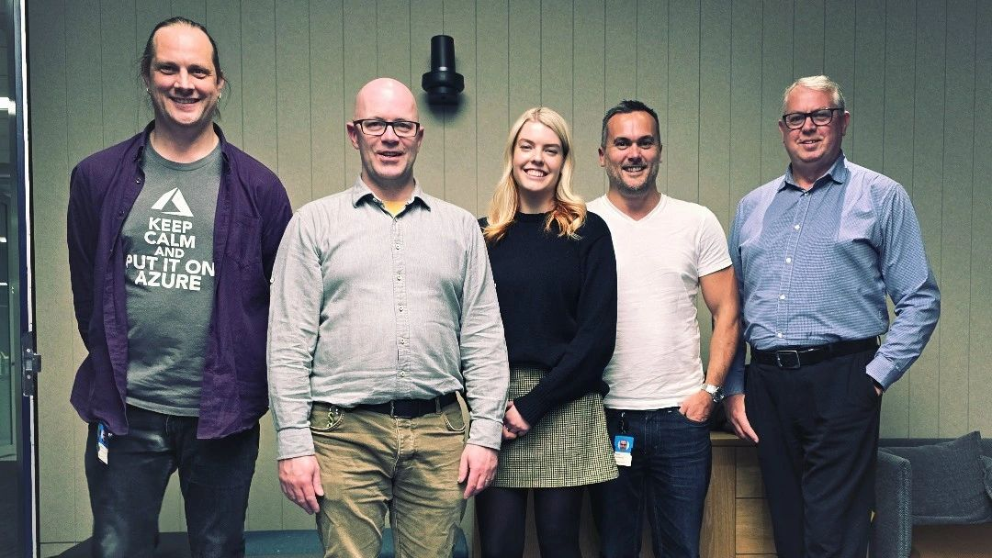
TUESDAY 25th “Adopting Copilot in your organisation
Notes:
Congratulations to our very own Lauren, on being a co-organiser for NZ’s copilot user group. If you would like to register to attend the next event on Tuesday either in person in Auckland or online click on the logo

Slide 5
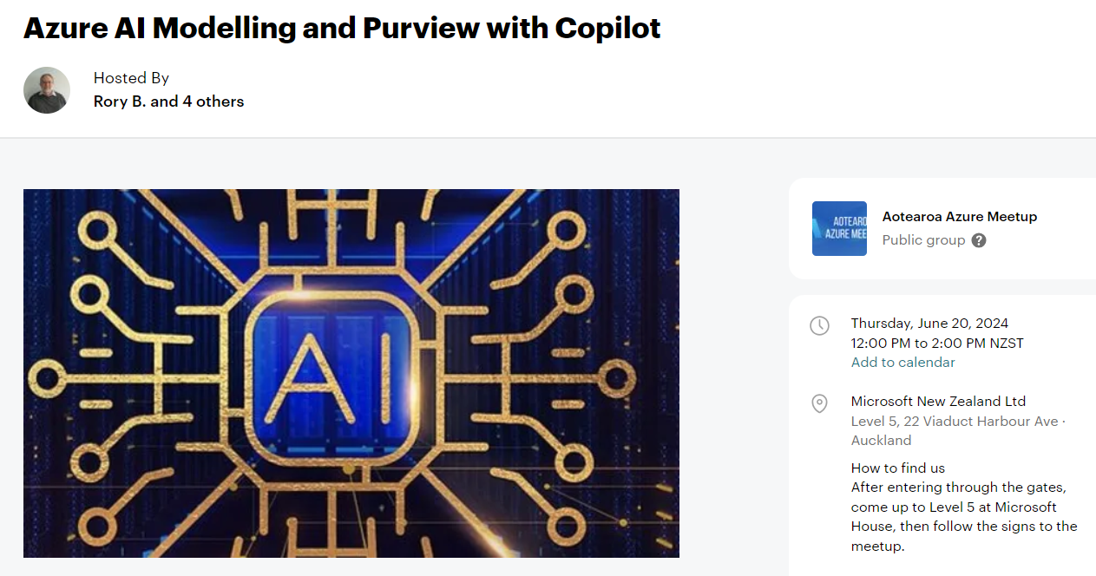

Slide 6



Slide 7
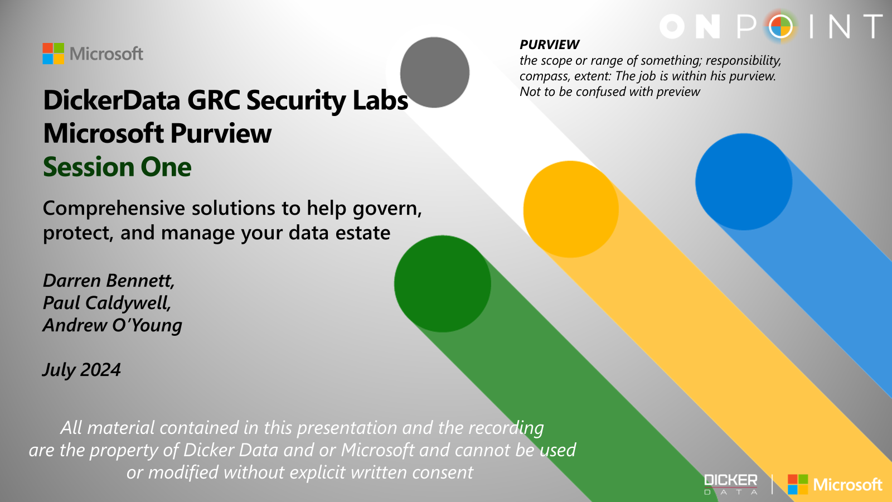
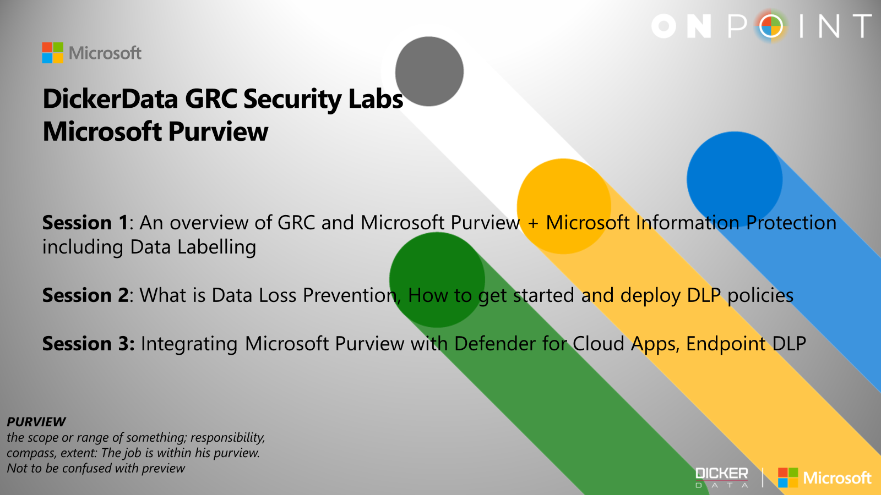
Purview Labs Workshops
Recordings will be on the Microsoft soon!
Notes:
EDM coming soon

Slide 8
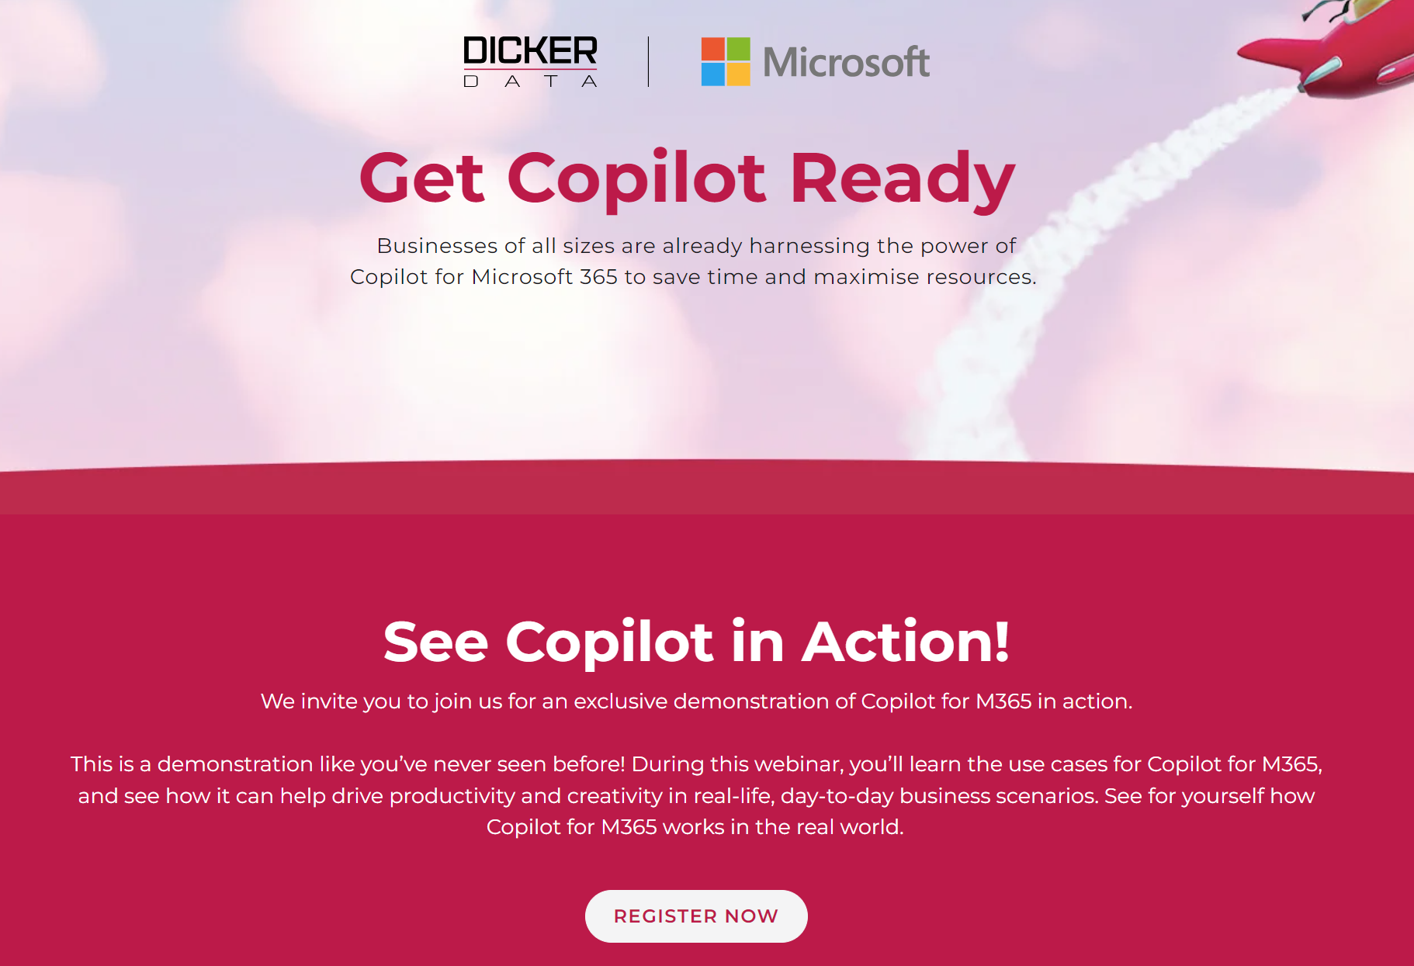
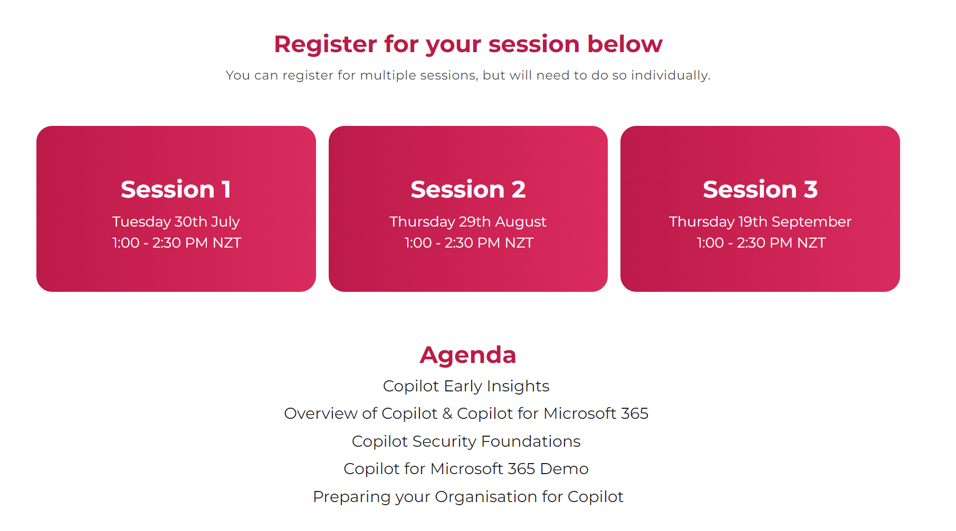
Copilot Webinars
Our next series of Copilot webinars kicks off next week – 30th July at 1pm.
Register here: Microsoft Copilot Ready (dickerdata.co.nz)

Slide 9
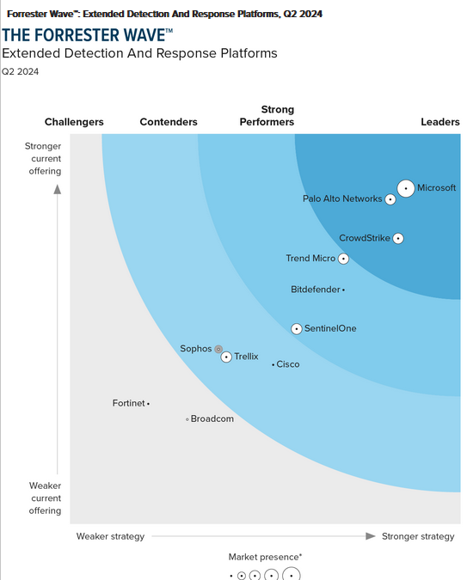
XDR Vendors Have Reached A Tipping Point To Compete With SIEM
In 2021, extended detection and response (XDR) vendors had offerings that were a jumble of features and a vision to ultimately replace security information and event management (SIEM) as the principal technology in the security operations center (SOC). Now, many vendors have reached a point of integration and product capability where customers can start to realize the SIEM replacement vision even if XDR still can’t compete for more niche SIEM use cases such as compliance, federated search, and heavy customization
“Microsoft has the most data-rich endpoint information in this evaluation. Reference customers cite unique features like a full timeline of activity that occurs on each endpoint as useful for investigation. The suite enables users to respond to alerts across integrated native tools (Defender for Cloud and Cloud Apps), search over the data, and build user-generated detections. References note the comprehensiveness and value of the suite, though prospects’ biggest frustration is how the licensing model all but forces practitioners to adopt with the rest of the business.”
Notes:
Microsoft's comprehensive XDR continues to receive recognition from analysts. The re-print is available in the link below. However here are some key points I pulled from the read. * Forrester emphasized that Defender XDR is the broadest native XDR on the market today as it includes native support email, SaaS apps and more. * Microsoft scored a 5/5 in native detection surface - (Quote) “Microsoft has the most data-rich endpoint information in this evaluation”. * Automatic attack disruption, built on the foundation of AI & ML, can detect the intent of the attacker (accurately predict their next move) and disrupt attacks with 99% confidence. (wow)

Slide 10

Content credentials
Generated with AI ∙ June 17, 2024 at 4:41 PM

Slide 11

Copilot Governance
Lauren Nobbs

Slide 12
Why is this important?
The permissions model in your Microsoft tenant is KEY to ensure data isn’t unintentionally leaked
We want to be comfortable with their current state of sharing and permissions so they can begin using Copilot widely in their business
Getting security right is imperative to ensuring a secure and positive Copilot rollout
Improving organisations maturity in governance is so important to protect sensitive and confidential data – whether they use Copilot or not!
Notes:
The permissions model within your Microsoft 365 tenant can help ensure that data won't unintentionally leak between users, groups, and tenants – Copilot only presents data that each individual can access using the same underlying controls for data access used in other Microsoft 365 services. Semantic Index honours the user identity-based access boundary so that the grounding process only accesses content that the current user is authorised to access. And if your data is encrypted by Microsoft Purview Information Protection, either by labels or IRM, Copilot honours the usage rights granted to the user.

Slide 13
It’s a continuous process
While initial audits, revies, policy implementations are important when first deploying Copilot – data governance is a continuous process
Change of employee roles, new employees, business structure changes, new site/team requirements
Changes to compliance requirements, industry regulations, privacy laws etc
Organisations should regularly review and update new data sources, permissions, external sharing, and business policies
Notes:
Establish continual auditing and report for SharePoint Sites and Teams at the container level and automate the maintenance of their security
Continue to routinely review links and groups used to grant permissions

Slide 14
Foundation of Zero Trust
6 steps to apply the principles of Zero trust to prepare for Copilot
Deploy or validate your data protection
Deploy or validate your identity and access policies
Deploy or validate your App Protection policies
Deploy or validate device management and protection
Deploy or validate your threat protection services
Deploy or validate secure collaboration with Teams
Deploy or validate user permissions to data
Notes:
Before introducing Copilot is important to have a strong foundation of security – Zero Trust framework
Verify explicitly - Enforce the validation of user credentials, device requirements, and app permissions and behaviours.
Use least privileged access – Use JIT (just in time) and JEA (just enough access) to eliminate oversharing and correct permissions on files, folders, email and Teams, use sensitivity labels and DLP policies to protect data
Assume breach – use EOP and Defender XDR services to automatically prevent common attacks and to detect and respond to security incidents
6 Steps:
Deploy or validate your data protection
Ensure your data is categorized with sensitivity levels.
Sensitivity labels are applied by users or automatically.
Ensure you can view how sensitivity labels are being used in your Microsoft 365 tenant.
Create DLP policies for files and email.
Create retention policies to keep what you need and delete what you don’t.
Use content explorer to see and verify items that have a sensitivity label, a retention label, or were classified as a sensitive information type in your organization.
Deploy or validate your identity and access policies
Ensure users are required to use strong authentication – implement MFA for all users and admins and block legacy authentication – if hybrid environment, implement Entra ID Password Protection
Use risk-based CA policies to require MFA/password reset when sign-in risk is elevated
Use PIM and PAM to protect privileged access accounts as part of your JIT/JEA strategy
Use access reviews to perform reviews of access granted to user accounts - group memberships, access to enterprise applications, and role assignments.
Deploy or validate your App Protection policies
App Protection policies ensure company data is contained within a managed app by effectively creating a wall between company and personal, data. It ensures company data can’t be copied and pasted into other apps on a device, even if the device isn’t managed.
Deploy or validate your device management and protection
Enroll devices in Intune
Set up AAP, compliance policies (and require devices to meet health and compliance requirements), and configuration profiles
Implement Defender for Endpoint monitor mobile device risk as condition for access, and monitor windows device compliance to security baselines
Implement DLP for Endpoints
Deploy or validate your threat protection services
Use EOP and Defender for O365 P1 policies to configure anti-malware, anti-spam, and anti-phishing protection
Implement Defender for Endpoint (Business, P1, or P2)
Deploy or validate secure collaboration for Microsoft Teams
Review Teams and implement the three-tiered approach for securing Teams - baseline, sensitive, and highly sensitive
Review external sharing & collaboration
Deploy or validate minimum user permissions to data
Identity items containing sensitive content and apply controls to limit access with Information Protection
Identify oversharing with SharePoint and Teams files with SAM

Slide 15

Apply appropriate Data Security controls
Core
Restrict data oversharing and data leaks with manual labeling and policies
Get started
1
2a
3
Required licenses:
Office 365 E3, Microsoft 365 Business Standard/Premium, or higher; and
SPP-SharePoint Advanced Management
5
Copilot for Microsoft 365 Optimization Assessment
Ready to deploy?
Yes
If used, disable Restricted SharePoint Search
4
Deploy Copilot for Microsoft 365
Optimize further as needed
Determine path
(26 questions; 30 minutes)
NO
Best-In-Class
Prevent data oversharing, data leaks, and detect non-compliant usage at scale with auto labeling and policies
2b
Enable Restricted SharePoint Search*
Required licenses:
Microsoft 365 E5; and
SPP-SharePoint Advanced Management
*Restricted SharePoint Search will limit Copilot for Microsoft 365 experiences and organization-wide search. It is a temporary option which gives you time to address oversharing concerns while getting started on your Copilot journey.

Slide 16
Restricted SharePoint Search
This is intended as a temporary solution to give you time to review and audit site permissions, while implementing robust data security solutions from Microsoft Purview and content management with SharePoint Advanced Management.
IMPACT
Restricted SharePoint Search disables organization-wide search, while allowing you to select sites that you trust. This means users in your organization can use Copilot to reason over:
An allowed list of curated SharePoint sites set up by admins (up to 100 SharePoint sites), honoring existing permissions on a site
Users’ OneDrive for Business, chats they are part of, emails they send and receive, calendars to which they have access, etc.
Files that are shared with, and accessed by users
Content from users’ frequently visited sites
Turning on Restricted SharePoint Search does not affect the site’s index or associated DLP and labeling policies.
Access this blog for more info.
Restricted SharePoint Search is designed for organizations particularly concerned about unintentional oversharing of content
When enabled, Copilot experiences and organization-wide search are limited to a select set of SharePoint sites, as well as the individual user’s files and content
PREREQUISITES
Available to tenants with Copilot for Microsoft 365 subscriptions
Activation requires Global/Tenant/SharePoint admin rights
Notes:
If your data isn’t ready and you don’t have data governance in place it does not mean you cannot use Copilot.
SharePoint Restricted Search allows you to create a curated list of up to 100 SharePoint sites that Copilot is allowed to search. The idea of it is to allow customers to comfortably rollout Copilot for M365 by buying them time to review and correct SharePoint site permissions for sites with sensitive/confidential content.
If Restricted SharePoint Search is enabled, your experience will be impacted in the following ways:
Search results and Copilot search results will be limited (enabling this feature impacts the search experience, even for non-Copilot users). Users will be able to discover content from:
An allowed list of curated SharePoint sites set up by admins (with up to 100 SharePoint sites), honoring sites’ existing permissions.
Content from their frequently visited SharePoint sites.
Users’ OneDrive files, chats, emails, calendars they have access to.
Files that were shared directly with the users.
Files that the users viewed, edited, or created.
Copilot will have less information available to reference, which may impact its ability to provide accurate and comprehensive responses to prompts.
Users within the organization will see the following banner on Copilot experiences: Your organization's admin has restricted Copilot from accessing certain SharePoint sites. This limits the content Copilot can search and reference when responding to your prompts.
Hub sites - Only the hub site (the URL in the Allowed list) is included in the 100. The sub sites under the hub site aren't counted against the 100 limit but RSS is effective on the sub sites.
RSS will go into effect within an hour after it's enabled.
The allowed list is configured via PowerShell.

Slide 17
Get started with Copilot for Microsoft 365
Baseline
Required licenses: Office 365 E3 or higher
Follow the recommended baseline activities to proceed with Copilot for Microsoft 365 deployment.
Product | Deployment outcomes | Get started activities
Copilot for Microsoft 365 | Evaluate data governance maturity and data security controls | Complete Copilot for Microsoft 365 Optimization Assessment Based on the outcomes of the assessment determine your path forward
 | Deploy Copilot for Microsoft 365 | Follow the Microsoft Copilot for Microsoft 365 setup guide to proceed with the deployment steps If there are any concerns about your data security, enable Restricted SharePoint Search If enabled, update Restricted SharePoint Search allow list: configure up to 100 sites to be on the allow list of sites. Start with sites containing highly used unrestricted content. FastTrack for Microsoft 365 can help you get started*
Copilot with commercial data protection | Enable commercial data protection in Copilot for all users in your organization | Log into Copilot on copilot.microsoft.com and flip the Work/Web toggle to Web. See if commercial data protection is enabled (look for green Protected pill by the user profile) Review the Copilot with commercial data protection documentation to ensure that commercial data protection is available for your users
*Note: Eligible customers can request technical and deployment assistance from Microsoft FastTrack.

Slide 18

Continue to the Core path as needed
Core
Required licenses:
Office 365 E3, Microsoft 365 Business Standard/Premium, or higher; and SPP-SharePoint Advanced Management
Follow the recommended activities for the Core path to further optimize data security controls.
Product | Deployment outcomes | Core activities
Copilot for Microsoft 365 | If enabled, update Restricted SharePoint Search allow list | Configure up to 100 sites to be on the allow list of sites. Extend to sites containing highly used, low risk content
Microsoft SharePoint* | Evaluate sharing controls that govern who can share and how broadly | Ask site owners to manually review SharePoint site permissions and correct as needed Ask OneDrive for Business (ODB) owners to run sharing reports in their ODB and correct settings if needed Set default sharing link type on tenant, and optionally set the sharing link type on specific sites Set sharing link expiration on anyone links Set site owner sharing approval on sensitive sites
 | Identify inactive sites, restrict access, and move sites to Microsoft 365 Archive or deleted | Implement Inactive Site Policy
 | Identify potentially overshared content, restrict site access, initiate site owner review | Run Data Access Governance (DAG) reports Apply RAC on sites based on DAG reports Manually contact top shared site owners from DAG reports and ask them to attest to permissions and sharing configuration
 | Set restricted access control and block file download policies on business-critical sites | Apply the BlockDownloadPolicy on sensitive sites Apply the BlockDownloadPolicy on Teams Meeting Recordings
Microsoft Purview | Gain visibility into how users are interacting with data in the organization and with Copilot for Microsoft 365 | Confirm that Microsoft Purview Audit is enabled, if not enable it
 | Enable citations and protections for sensitive data access by Copilot for Microsoft 365 | Manually Label emails and documents with out-of-the-box sensitivity labels using one-click or previously created policies
 | Protect sensitive information from being shared beyond its intended audience and reduce the risk of oversharing | Create and deploy Data Loss Prevention (DLP) policies for SharePoint, Exchange, and OneDrive for Business
 | Retain the data you need to keep and remove data that no longer has business value to reduce data surface for oversharing | Create and Configure retention policies to archive or delete content exceeding data retention guidelines or maximum retention date
 | Gain additional understanding of content used and shared in Copilot interactions | Use Microsoft Purview eDiscovery Content search to find email in search for in email, documents, and instant messaging conversations
*Note: Customers using Microsoft 365 Business Standard/Premium may choose to evaluate their environment with manual controls in lieu of implementing SharePoint Advanced Management capabilities

Slide 19

Continue to the Best-in-Class path as needed
Best-in-class
Required licenses: Microsoft 365 E5; and SPP-SharePoint Advanced Management
Follow the recommended activities for the Best-in-Class path to achieve top-tier security posture.
Product | Deployment outcomes | Best-in-Class activities
Copilot for Microsoft 365 | If enabled, update Restricted SharePoint Search allow list | Configure up to 100 sites to be on the allow list of sites. Extend to sites containing restricted content, after validating permissions are set correctly
 | Disable Restricted SharePoint Search to allow full Copilot experience | Once all the data security concerns are addressed, disable Restricted SharePoint Search
Microsoft SharePoint | Perform periodic reviews of oversharing reports, restrict access as appropriate | Run DAG reports on a periodic basis and apply RAC to sites that appear to be overshared
 | Perform periodic reviews of inactive sites, and take action | Apply inactive sites policy and review resulting report
 | Perform periodic reviews of Change History reports to discover when oversharing occurs | Run the change history report and investigate changes to sharing in sites
Microsoft Purview | Apply a baseline protection to documents and containers (Microsoft 365 Groups, Microsoft Teams Sites) without the need for content inspection or manual labeling | Set a default sensitivity label on SharePoint Online document libraries to protect documents without content inspection Use Sensitivity labels to protect content in Teams, Groups and SharePoint sites
 | Dynamically protect sensitive information from being shared beyond its intended audience and reduce the risk of oversharing on across instant messages and user endpoints. | Create, deploy, and regularly evaluate Teams DLP Policies Create, deploy, and regularly evaluate Endpoint DLP Policies Create Adaptative Protection policies to automatically assign DLP policies based on the users identified risk level
 | Automatically protect sensitive data access by Copilot for Microsoft 365 based on recommended conditions. | Automatically apply sensitivity labels to content in SharePoint, OneDrive, and Exchange Automatically apply sensitivity labels to content within Office apps
 | Automatically retain or dispose of documents based on their content | Automatically apply retention labels to content that match specific conditions
 | Detect sensitive data and non-compliant content in Copilot interactions | Create Communication Compliance policies to regularly evaluate interactions with Copilot for Microsoft 365
 | Preserve, collect, review, analyze, and export Copilot interactions | Use eDiscovery Premium to search for and optionally delete Copilot interactions

Slide 20
Prepare your SharePoint Data
Archive or delete old/irrelevant data to focus Copilot on current valuable information
Structure files, folders, and sites logically – e.g. Financial reports under the Finance folder, and add metadata to files
Tag content – use labels and metadata tags on files, emails and pages
Use consistent, descriptive files names and standardise this across the organisation - avoid abbreviations
Retain just the final version of documents – remove old versions to reduce confusion/contradictions from Copilot
Encourage and educate on good data hygiene habits – save files to correct locations, rely on M365 versioning, use standardised file names, tag documents, delete content no longer required etc
Notes:
The permissions model within your Microsoft 365 tenant can help ensure that data won't unintentionally leak between users, groups, and tenants. Microsoft Copilot for Microsoft 365 presents only data that each individual can access using the same underlying controls for data access used in other Microsoft 365 services.

Slide 21
SharePoint Permissions
Review the use of wide scope permission groups
Review the sharing links reports for SharePoint – Anyone and People in Organisation sites
Review sharing links reports in OneDrive
Review the sharing settings in SharePoint Admin Center
Default file folder links
Educate Site & Team Owners – highlight sharing reports and ensure they are recipients of access requests
Do any sites need to be excluded from search?
Understand the change in the findability construct (semantic index)
Identify inactive sites and restrict access/delete
Notes:
Wide scope permission groups – such as the Everyone Except External Users default permissions group
RSS – you can do all this in parallel with your copilot rollout
Review the use of wide scope permission groups – hide the “Everyone Except External Users" from people picker so people can’t select it
Review the sharing links reports for SharePoint – Anyone and People in Organisation sites
Review sharing links reports in OneDrive
Review the sharing settings in SharePoint Admin Center
Default file folder links
Educate Site & Team Owners – highlight sharing reports and ensure they are recipients of access requests
Do any sites need to be excluded from search?
Understand the change in the findability construct (semantic index)

Slide 22
SharePoint Advanced Management
Restrict SharePoint site access with M365 or Security Groups
Restrict OneDrive content access
Restrict OneDrive service access
Data access governance reports for SharePoint Sites
Conditional access policy for SharePoint sites and OneDrive
Secure SharePoint document libraries with sensitivity labels
Block download policies
Change history reports
Inactive site policies
Notes:
Licensing
SharePoint Advanced Management is a per-user license. To use SharePoint Advanced Management, you must have a license for each user in your organization. (It's not required for guests.) Users must also be licensed for SharePoint K, P1, or P2 via standalone or a Microsoft 365 suite.
Restrict SharePoint site access with Microsoft 365 groups and Entra security groups
Restrict the access of a SharePoint site and its content only to the members of Microsoft 365 group (for group-connected sites) or a security group (for non-group connected sites). Users who aren't in the specified groups won't have access to site content even if they previously had site access permissions or a file sharing link.
Restrict OneDrive content access
You can limit access to shared content in a user's OneDrive to people in a security group. The OneDrive access restriction policy prevents anyone who is not in the security group from accessing content in that OneDrive even if it's shared with them.
Restrict OneDrive service access
You can limit OneDrive access to members of a specific security group if you want to allow only certain users to have access. Even if other users outside of these security groups are licensed for OneDrive, they won't have access to their own OneDrive or any shared OneDrive content.
Data access governance reports for SharePoint sites
These reports help you discover sites that contain potentially overshared or sensitive content. You can use these reports to assess and apply appropriate security and compliance policies.
Conditional access policy for SharePoint sites and OneDrive
With Microsoft Entra authentication context, you can enforce more stringent access conditions when users access SharePoint sites. Authentication contexts can be directly applied to sites or used with sensitivity labels to connect Microsoft Entra Conditional Access policies to labeled sites.
Secure SharePoint document libraries
When SharePoint is enabled for sensitivity labels, you can configure a default label for document libraries. Then, any new files uploaded to that library, or existing files edited in the library will have that label applied if they don't already have a sensitivity label, or they have a sensitivity label but with lower priority.
Block download policy for SharePoint sites and OneDrive
You can block download of files from SharePoint sites or OneDrive without needing to use Microsoft Entra Conditional Access policies. Users have browser-only access with no ability to download, print, or sync files. They also won't be able to access content through apps, including the Microsoft Office desktop apps.
Review your recent changes to SharePoint site properties
The recent actions panel lets you review and monitor the last 30 changes you've made to a SharePoint site's properties (such as renaming a site, deleting a site, changing storage quota) within the last 30 days in the SharePoint admin center. This feature only shows changes made by you and not other administrators. Also, changes made to site properties at the organization-level will not show in the panel.
Manage site lifecycle policies - You can set up an inactive site policy to automatically detect inactive sites and send notifications to site owners via email. The owners can then confirm whether the site is still active. When you're setting up a site lifecycle policy, you can choose between a simulation policy and an active policy.
Create change history reports - You can create change history reports in the SharePoint admin center to review SharePoint site property changes made within the last 180 days. Create up to five reports for a given date range and filter by sites and users. You can download the report as a .csv file to view the site property changes.

Slide 23
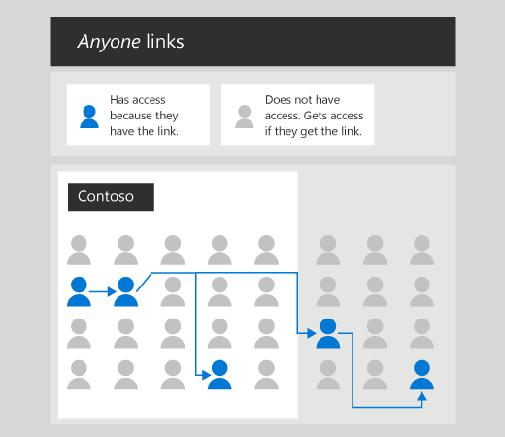
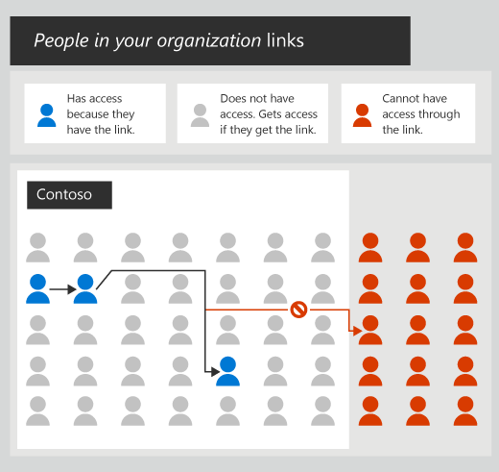
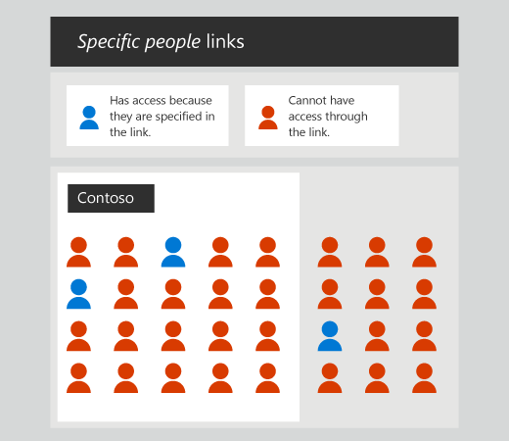
Understanding Sharing Links
Types of links:
Anyone – anyone with the link can access the link without authenticating.
People in your organisation – only works for internal users and they need to be authenticated. It doesn’t not make the content automatically available to the whole organisation or be accessible via Copilot.
Specific people – non transferrable link that can be used for internal and external users, that will only work for the people specified when a user shares the item. This content is accessible via Copilot for the users with the sharing link.
Notes:
Types of links:
Anyone:
anyone with the link can access the link without authenticating
Transferable
Access can’t be audited
Access is revocable anytime by deleting the link
People in your organisation
Only for internal users, not guests
Transferable
When they open the link, they need to be authenticated as a member. If not signed in, they will be prompted to sign in
Creating this link does not make the file/folder appear in search results, be accessible with copilot, and does not grant access to the whole org. Users must possess the link and it needs to be activated through redemption by clicking on it, or in some cases it’s automatically redeemed when sent to someone via email or chat.
Specific people
Nontransferable
Can only be used by the users/security groups specified by the person sharing the item
Can be used for internal and external users
Makes the content appear in search results and Copilot responses
Users need to be authenticated to use the link

Slide 24
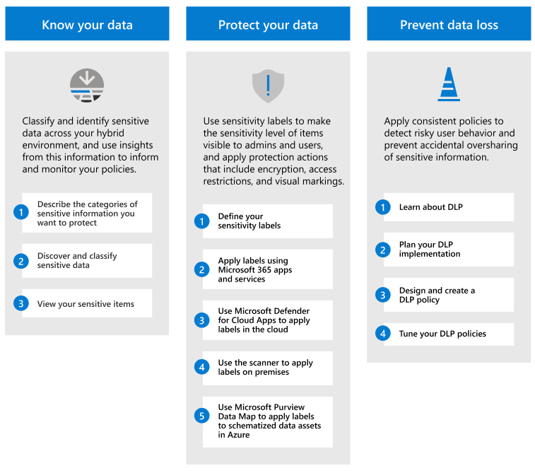
Information Protection

Slide 25
Copilot & Sensitivity Labels
Sensitivity labels allow you to protect content with settings that include encryption and content markings
When a label applies encryption, the user must have the EXTRACT and view use right for Copilot to return the data
In Copilot w/ GGC, the sensitivity of labelled content is displayed for citations and items in the response (highest priority label)
When creating content with Copilot by referencing a file, if the source file is labelled, the generated content will automatically inherit the same sensitivity label
Notes:
Encrypted w/o label – needs extract or view for copilot to return data
Users can override automatically inherited labels
Highest priority label is applied
Currently copilot can access documents that are encrypted with user-defined permissions when they're open in the app (data in use).
Sensitivity labels that are applied to groups and sites (also known as "container labels") aren't inherited by items in those containers. As a result, the items won't display their container label in Copilot and can't support sensitivity label inheritance.

Slide 26
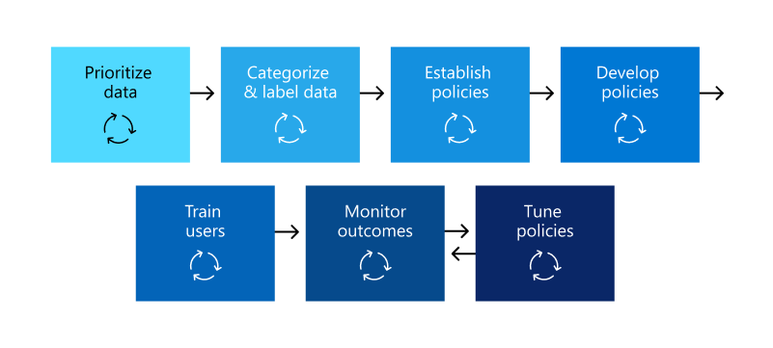
Data Loss Prevention
DLP helps prevent users from inappropriately sharing data with people who shouldn’t have access to it
DLP policies don't support interactions for Copilot for Microsoft 365 yet, data classification for sensitive info types and trainable classifiers are supported to identify sensitive data in user prompts and responses

Slide 27
Retention Policies
You can apply retention and deletion policies to Copilot interactions
Location: Teams chats and Copilot interactions
For labels to retain files referenced in Copilot interactions, you need to select ‘Apply label to cloud attachments and links shared in Exchange, Teams, Viva Engage’
Notes:
Existing retention policies previously configured for Teams chats now automatically include user prompts and responses to and from Copilot
Copilot Interactions – the prompt and the response from copilot including text, links and references
Data from Copilot interactions is copied and stored in the users exchange online mailbox in a hidden folder that isn’t directly accessible by users or admins, but can be searched by admins with ediscovery tools
When a user closes a copilot chat or window, the interaction isn’t removed bu hidden. Unless the users deletes the copilot chat or deletes their copilot interaction history, then the interactions are removed.

Slide 28
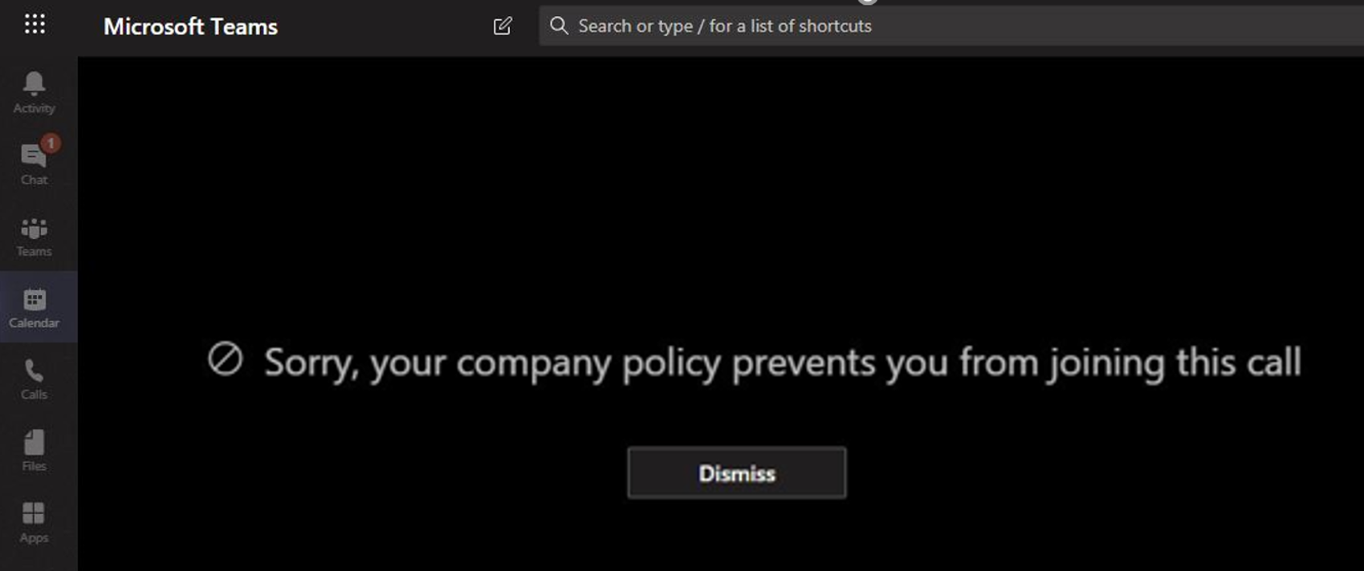
Information Barriers
Allows you to restrict two-way communication and collaboration between users and groups in SharePoint, Teams and OneDrive
SharePoint & OneDrive – sharing a site/content, searching a site, adding a member to a site, accessing site or content by a user
Teams – adding a team member, starting a chat, calling, screen sharing, sharing a file, inviting to a meeting, searching for a user
IB policies don’t apply to email – use mail flow rules to achieve this

Slide 29
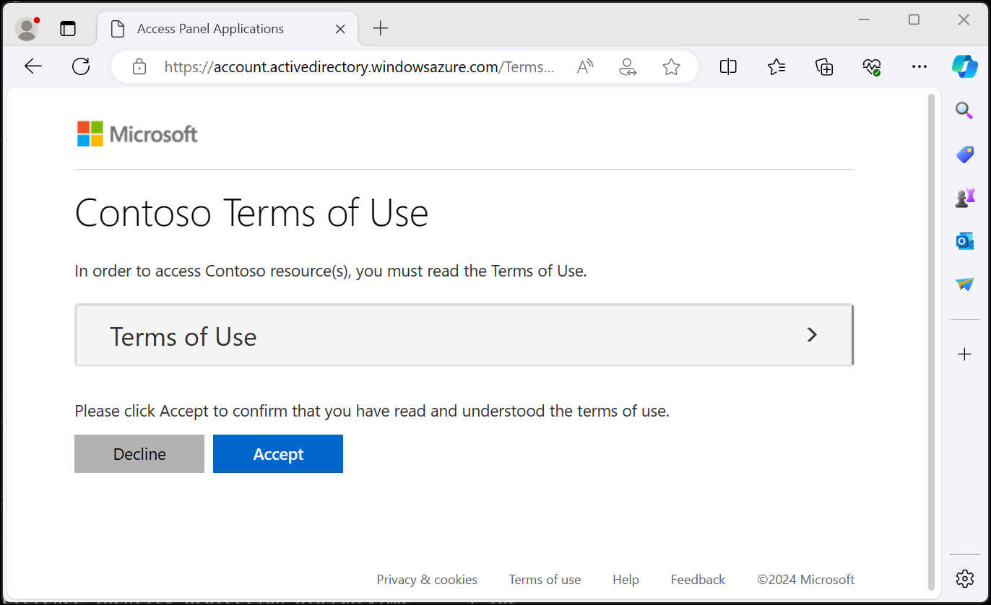
Terms of Use
You can create a conditional access policy to require users to accept a terms of use policies before getting access a service
Create terms of use, then use CA policy to enforce
You can upload multiple versions in different languages, requirement them to view the terms of use policy, and require them to consent on every device, set an expiry date or duration before re-acceptance is required
Once enforced existing users need to sign out/sign in to satisfy the policy
Licensing: Entra ID P1

Slide 30
Authentication Context
With Microsoft Entra authentication context, you can enforce more stringent access conditions when users access SharePoint sites.
For example, you may have content within a SharePoint site that requires extra protection, and users who have access to those files might be required to access them from a specific device or agree to terms of use.
You can apply authentication context directly to a site via PowerShell or through sensitivity labels.
Notes:
Licensing
Using authentication context with SharePoint sites requires one of the following licenses:
•Microsoft Syntex - SharePoint Advanced Management
•Microsoft 365 E5/A5/G5
•Microsoft 365 E5/A5 Compliance
•Microsoft 365 E5 Information Protection and Governance
•Office 365 E5/A5/G5
•
Authentication context can be used to further secure data and actions in applications. These applications can be your own custom applications, custom line of business (LOB) applications, applications like SharePoint, or applications protected by Microsoft Defender for Cloud Apps.
For example, an organization might keep files in SharePoint sites like the lunch menu or their secret BBQ sauce recipe. Everyone might have access to the lunch menu site, but users who have access to the secret BBQ sauce recipe site might need to access from a managed device and agree to specific terms of use.

Slide 31
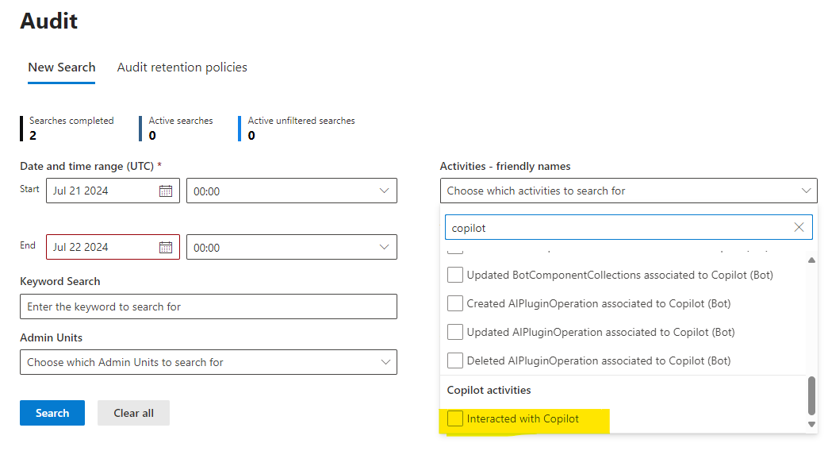
Audit Log
View when users interact with Copilot with the ‘Interacted with Copilot’ activity – time, M365 app, referenced files, labelled files
A Copilot interaction is when a user, or admin or system on behalf of a user, entered prompts in Copilot
Notes:
Audit Standard – 180 day log retention
Audit Premium – 1 year log retention (option to add 10yr add-on)
Audit (Standard) logs generated before October 17, 2023 are retained for 90 days. Audit (Standard) logs generated on or after October 17, 2023 follow the new default retention of 180 days.

Slide 32
Content Search
With content search you can view the actual prompts and responses
Location: User’s mailbox
Condition: Type > Equals any of > Add/Remove more options > Copilot interactions
Notes:
Interactions are stored in a user’s mailbox

Slide 33
Communication Compliance
Communication compliance can be used to detect inappropriate or risky Copilot interactions or sharing of confidential information
You can create a new policy for Copilot, add Copilot as a location in an existing policy, or create a policy to review all Copilot interactions
There is a policy template for Copilot – ‘Detect Copilot for Microsoft 365 interactions’
Notes:
Communication compliance can detect Copilot interactions in these apps:
Excel Copilot
Forms Copilot
Loop Copilot
Microsoft 365 Chat in Bing
Microsoft 365 Chat in Teams
OneNote Copilot
Outlook Copilot
Planner Copilot
PowerPoint Copilot
Stream Copilot
Teams (chats/channels/meetings) Copilot
Word Copilot
Whiteboard Copilot

Slide 34
Dicker Data Webinar Thank you
Microsoft Partner FY25 GTM Launch Recap
Notes:
Microsoft Teams Prem Thank you for your attendance and if you have any questions we will stop recording. Feel free to ask in the chat window.
HOW CAN WE HELP?

