Slide 1


Slide 2
Dicker Data Webinar Security basics for your new Azure subscription
Notes:
Thank you for joining we will start shortly

Slide 3
Agenda
1
News
2
Main Topic: Security basics for your new Azure subscription
3
Close
5
Code of Conduct
Notes:
Welcome to Opoint 2024, Happy New year. If you are joining for the first time welcome and thank you, we hope that you find the next 30 mins informative and possibly a little entertaining.
If you have attended our previous onpoints welcome back and thanks for all your support. You will find this year we are doing things a little different this year. More about that in a moment.
Then we do a quick catchup on our carefully hand curated Microsoft relevant news for the previous week,
Followed by the subject de semaine (week in English) today we will explain on why you should choose Dicker Data as your Distributor and the benefits of being a Dicker Partner.
Then we close out with an open Q&A session /prize draw
For those of you new to Powerpoint live. A quick familiarisation, We welcome your reactions using the emotion icon at the top right of your screens. Please ask questions in the chat window during the call. We will invite you to come off mute at the end of the call if you would prefer to ask your question out loud. During the call, please ensure you are on mute, and your video is turned off.
All links to sites are available by clicking on the link in the slide or will be posted to the chat window. We recommend you click on all relevant links and then review post call.
Calls will be recorded and made available post call, The teams generated recording will not be available external so don’t panic we will make the recording available to you later .
Participation in these calls means that you agree to Microsofts terms and conditions for digital meetings a link is available on this slide should you wish to review these. or to test the live link feature
Introduce speakers Role and location

Slide 4

News
Need to know
Notes:
But First The News. This is the section which is a concise update of relevant information, or opportunities compiled by Dickers subject matter experts. Who attend those early morning calls, wade through endless emails, yammer messages etc so you don’t have to

Slide 5
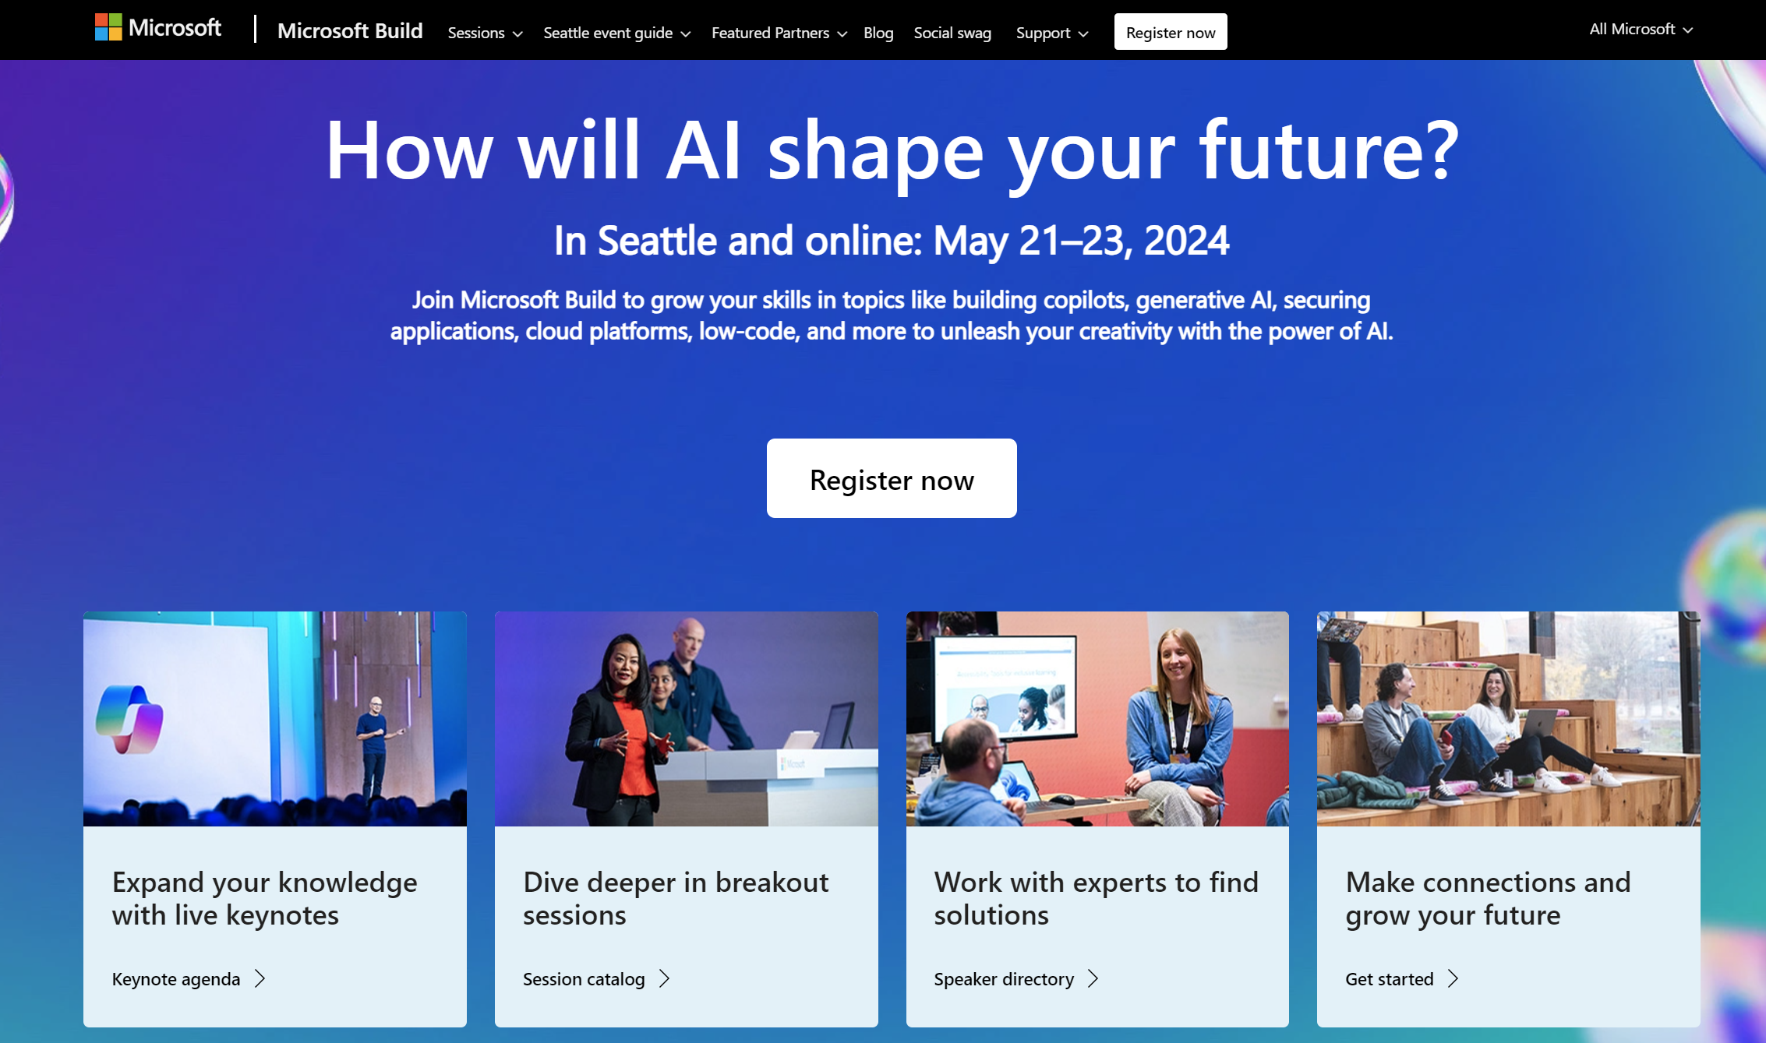
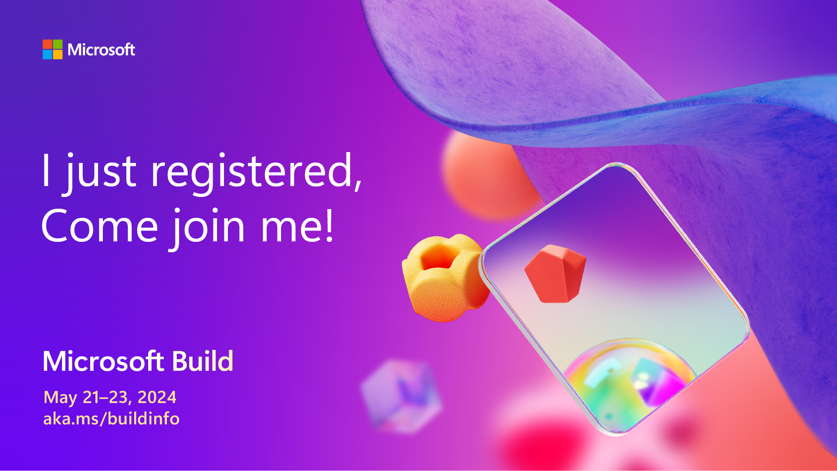
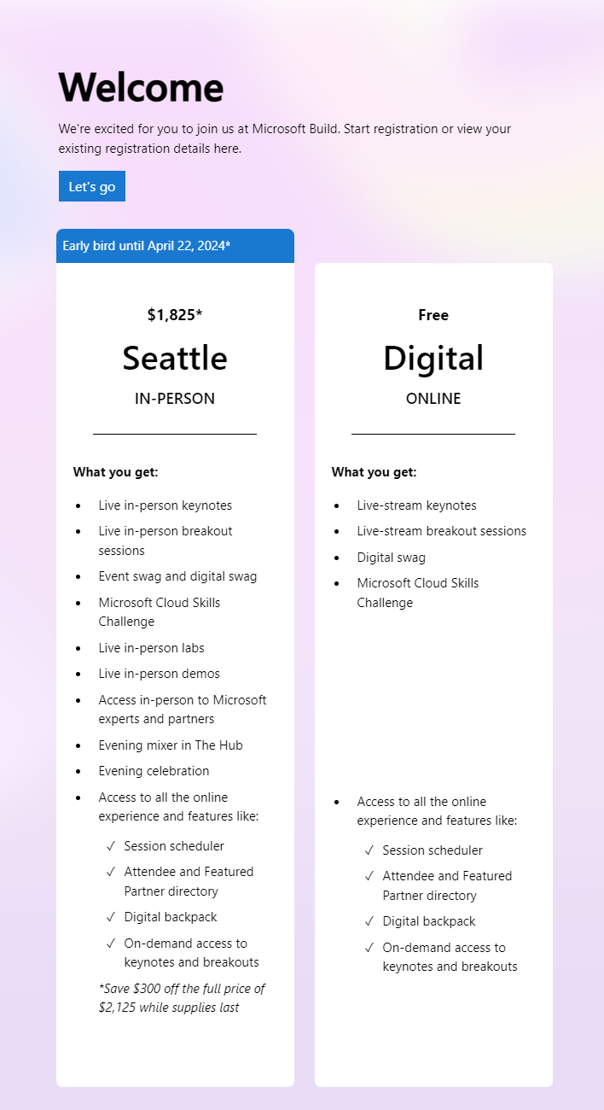
Notes:
21st May to 23rd May

Slide 6
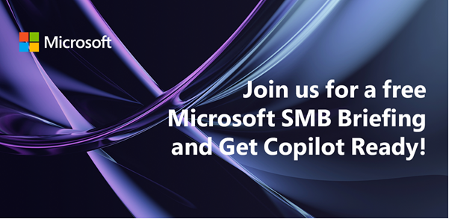

DATE & TIME:
Session 1: Tuesday 30th April 11:00 AM NZT
Session 2: Thursday 30th May 1:00 PM NZT
Session 3: Wednesday 26th June 1:00 PM NZT
Dicker Data is inviting you to bring your customers to our live digital briefing where we’ll showcase how Microsoft 365 can help put the power of AI to work with a live demo of Copilot for Microsoft 365! Copilot for Microsoft 365 can dramatically transform the way work gets done, empowering people to focus on more innovation and creativity – and unlocking a new wave of productivity growth.
Notes:
NZ Only Hide for AU

Slide 7
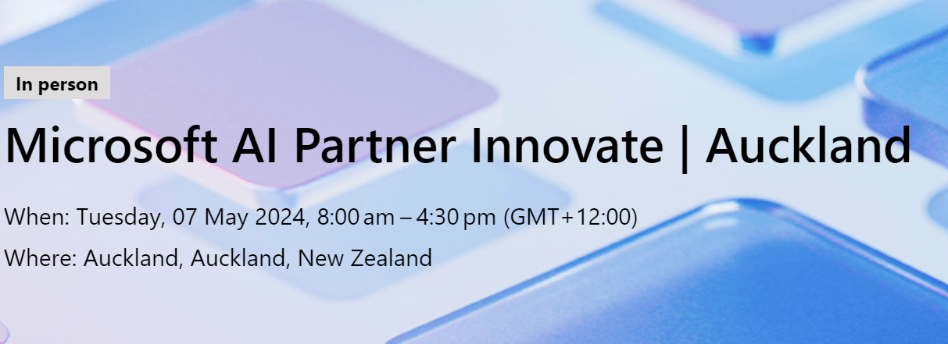
Agenda
08:00 AM - 09:00 AM
Registration & Networking Breakfast
09:00 AM - 10:15 AM
Opening Keynote - AI Vision
10:15 AM - 10:45 AM
Morning Tea
10:45 AM - 12:15 PM
Empowering Partners with AI
12:15 PM - 01:15 PM
Lunch
01:15 PM - 03:00 PM
Modern Work, Azure & Surface Go to Market and Sales Excellence with Microsoft
03:00 PM - 04:30 PM
Networking
Rego code: DID124CRM
Notes:
NZ Only

Slide 8



Microsoft Cloud and Hosting Partner Online Meeting e153 Copilot for News, Training
Tue, Apr 30
AU 1:00 PM
NZ 3:00 PM
Online event
Notes:
ANZ

Slide 9
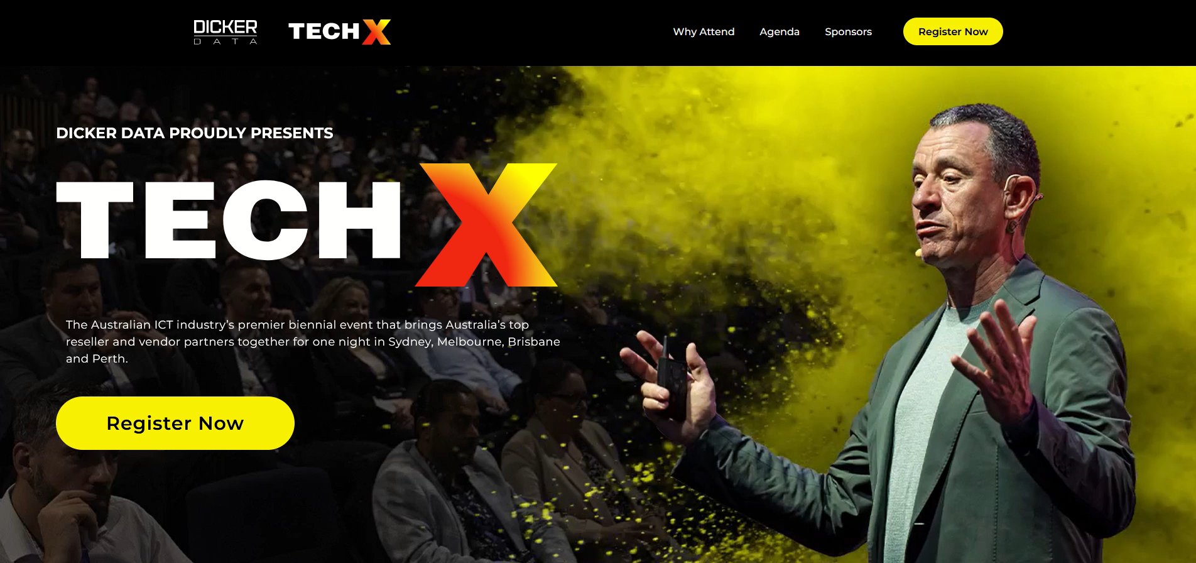
The New Zealand ICT industry’s premier biennial event that brings New Zealand's top reseller and vendor partners together for one night in Auckland
Australia
New Zealand
Notes:
ANZ

Slide 10
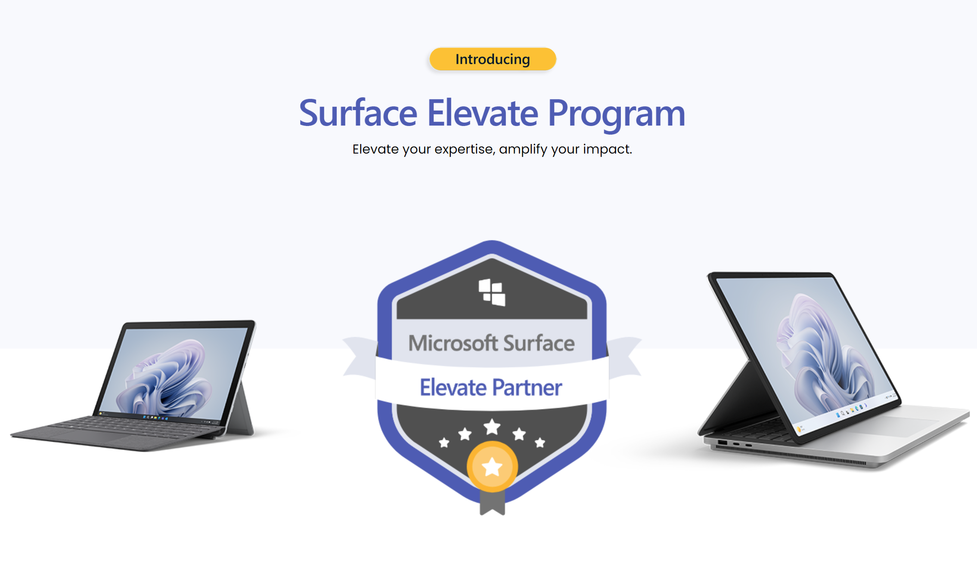
Windows 10 will reach end of support on October 14, 2025. The current version, 22H2, will be the final version of Windows 10, and all editions will remain in support with monthly security update releases through that date.
Join the Surface Elevate Program for a comprehensive four-hour session that transforms you into a Surface expert, offering an all-encompassing training experience designed to enhance your product knowledge and sales tactics in one dynamic workshop.
Upon finishing, proudly display your earned badge of expertise, which not only reflects your dedication to mastery but also serves as a trusted emblem to your customers, solidifying your role as their go-to for all things Surface.
Dive into this program to streamline your sales strategy, elevate your customer interactions, and become a one-stop source for informed, effective Surface solutions.

Slide 11

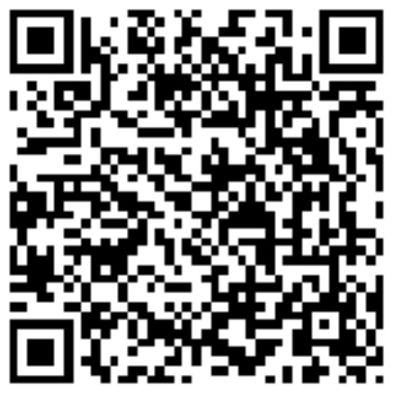

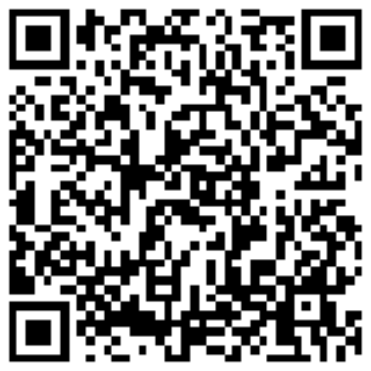

Security Basics for your New Azure Subscription
Agenda:
Review some security concepts
Cloud Security
Recommendations:
Secure Identities
Secure Resources
Gain Visibility
Saeed Nouri
Cloud Solution Architect ( MCT )
Saeed.Nouri@dickerdata.com.au
Mikki Chopra
Cloud Solution Architect ( MCT )
Mikki.Chopra@dickerdata.com.au
Notes:
Thank you for joining we will start shortly

Slide 12
Microsoft Azure Security
Security basics for your new Azure subscription
Agenda:
Review some security concepts
Cloud Security
Recommendations:
Secure Identities
Secure Resources
Gain Visibility
Saeed Nouri
Cloud Solution Architect ( MCT )
Saeed.Nouri@dickerdata.com.au
Mikki Chopra
Cloud Solution Architect ( MCT )
Mikki.Chopra@dickerdata.com.au

Slide 13
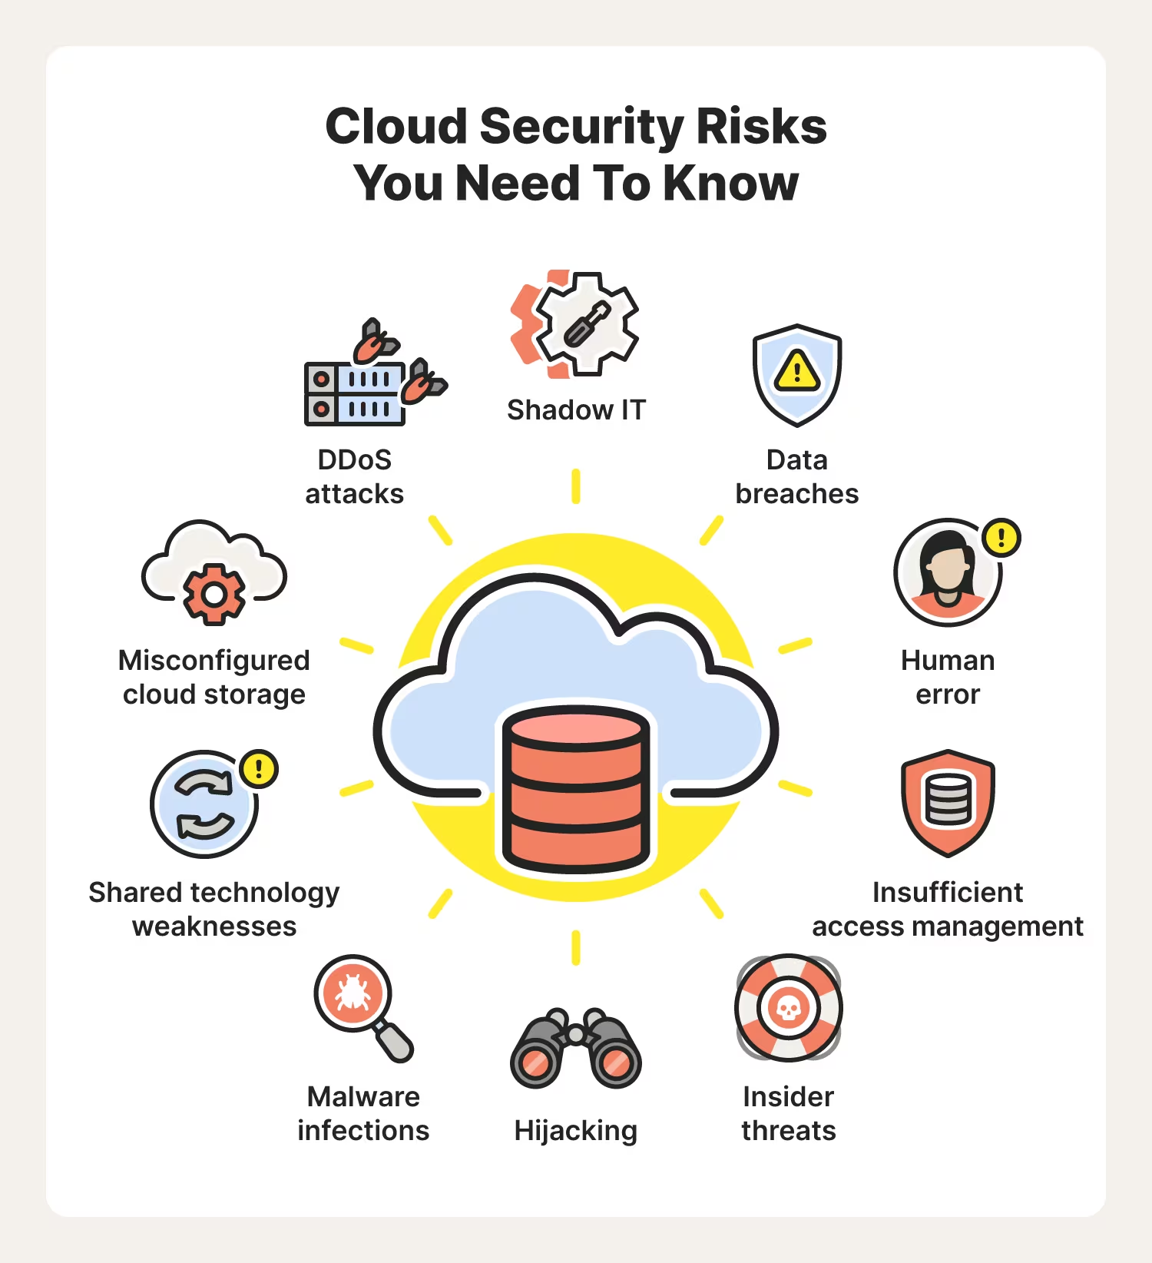
Cloud Security
Some
Cloud cybersecurity isn't a mere product you enable and then disengage from; it's a journey. This path requires constant engagement, evolving strategies, and a commitment to adaptability as the cloud landscape and its associated threats transform.
Navigating this journey successfully demands a proactive stance, continuous learning, and the integration of best practices into the very fabric of an organization's operations, ensuring the protection of its cloud-based assets is not a one-time task but an ongoing endeavor
Perimeter vs. Identity-Centric
Implicit vs. Explicit Trust
Flat vs. Segmented Network
Reactive vs. Proactive

Slide 14
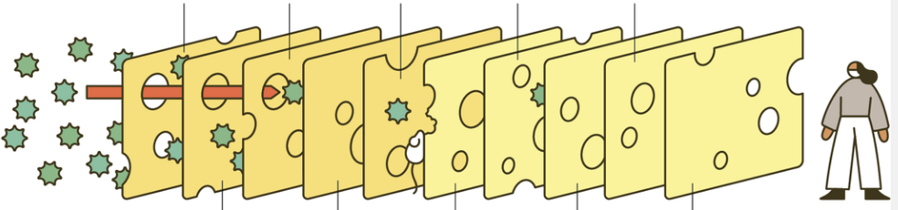
Defence in Depth (DiD)
A layered security strategy essential for protecting an organization's digital assets against cyber threats. It integrates multiple security measures—technological, administrative, and physical—to ensure redundancy and resilience. This approach is highlighting the importance of a proactive security posture, adaptability, and a culture of security awareness across the organization.
DiD not only defend against diverse threats but also supports the organization's overall sustainability and reputation

Slide 15
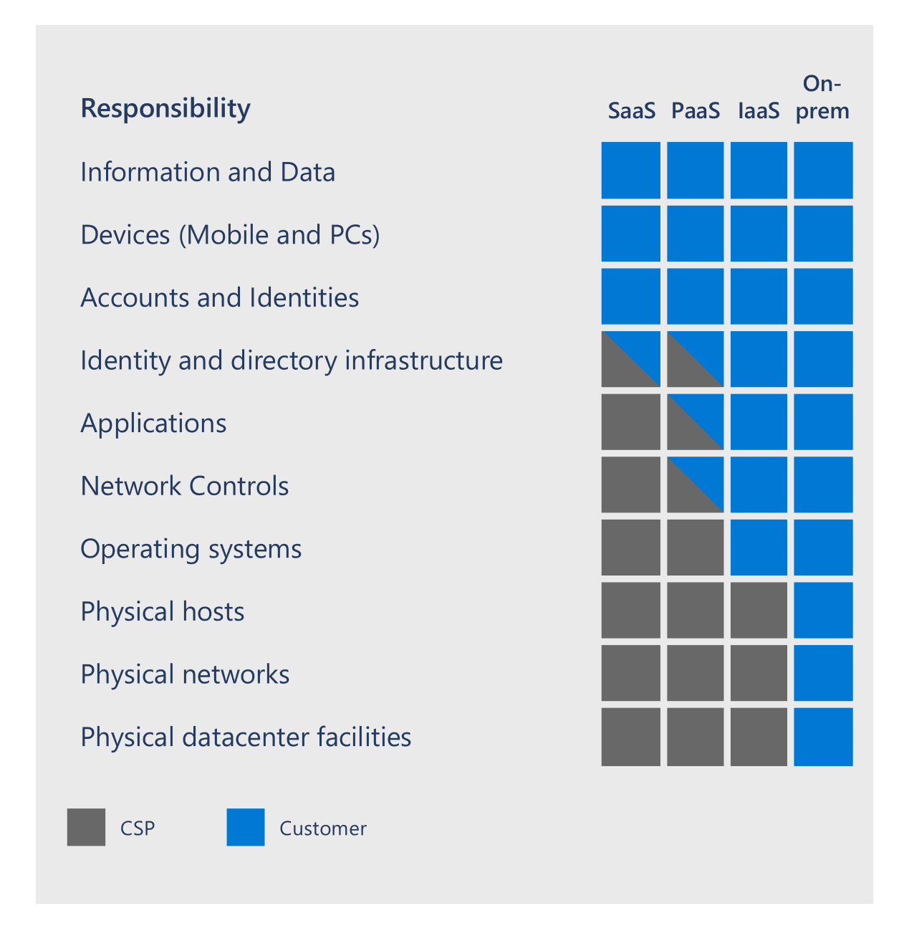
Shared Responsibility Model
Shared Responsibility Model outlines that while Microsoft secures the cloud infrastructure, customers are responsible for securing their data, configuration and applications within the cloud.
This delineation ensures a collaborative approach to cloud security

Slide 16
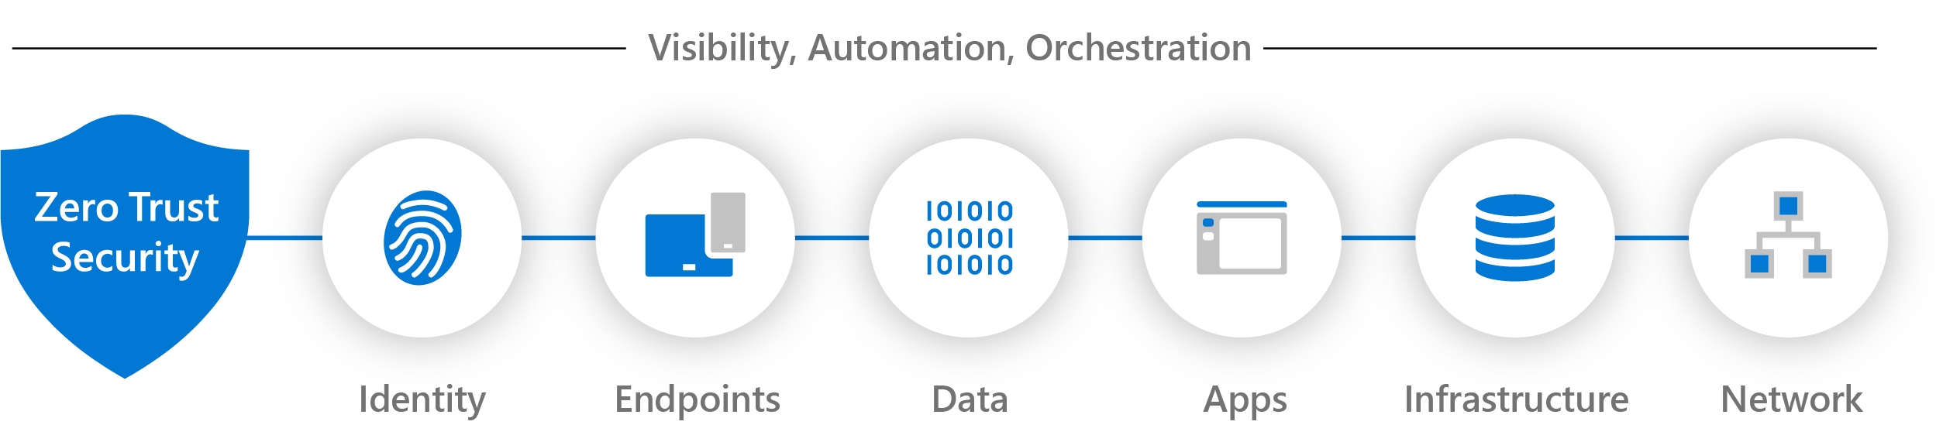
Zero Trust
Zero Trust is a cybersecurity approach that challenges the traditional notion of "trust but verify" by assuming that no entity, whether inside or outside an organization's network, should be inherently trusted. Instead, Zero Trust advocates verifying every user, device, and application attempting to access resources, regardless of their location. The core principle of Zero Trust is to minimize the "attack surface" and reduce the potential impact of security breaches.
Zero Trust differs from traditional security architectures, such as perimeter-based models
Verify explicitly | Use least-privileged access | Assume breach

Slide 17

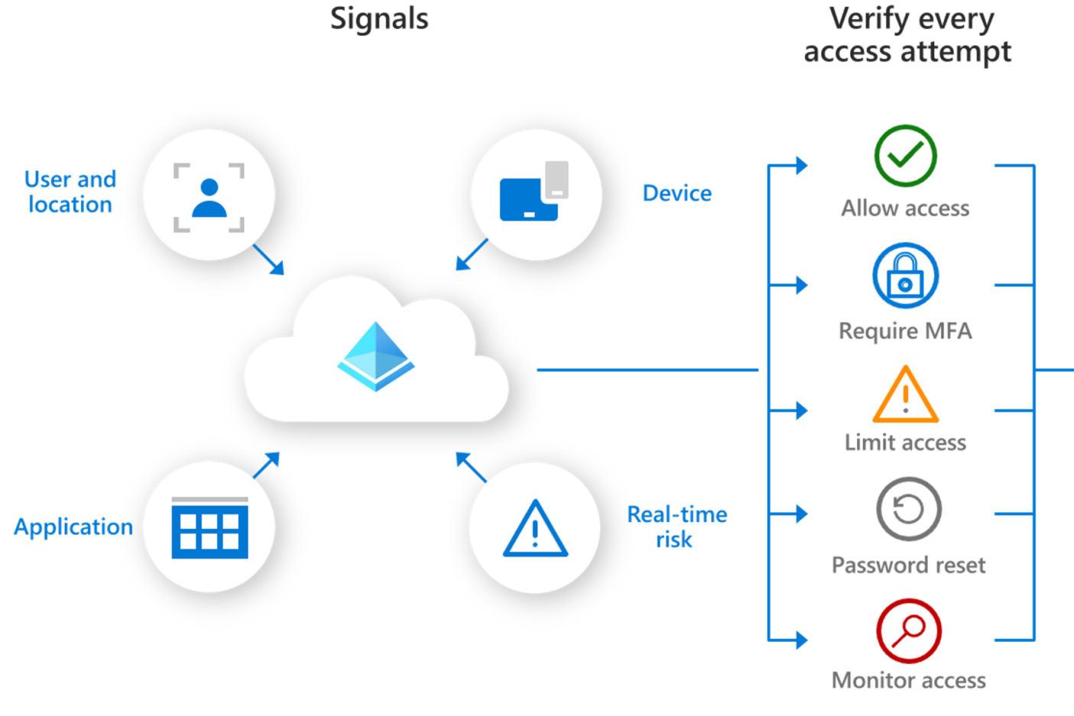
Securing Identities - Recommendations
Enforce multifactor authentication (MFA) for all users in tenants for you and your customers
Implement conditional access policies to provide maximum protection
Nominate your Security contacts
Explore the benefits of these defaults and follow simple actions to enable them for your customers. Read more
Plan for your conditional access deployment before deployment. Read more
The security contact is an individual or group within your organization who will serve as the point of contact if Microsoft detects a threat. The contact must have an inbox that can be monitored constantly—we recommend using a distribution
list—and respond with urgency to investigate and remedy security concerns. Read more
Use Conditional Access templates. The provide a convenient method to deploy new policies aligned with Microsoft recommendations. Read more
Microsoft Entra ID Security Defaults. Read more
Learn what happens when multiple conditional access policies applies. Watch this
Best practices for Microsoft Entra Roles. Read more
Your identity secure score shows how aligned you are with Microsoft’s security recommendations—and where you can better protect your customers and business. Read more
Securely manage your customer’s services
Familiarize yourself with GDAP it allow partners to control access to their customers' workloads to better address their security concern. Read more , Obtain permissions
Passwordless authentication is
an effective alternative to MFA, implement it where applicable. Read more

Slide 18

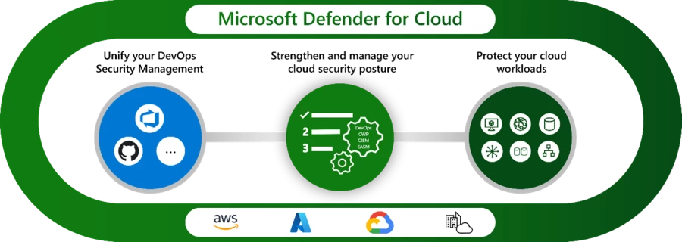
Securing Resources - Recommendations
Microsoft Defender for Cloud provides comprehensive, cloud-native protections from development to runtime in multicloud environments. Defender for Cloud helps you protect resources across Azure, other clouds, and on-premises through enhanced security capabilities
Defender for cloud provides insight in a unified dashboard from all the protected workloads. Read more
Defender for cloud incudes Security Posture Management ( CSPM ) Read more
Consider defender for Server P2, this is an extremally powerful package with unique features Compare Defender for Server P1 vs P2
Defender for cloud is free for first 30 days and the charges start beyond 30 days Defender for cloud pricing scheme
Follow the provided recommendations to gain an insights on the improvement opportunities. In most cases the “Fix” button implements the changes. Read more
If your customer needs be aligned with Security Governance or regulatory standard, consider higher CSPM package Compare CSPM Offers
Defender for cloud is MSP ready, you can securely manage multiple tenants Read more

Slide 19









Ongoing Monitoring- Recommendations
Most incidents and attacks within Azure environments often manifest through subtle yet discernible anomalies or changes in resource utilization, such as an unexpected surge in resource consumption. These signals, while seemingly innocuous, can be indicative of underlying security threats or breaches in progress. Recognizing these early warning signs—such as unusual spikes in data traffic or resource usage—enables organizations to swiftly respond and mitigate potential security incidents, underscoring the importance of vigilant monitoring and anomaly detection in maintaining a robust cybersecurity posture
Identify misuse, manage nonpayment, and enable safeguards against unforeseen spending with actions designed to detect fraud.
Establish a spending budget in Azure to receive alerts for any spending overages or adopt the sophisticated Azure cost management tools. Addressing or averting unforeseen expenditure spikes is crucial for safeguarding your enterprise and clientele. Create and Manager budgets
Implement Azure Policy to enforce and manage your cloud environment's compliance standards. By establishing robust policies, you can significantly enhance security, ensuring that resources adhere to your organization’s security and compliance requirements.
This proactive measure aids in preventing potential security breaches by maintaining strict governance over your Azure infrastructure. Assign a policy through Azure Portal
Great videos to watch:
Anatomy of Azure policy Watch
Enable and subscribe to Azure fraud detection and notification. Read more
Cost alerts are designed to inform you when a customer's expenditure surpasses a predetermined threshold. These alerts can be categorized into budget, credit, and department spending quota types, allowing for comprehensive monitoring of your customers' financial activities.
This functionality is key to detecting any unusual or suspicious spending patterns promptly. Setup Cost Alerts
Set up notification emails through Entra ID Identity Protection to receive real-time updates on users at risk and detected risky sign-in attempts. Swiftly investigate any suspicious activities to maintain customer safety and security. Configure Entra ID Protection notifications
LS

Slide 20

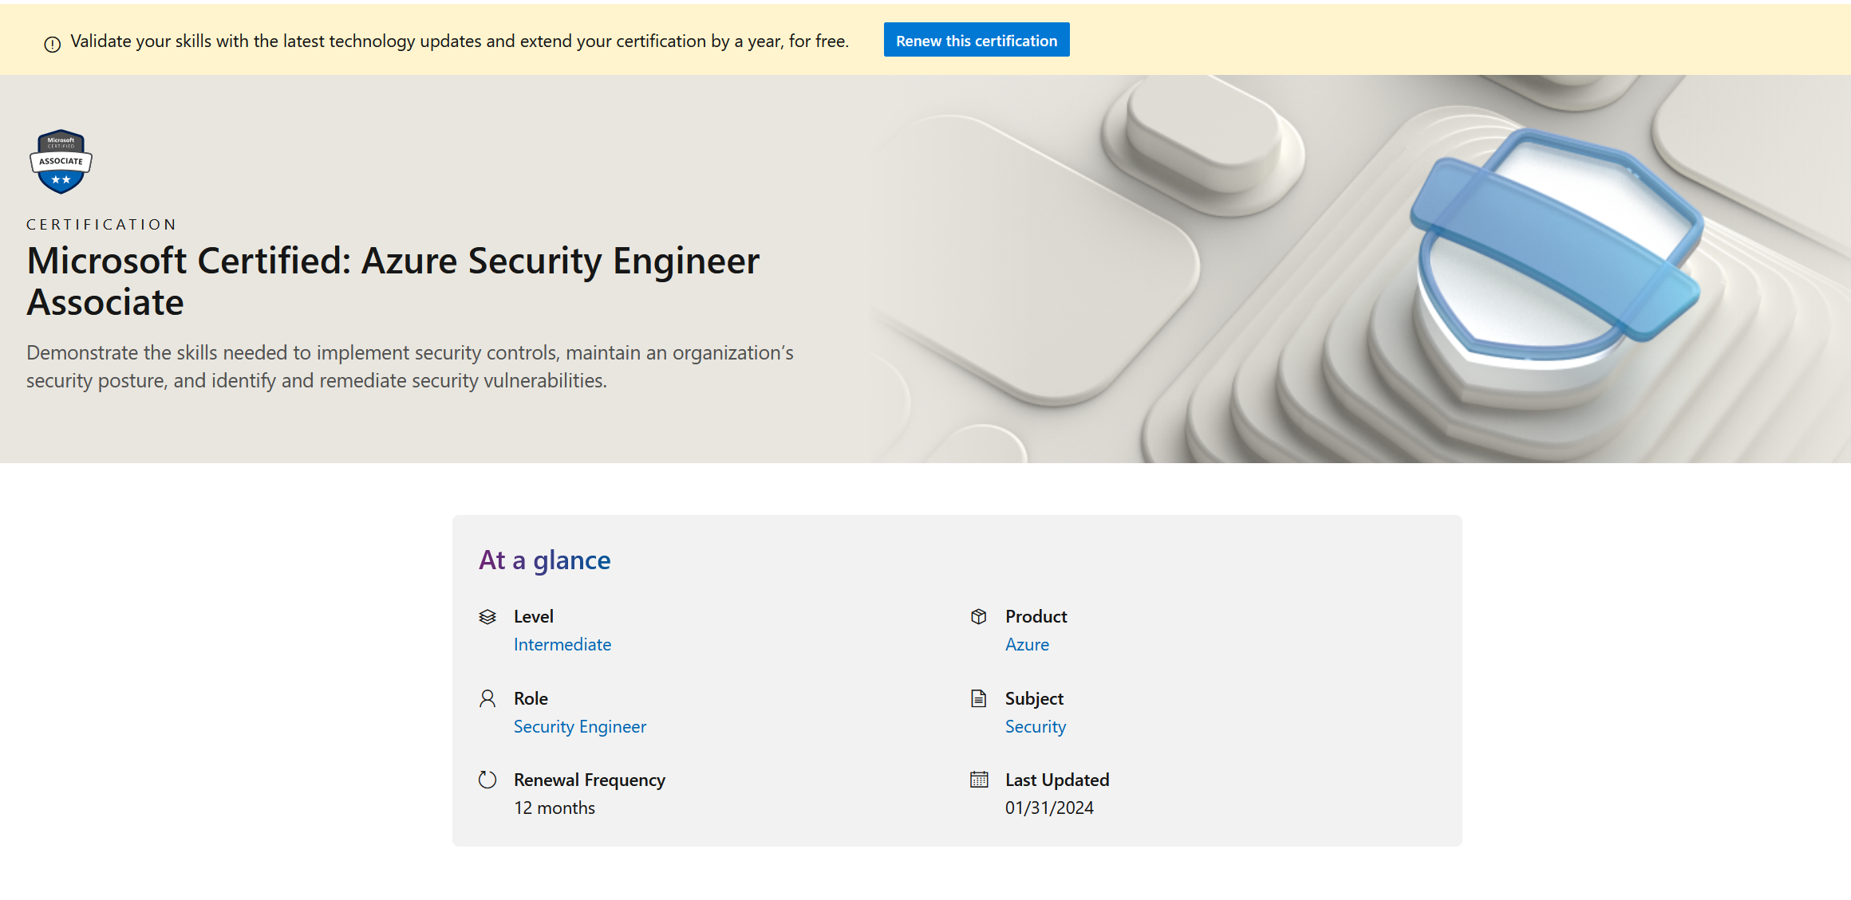
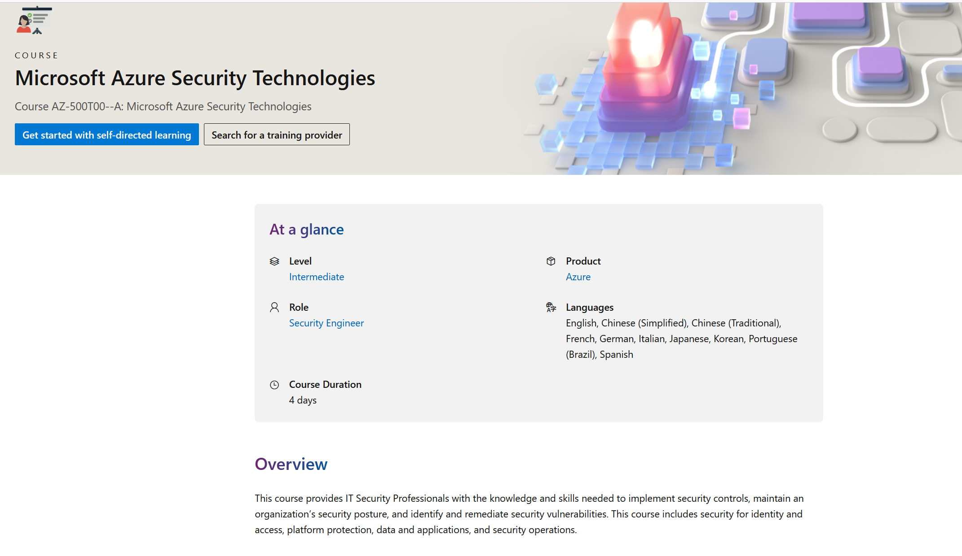
NEXT STEPS
AZ-500

Slide 21
Dicker Data Webinar Thank you
Next Week: Microsoft Surface
Notes:
Thank you for your attendance and if you have any questions we will stop recording. Feel free to ask in the chat window.
HOW CAN WE HELP?

