Slide 1
Dicker Data Webinar Microsoft Copilot for M365
Notes:
Thank you for joining will start shortly

Slide 2
Agenda
1
News
2
Main Topic: Copilot for M365
3
Close
5
Code of Conduct
Notes:
Welcome to Opoint 2024, Happy New year. If you are joining for the first time welcome and thank you, we hope that you find the next 30 mins informative and possibly a little entertaining.
If you have attended our previous onpoints welcome back and thanks for all your support. You will find this year we are doing things a little different this year. More about that in a moment.
Then we do a quick catchup on our carefully hand curated Microsoft relevant news for the previous week,
Followed by the subject de semaine (week in English) today we will explain on why you should choose Dicker Data as your Distributor and the benefits of being a Dicker Partner.
Then we close out with an open Q&A session /prize draw
For those of you new to Powerpoint live. A quick familiarisation, We welcome your reactions using the emotion icon at the top right of your screens. Please ask questions in the chat window during the call. We will invite you to come off mute at the end of the call if you would prefer to ask your question out loud. During the call, please ensure you are on mute, and your video is turned off.
All links to sites are available by clicking on the link in the slide or will be posted to the chat window. We recommend you click on all relevant links and then review post call.
Calls will be recorded and made available post call, The teams generated recording will not be available external so don’t panic we will make the recording available to you later .
Participation in these calls means that you agree to Microsofts terms and conditions for digital meetings a link is available on this slide should you wish to review these. or to test the live link feature
Introduce speakers Role and location

Slide 3
News
Need to know
Notes:
But First The News. This is the section which is a concise update of relevant information, or opportunities compiled by Dickers subject matter experts. Who attend those early morning calls, wade through endless emails, yammer messages etc so you don’t have to

Slide 4
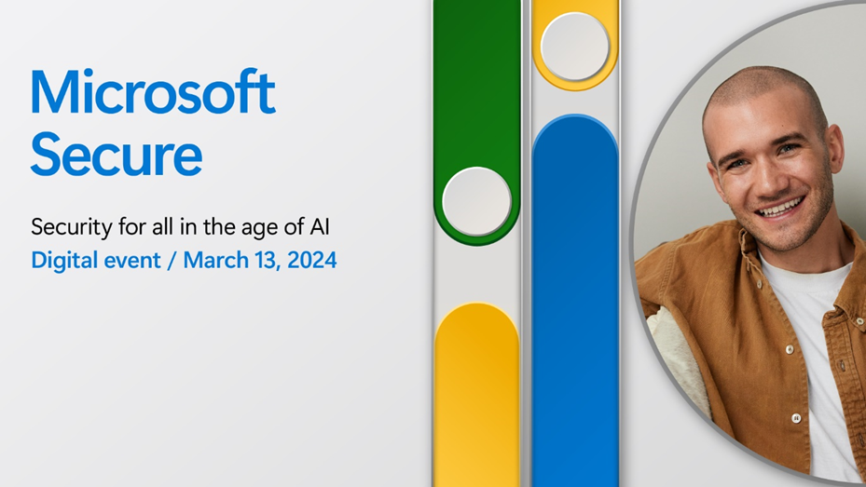
Microsoft Secure
Microsoft Secure 2024 is a two-hour digital event from 5:00 AM – 7:00 AM NZT where Microsoft experts share insights, practices, and most importantly—new technology—to safeguard your organization. —it’s an opportunity to be the first to see what Microsoft is building to help you secure your organization.
Whether you are new to security or a seasoned professional, you’ll find something valuable and relevant to help you take your security to the next level. AI, in the wrong hands, fuels sophisticated attacks exploiting system vulnerabilities. In the right hands, it empowers defenders, giving organizations a decisive advantage. Expect some exciting announcements on the availability of Copilot for security.
So don’t wait. Register today and join me on March 14, 2024, from 5:00 AM – 7:00 AM NZT, for the ultimate AI security showcase.
Want more after Secure?
Practitioners can also join the Microsoft Secure Tech Accelerator post-event in the Tech Community on April 4, 2024. The 5-hour live event gives you deeper technical information on implementation and a chance to ask the team questions. Learn more, RSVP, and build your schedule. 3.00am -7.00am NZT.

Slide 5

DD Microsoft Security Labs
Join our experts Darren Bennett, Sean McGrath & Steven Lanfranca as they host our 3-part Microsoft Security Deep Dive Series. Over the 3 virtual sessions, the team will deep dive into Microsoft's Modern Work Security platform.
These sessions will explore Microsoft 365 Security functionality as well as the intersection with Microsoft Azure to give you a thorough understanding of Microsoft’s Security platform for SMBs.
Sessions begin in a live practice environment and then move to discuss real customer scenarios as well as positioning guides to help you hit the ground running.
The course runs across three 2-hour virtual sessions.
Register for Session II: Tues 5th March 2024 12pm NZT
Register for Session III: Tues 12th March 2024 12pm NZT
Notes:
Recommend Session 3 which is focussed on copilot readiness
Register for our Microsoft Security Deep Dive Series. Session III on 12th March will be focused on Copilot Technical Readiness. We’ll cover:
Introduction to AI
Introduction to Copilot for Microsoft 365
Copilot Readiness Assessment
Licensing Requirements
Information Protection and why it is important
Demo of the Copilot deployment process
Demo of creating an Information Protection/Data Loss Prevention security baseline

Slide 6
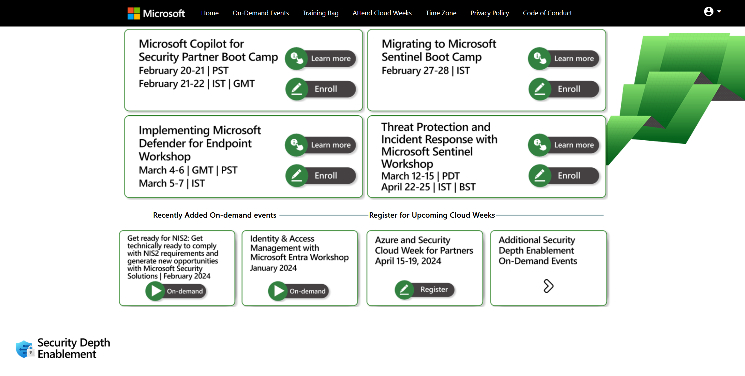
Security Depth Enablement
Access the Security Depth Enablement curriculum here.

Slide 7

AVD Training Day: Data Fundamentals
Build the skills you need to create new opportunities and accelerate your understanding of Microsoft Cloud technologies at a free Microsoft Azure Virtual Training Day from Microsoft Learn.
Join us at Data Fundamentals to master the basics of core data concepts and explore Azure cloud data services. You’ll learn about Azure relational database services and Azure Storage for non-relational data, and discover the benefits of Azure Cosmos DB, a fast NoSQL database with open APIs for any scale. We’ll also discuss options for large-scale data lakehouses and data warehouses, real-time analytics and data visualisation.
Monday, 4 March 2024 | 10:00 AM - 12:15 PM AEDT (GMT+11) Sydney | 12:00 PM - 2:15 PM NZDT (GMT+13) Auckland Tuesday, 5 March 2024 | 10:00 AM - 11:50 AM AEDT (GMT+11) Sydney | 12:00 PM - 1:50 PM NZDT (GMT+13) Auckland

Slide 8

What’s Next for Copilot Event
What's Next for CSP Partners and Microsoft Copilot
Build on the Copilot for Microsoft 365 momentum and help your customers drive adoption and expansion by leveraging early Copilot learnings and best practices. Combine the power of Copilot for Microsoft 365 with role-specific insight and actions from Microsoft Copilot for Sales and Microsoft Copilot for Service. Learn how Dynamics 365 Business Central and its new Copilot capabilities bring unmatched value to customers who are looking for a business management solution that works seamlessly with their Microsoft 365 productivity and collaboration suite.
When: March 01, 2024 2:00 PM (Pacific/Auckland)
Duration: 1 hour
Register here.

Slide 9

Microsoft Copilot for Microsoft 365

Slide 10
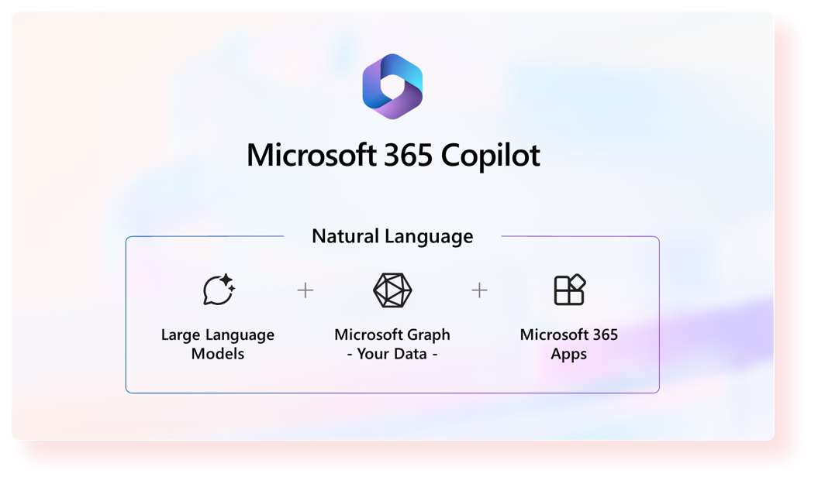
Overview
Transforms the way users work by helping them generate content and complete tasks that consume time, creativity and energy, so that they can focus on more meaningful work
It leverages Large Language Models (LLMs) and your data in the Microsoft Graph and the Microsoft 365 Apps
Integrated into the Microsoft 365 Apps -Teams, Word, Outlook, PowerPoint, Excel, Whiteboard, Loop and OneNote
Notes:
Copilot for Microsoft 365 is an AI-powered productivity tool that is designed to help people save time and work more efficiently. It’s called ‘Copilot’ and not ‘Autopilot’ for a reason, because it is not designed to replace people, but rather work alongside them to improve their productivity by changing the way they work by generating content, finding information, improving communication and so on.
Copilot leverages Large Language Models (LLMs), content in Microsoft Graph (this is your email, chat, and file data etc), and the Microsoft 365 apps to provide real-time intelligent assistance. All the M365 apps are included in Copilot for M365, so there isn’t a separate product or license for Copilot for Word/Teams etc. LLMs, like pretrained models like GPT-4, are trained on huge amounts public data (like books, articles, websites etc) to learn language, context and meaning and you can interact with them using natural language which is called a prompt, which is a statement or question like ‘summarise this article’, and the LLM will generate a response based on it’s training and how it understands the context (which can come in how you phrase your prompt).

Slide 11
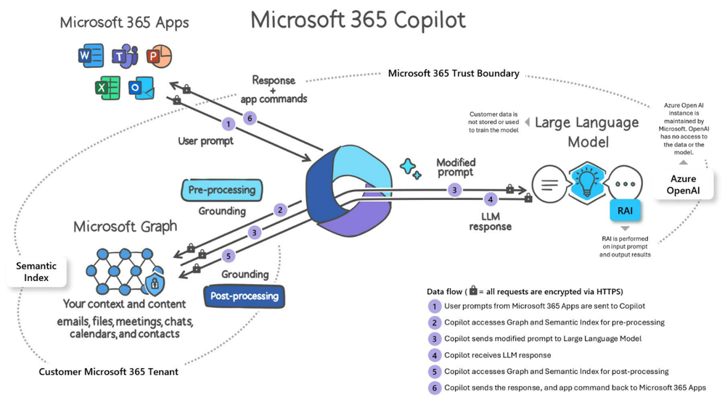
Data, Security & Privacy
Notes:
After you start a chat by prompting copilot the full conversation gets sent with each subsequent prompt so the LLM gets more context and can generate relevant responses, but it only remembers your prompts while it’s in the conversation. So with each new conversation the chat history is wiped and it won’t use any of the knowledge or prompts from your conversations to train the models. Copilot uses Azure OpenAI Services, not OpenAI’s public services, so all of the processing stays within the Microsoft 365 service boundary.
Copilot respects the permissions model with any content and graph information it receives – so it only shows you data you have permissions to view, and it only searches for information within your tenant, so if you are a guest in any other Microsoft 365 tenants it will not search them.

Slide 12
Licensing & Availability
Pricing
Eligible Base Licenses
Availability
$582NZD/per user/per year (RRP)
Annual commit, pay annually ONLY
No NFP subscriptions
EDU subscriptions available 1st March 2024
Microsoft 365 E3/E5
Office 365 E3/E5
Microsoft 365 A3/A5 for faculty
Office 365 A3/A5 for faculty
Microsoft 365 Business Standard
Microsoft 365 Business Premium
No minimum seat purchase requirement
No trial licenses
No IUR licenses
No demo tenants
Notes:
As of Jan 16th, Microsoft removed the 300-seat purchase minimum and made copilot available to CSP customers (previously just EA). Copilot for M365 is an add-on license that is $582/user/year and requires one of those listed base licenses as a prereq. You’ll notice that OE3 & OE5 are now included as base licenses, I still always recommend leading with BP, ME3 & ME5 as these licenses have the security features that should be deployed alongside copilot- however we will talk more about that later. You can only purchase 1x Copilot add-on for each base license in the tenant, so you can’t end up in a situation where you have more add-ons than base licenses.
You can only purchase copilot on annual commit, pay annually. There is no monthly commit option, and no annual commit pay monthly option. We do not know if/when monthly term subscriptions will become available. Make sure that your base licenses don’t expire before the add-on.
*if they ask why, this is to ensure Microsoft gets ROI for the investment into copilot*
This is currently the only way you can get access to Copilot – there are no trial licenses, no IUR licenses (not included in SPD benefits), and no demo tenants in CDX – although we are frequently asking MS about this and they are very aware that there is huge demand from the channel for IUR or demo licenses.
Currently there is no charity or education discounted SKUs available in CSP. We don’t know if or when these will be introduced.
And finally, Copilot for M365 is not included in any of the O365/M365 bundled licenses (like BP or E5). The Copilot for M365 capabilities are however included in two other copilot subscriptions – Copilot for Sales & Copilot for Service. We’ll talk more about these soon as well.

Slide 13
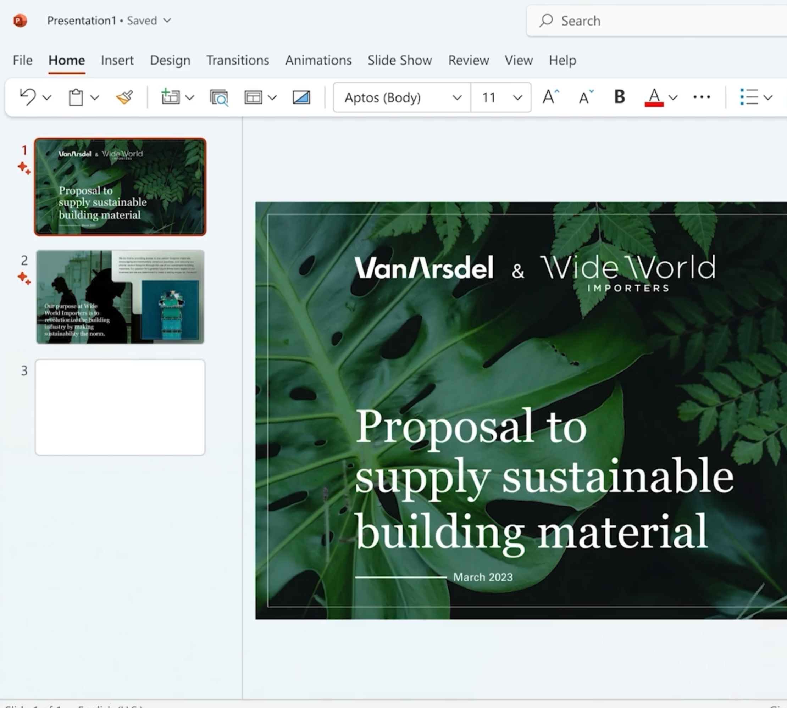

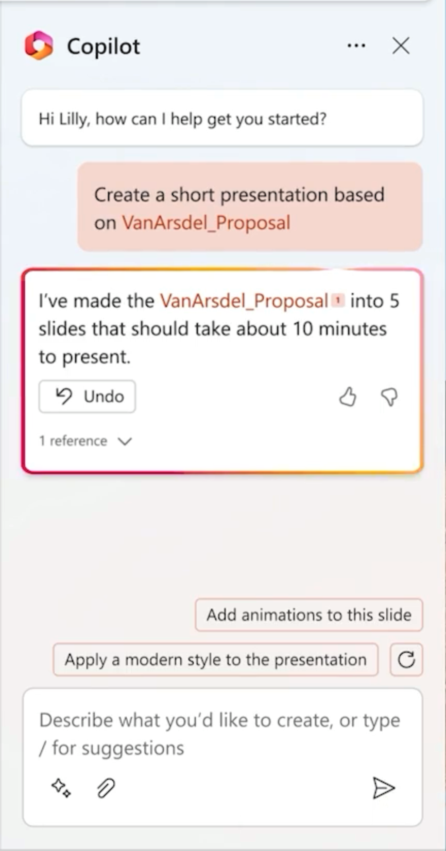


Use cases
Create first drafts, add more content, summarise long documents, ask questions about the content with Copilot in Word
Hi Daichi, how can I help you get started?
Analyse data and produce insights, sort and filter data, and generate formulas with Copilot in Excel
Transform word documents into a PowerPoint deck, summarise content, edit and format content, generate images with Copilot in PowerPoint
Notes:
There are HEAPS of different ways you can use Copilot to support your everyday work across a huge range of tasks. I’m going to demo a few of these later, but to give you some examples
Outlook
Summarise email chains
Draft replies
Coaching
Desktop Outlook – Summarise in Outlook available, coaching by copilot rolling out, draft with copilot will being to roll out March 1st.
Word
Draft with Copilot - Generate text with and without formatting in new or existing documents
Chat – ask questions, summarise docs, create content
PowerPoint
Draft with Copilot - Create a new presentation from a prompt or Word file
Chat – Summary & Q&A
Light commanding - Add slides, pictures, or make deck-wide formatting changes.

Slide 14
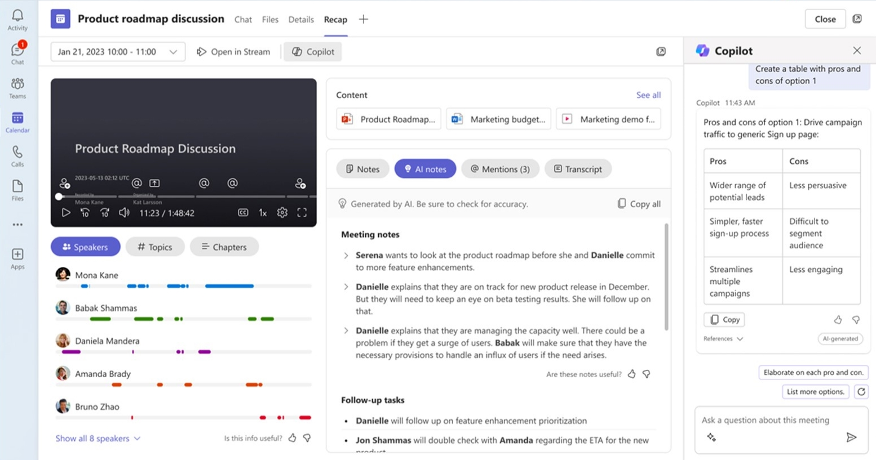

Copilot in Teams
Intelligent recap
Copilot in Teams
Built-in and automated
On-demand
Standardized
Based on unique prompts
Video, speaker, and chapter markers
Conversational interaction, with citations
Available after meeting only
Available real-time (during & after meeting)
Use built-in meeting summaries and ask any question about the meeting
*Intelligent recap is also available in Teams Premium
Notes:
Intelligent recap provides an AI-generated meeting summary after the meeting, including action items, and segments the recording with video timeline markers. Big time saver if you need to send a meeting summary to a customer or update your CRM with notes etc.This is a feature that’s included in Teams Premium and Copilot in Teams.
​
Copilot can expand on intelligent recap with it’s ability to ask any question about the meeting, and it’s on demand and is based on each user’s unique question or prompt, it uses a conversational UI, and is available both during and after the meeting. So you can ask it questions during for meeting like “catch me up on what I’ve missed so far” if you are late, or “have we missed any questions that have been asked” etc. You also ask copilot questions after the meeting, like “what was the customer sentiment” or “did we agree on a date for this task” and so on
​
Every user that needs access to IR and copilot needs a license. ​
Copilot in Teams requires transcription to be enabled (unless organizer enables copilot without transcription), and it will only work in meetings hosted in your tenant.
Prompt examples:
Draft an email to the meeting participants that summarized the meeting and includes the action items.
What questions are unresolved?
Suggest follow-up questions.
Recap the meeting so far.
Where do we disagree on this topic?
How did [a meeting participant] respond to this proposal?
What questions can I ask to move the meeting forward?
Create a table with the ideas discussed and their pros and cons.
Without transcription/recording – a temporary transcript is created for the duration of the meeting, so you can use copilot during the meeting, but it won’t be available in the recap tab after the meeting. Copilot also won’t automatically turn ‘on’ so you have to start it by selecting it from the top menu in teams. If you turn on transcript during the meeting copilot will be available after the meeting with only with the information from the point that transcription was enabled. Since the transcription isn’t kept after the meeting it can’t be available for eDiscovery.
​

Slide 15
Copilot with Commercial Data Protection
Overview
Use Cases
Licensing
Security
Previously Bing Chat Enterprise
AI-powered chat for the web
Accessed via:
https://copilot.microsoft.com/ or https://www.bing.com/chat or Copilot in Edge or Copilot in Windows
Summarise long articles/PDFs
Research, find answers, analyse data
Generate content or images
M365 E3/E5
M365 F3
M365 Business Standard
M365 Business Premium
M365 A3/A5 for faculty and students (18+)
O365 A1/A3/A5 for faculty and students (18+)
Doesn’t retain chat prompts or responses
Data is not used to train underlying AI models
Chat data encrypted in transit & at rest
Must be signed in & licensed
Notes:
Originally called bing chat enterprise
Two experiences – consumer/free and commercial data protection
Use cases
Copilot vs Copilot for M365
Pricing
Copilot is a generative AI service grounded in data from the public web in the Bing search index only. built on the latest large language models, GPT-4 and DALL-E 3. It doesn't have access to organizational resources or content within the Microsoft 365 Graph, such as documents in OneDrive, emails, or other data, even when commercial data protection is turned on.
Copilot for Microsoft 365 adds three things:
Access to data within the Microsoft 365 Graph in your tenant.
Prompts and responses are processed entirely within your Microsoft 365 tenant boundary, along with other Microsoft 365-specific security, compliance, and privacy features.
Access to this generative AI capability from Microsoft 365 applications like Teams, Outlook, and Word.

Slide 16

Copilot feature comparison
For Individuals
For Organisations
 | Copilot | Copilot Pro |  | Copilot | Copilot for Microsoft 365
Foundational Capabilities | ● | ● |  | ● | ●
Web Grounding | ● | ● |  | ● | ●
Commercial Data Protection | ● | ● |  | ● | ●
Priority Model Access |  | ● |  |  | ●
Copilot in Outlook, Word, Excel, PowerPoint, and OneNote |  | ● |  |  | ●
Copilot in Teams |  |  |  |  | ●
Microsoft Graph Grounding |  |  |  |  | ●
Enterprise-Grade Data Protection |  |  |  |  | ●
Customization |  | Copilot GPT Builder |  |  | Copilot Studio
Free
$20
Free
$30
Prices are monthly & USD. Commercial Data Protection applies when users are signed into their work account using their organisation’s Entra ID.

Slide 17
Getting Customers AI Ready
Data protection and restriction
Data structuring
Get AI Ready services
Reviewing subscription renewals & upselling licenses
Consolidating data in Microsoft 365
Identifying business cases and which users within the organisation with benefit from Copilot for M365
Reviewing and correcting permissions
Implementing Microsoft Information Protection
Foundational productivity deployment
AI readiness evaluation
Copilot for Microsoft 365
Copilot for M365 license
Notes:
The point of this slide is to highlight that there is a lot to think in terms of getting your business and customers ready for Copilot. It’s not a product you should just buy and rollout – which is why all our messaging around copilot hasn’t just been ‘go buy it’ – because this is so critical in order for your customers to have a positive experience.
There are two main risks:
Security
The responses and content copilot generates is in the context of the user and what Microsoft 365 content they have access to. So for example, if both me and my manager ask copilot the same question, we may get very different responses as he has access to a lot of content than me.
It is very likely that a lot of your customers won’t all be correct. Before copilot, if a user has access to something they are not meant to, they have to actively look for that information or know what to search to discover it, but with copilot that can be very easily surfaced for them (which is positive thing, as we know finding information is a huge productivity drain, but also can be negative if there isn’t security measures in place). Over time as different engineers make changes to permissions, people come and go, and the permissions are modified, folders and files are shared and move – the permissions get more and more messy. You will also likely have a lot of tenants you have inherited from other MSPs, and never did the SharePoint migration or set up for them so may have no idea what the permissions really look like. They also may not have any information protections in place – particularly clients on the licenses that don’t have security (business std, O365 E3).
We know that one of the most common questions Copilot is being asked is about salary information. The fallout if sensitive information is leaked after copilot is deployed could be huge. Not just salary information but if health or sensitive HR related information about employees is exposed this it could have a big emotional impact on the individual, or if legally sensitive information is exposed then on the business. And if there is an account breach, it will be even easier for the attacker to obtain data to use to expand the depth of the breach or use for malicious purposes.
2. Copilot ‘misuse’
Like I said earlier, copilot is not designed to replace employees and it is not designed to do your work for you. AI can get it wrong – AI-produced content may contain inaccuracies, biases, or sensitive materials because they were trained on information from the internet, as well as other sources. AI may not know about recent events yet, and struggles to understand and interpret sarcasm, irony, or humour. It is not a person.
At the end of the day you are responsible for the information you provide and the work you do, it’s important that customers understand that and that they know they are responsible for reviewing content generated by AI and ensuring it has accurately produced what they wanted.
This may also be reassuring – a lot of people are wondering whether AI is going to replace them at work. No – AI can help you make certain tasks more efficient, but it won’t replace you. Copilot cannot do more complex tasks that require human judgment, decision-making, and creativity. AI can create drafts of content but it's still important to have a human in the loop to review, edit, and approve the content AI has created.

Slide 18
Partner Opportunity
Notes:
This is where the opportunity lies for you as a partner – Copilot for M365 opens doors to deliver professional and managed services to your customers. With the Copilot for M365 license, you have margin, however this is a low margin SKU compared to the other M365/O365 subscriptions, and then you have an SPD you earn rebates, as Copilot for M365 falls under the strategic SKU accelerator tier 2 incentive which means you get an additional 7% rebate on this license. However, if we look as this from a partner profitability perspective, the opportunity is not in the licenses, but in the services you wrap around it.

Slide 19
Copilot brings additional CSP revenue and profitability opportunities
Extensions with Copilot Studio
Copilot for M365 user adoption & training
Copilot for M365 deployment and adoption services
Teams Phone
Microsoft Copilot for M365 Deployment
Teams Meeting room
Microsoft Copilot Deployment
Endpoint MDR/SOC
NIST/CIS security frameworks standardization
Data protection, restriction and labeling
Business Premium managed services
Partner services opportunity with Business Premium 2-3x license price
Risk assessment w/ secure score
Save data to OneDrive
Onboarding services (email, endpoint, identity, remote access, etc.)
Get AI Ready services
M365 foundational productivity deployment
Device lifecycle management
Support
AI readiness evaluation
Microsoft 365 Business Premium standard services
Copilot for M365
Notes:
*security*
When I talked about AI readiness just before, you can address those key concerns by providing security and adoption services:
From a security perspective this can look like:
Working with your customers to review their permissions and data structure in SharePoint. Make sure there is no data oversharing.
Consolidating in M365 – their data should be centrally located in their Microsoft tenant. If people in the organisation are storing their data locally on their desktops and in other storage providers like DropBox and Google Drive, they are not going to get the most value out of copilot as it can’t access these locations (out of the box).
Testing – roll Copilot out to SLT first, and get them to test it with a test account that has ‘standard employee’ permissions. Ask questions about salaries, financial information, sensitive HR files – make sure this information isn’t populating in the responses.
Information protection
Data Loss Prevention
Sensitivity Labels

Slide 20



Security and Compliance controls for Copilot for Microsoft 365
Essential security controls
Comprehensive security controls
Copilot +
M365 Business Standard
Copilot +
Microsoft 365 Business Premium
Multi-factor Authentication
with security defaults
Device-based access & security controls
for M365 resources
Basic content and keyword search
for Copilot generated data
Everything in M365 Business Standard, plus:
Conditional Access policies based on identity, device, location, & network
Terms of use policies to accept before getting access
Restrict saving business data and files to approved applications only
Protect sensitive M365 data from exfiltration and improper use (files & emails only)
eDiscovery, litigation hold and retention policies
Note: Not all features/products shown.
Notes:
Business Premium:
DLP – exchange online, OneDrive, SharePoint
Sensitivity labels - manual

Slide 21

Security and Compliance controls for Copilot for Microsoft 365
Baseline security
Core security
controls
Best in class security controls
Copilot +
Office 365 E3
Copilot +
Microsoft 365 E3
Copilot +
Microsoft 365 E5
Multi-factor Authentication
with security defaults
Manual sensitivity labels
for Copilot generated content
(Office only)
Conditional Access
policies based on identity, device, location, & network
Manual sensitivity labels
for non-Microsoft documents
(e.g., pdf)
Endpoint management
capabilities
User/session risk
and access control
Automatic sensitivity labels
for non-Microsoft documents
(e.g., pdf)
Discover and evaluate the
risk of 400+ AI apps & implement controls to for their use at work
Notes:
M365 E5
DLP for EXO, OD, SP , EndPoints and Teams
Automatic sensitivity labels
Sensitivity labels for containers

Slide 22
Copilot brings additional CSP revenue and profitability opportunities
Extensions with Copilot Studio
Copilot for M365 user adoption & training
Copilot for M365 deployment and adoption services
Teams Phone
Microsoft Copilot for M365 Deployment
Teams Meeting room
Microsoft Copilot Deployment
Endpoint MDR/SOC
NIST/CIS security frameworks standardization
Data protection, restriction and labeling
Business Premium managed services
Partner services opportunity with Business Premium 2-3x license price
Risk assessment w/ secure score
Save data to OneDrive
Onboarding services (email, endpoint, identity, remote access, etc.)
Get AI Ready services
M365 foundational productivity deployment
Device lifecycle management
Support
AI readiness evaluation
Microsoft 365 Business Premium standard services
Copilot for M365
Notes:
*adoption & support*
In terms of user adoption, this can include:
Working with your customers to help them identity how Copilot can be used in their business & which users/roles will benefit from it
Understanding the role of copilot – not designed to do work for them
Training - How to use copilot in the M365 apps, in their day to day work
Constructing prompts
Customisation
Building custom copilots with copilot studio to serve a particular business purpose
Bundle into managed services
Ongoing training as new capabilities are released and as the business evolves
Regular security reviews – permissions and information protection – this is important to address anyway as the customers security requirements will change over time as the cyber threat landscape changes, if the customer is subject to new requirements from industry regulations, cyber insurance policies, or internal security requirements

Slide 23
Dicker Data Webinar Thank you
Notes:
Thank you for your attendance and if you have any questions we will stop recording. Feel free to ask in the chat window.
HOW CAN WE HELP?

