Slide 1
Dicker Data Webinar TECH FOR SOCIAL IMPACT!!
Notes:
Thank you for joining we will start shortly

Slide 2
Agenda
1
News
2
Main Topic: TSI
3
Close
5
Code of Conduct
Notes:
Welcome to Opoint 2024, Happy New year. If you are joining for the first time welcome and thank you, we hope that you find the next 30 mins informative and possibly a little entertaining.
If you have attended our previous onpoints welcome back and thanks for all your support. You will find this year we are doing things a little different this year. More about that in a moment.
Then we do a quick catchup on our carefully hand curated Microsoft relevant news for the previous week,
Followed by the subject de semaine (week in English) today we will explain on why you should choose Dicker Data as your Distributor and the benefits of being a Dicker Partner.
Then we close out with an open Q&A session /prize draw
For those of you new to Powerpoint live. A quick familiarisation, We welcome your reactions using the emotion icon at the top right of your screens. Please ask questions in the chat window during the call. We will invite you to come off mute at the end of the call if you would prefer to ask your question out loud. During the call, please ensure you are on mute, and your video is turned off.
All links to sites are available by clicking on the link in the slide or will be posted to the chat window. We recommend you click on all relevant links and then review post call.
Calls will be recorded and made available post call, The teams generated recording will not be available external so don’t panic we will make the recording available to you later .
Participation in these calls means that you agree to Microsofts terms and conditions for digital meetings a link is available on this slide should you wish to review these. or to test the live link feature
Introduce speakers Role and location

Slide 3
News
Need to know
Notes:
But First The News. This is the section which is a concise update of relevant information, or opportunities compiled by Dickers subject matter experts. Who attend those early morning calls, wade through endless emails, yammer messages etc so you don’t have to

Slide 4
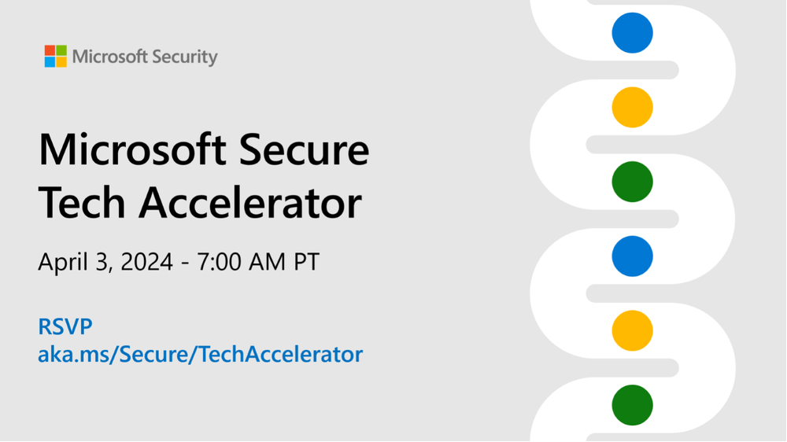
Start time | Session title
7:00 a.m. PT | Copilot for Security: Customize your Copilot (deep dive + AMA)
8:00 a.m. PT | Secure AI applications using Microsoft Defender for Cloud Apps (deep dive)
8:30 a.m. PT | Transform your defense: Microsoft Security Exposure Management (deep dive + AMA)

Slide 5
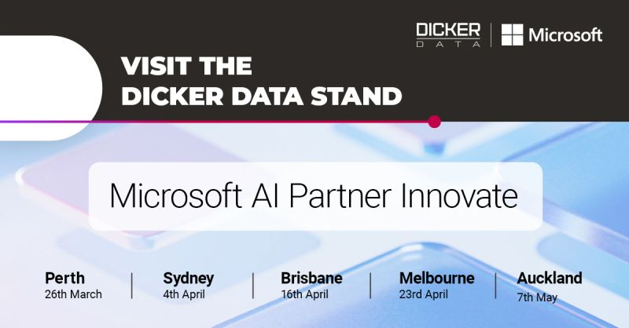
Sydney 4th April: https://lnkd.in/g8iVHvbQ Brisbane 16th April: https://lnkd.in/gP-muFHp Melbourne 23rd April: https://lnkd.in/gvfkx_Xc Auckland 7th May: https://lnkd.in/g3uPge_e
Rego code: DID124CRM
Agenda
08:00 AM - 09:00 AM
Registration & Networking Breakfast
09:00 AM - 10:15 AM
Opening Keynote - AI Vision
10:15 AM - 10:45 AM
Morning Tea
10:45 AM - 12:15 PM
Empowering Partners with AI
12:15 PM - 01:15 PM
Lunch
01:15 PM - 03:00 PM
Modern Work, Azure & Surface Go to Market and Sales Excellence with Microsoft
03:00 PM - 04:30 PM
Networking
Notes:
a day packed with real-world insights, best practices, and crucial information on how AI can help organizations drive innovation, efficiency and growth.
Don't miss this opportunity to connect with decision makers, industry peers and Microsoft Leaders to share insights and ideas on how to address the biggest challenges and create new opportunities in the era of AI.

Slide 6
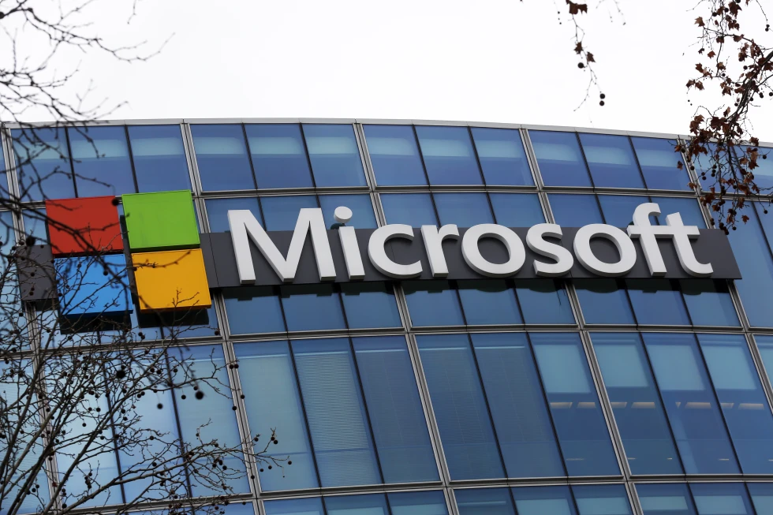
REDMOND, Wash. (AP) — Microsoft will stop packaging its Teams videoconferencing app with its Office software after the practice attracted antitrust scrutiny.
The tech giant said Monday that customers buying Office subscriptions starting this week won’t get Teams bundled with the service. Microsoft will start selling the two products separately around the world, following a move last year to separate the products in Europe.

Slide 7
Summary of changes:
New subscriptions without Teams with be available for the following licenses (they will be named the same but with ‘no teams’ at the end):
Microsoft 365 E3/E5, Office 365 E1/E3/E5
Microsoft 365 Business Premium, Business Standard, Business Basic
Microsoft 365 F1/F3, Office 365 F3
A new standalone Teams subscription will be introduced:
Microsoft Teams Enterprise
End for sale for net-new subscriptions for the following SKUs with Teams:
Office 365 E1/E3/E5
Microsoft 365 E3/E5
New versions of the SMB/Frontline subscriptions without Teams (the existing subscriptions with Teams will continue to be offered):
Microsoft 365 Business Basic/Standard/Premium
Microsoft 365 F1/F3
Office 365 F3
Announcement - https://learn.microsoft.com/en-us/partner-center/announcements/2024-april#important-notice-changes-to-microsoft-365-office-365-and-microsoft-teams-licensing-worldwide-expansion-of-approach-taken-in-the-european-economic-area-and-switzerland
Partner Resources - https://cloudpartners.transform.microsoft.com/partner-gtm/csp?tab=microsoft-365-teams-licensing (FAQs, email templates etc)
Licensing Blog - https://www.microsoft.com/en-us/licensing/news/Microsoft365-Teams-WW
Online Training Course (20mins) - https://cloudpartners.transform.microsoft.com/resources/m365-and-teams-worldwide-licensing-training

Slide 8
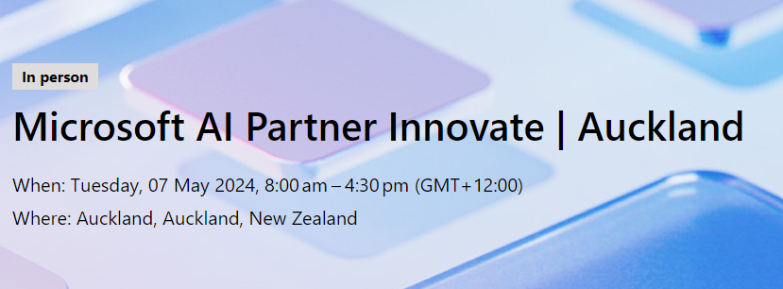
Agenda
08:00 AM - 09:00 AM
Registration & Networking Breakfast
09:00 AM - 10:15 AM
Opening Keynote - AI Vision
10:15 AM - 10:45 AM
Morning Tea
10:45 AM - 12:15 PM
Empowering Partners with AI
12:15 PM - 01:15 PM
Lunch
01:15 PM - 03:00 PM
Modern Work, Azure & Surface Go to Market and Sales Excellence with Microsoft
03:00 PM - 04:30 PM
Networking
Rego code: DID124CRM

Slide 9
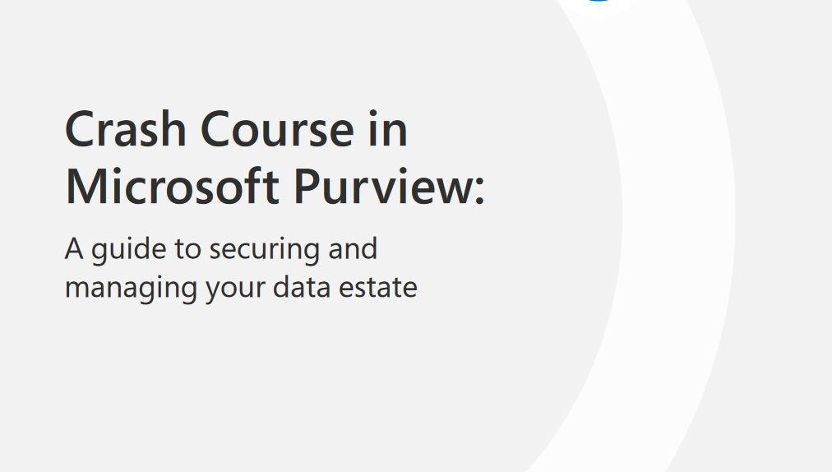
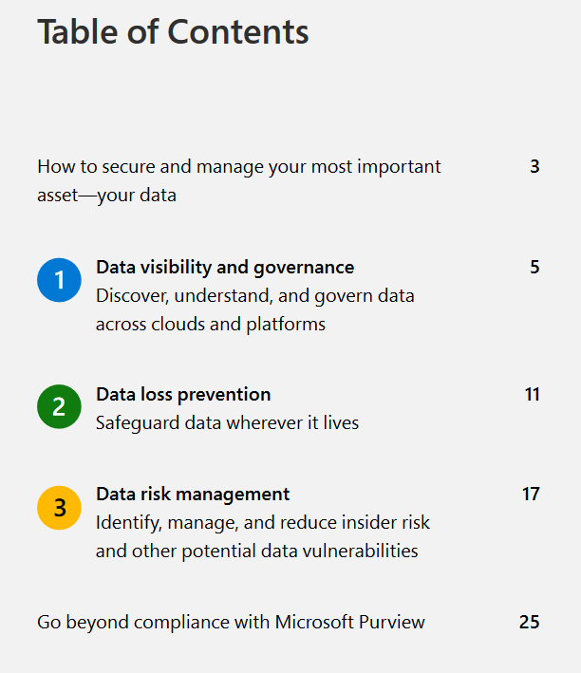
https://clouddamcdnprodep.azureedge.net/gdc/gdcieULMS/original
Notes:
Ebook download

Slide 10
TECH FOR SOCIAL IMPACT (NZ/AU)

Slide 11

Introduction
TSI PDM ANZ

Slide 12
Key takeaways
Microsoft Tech for Social Impact (TSI) introduction
Sector
Partner opportunity
Customer eligibility
Nonprofit hero offers from Microsoft
Security
AI
Azure
Demand Generation & Partner Co-marketing
Partner spotlight program
Notes:
Today, I will be going through variety of topics.
I will start of with introduction of Microsoft Tech for Social Impact or TSI.. Then I will cover few stats on nonprofit sector….total addressable market in Australia
I will go through some of the Free secrutiy offers that you can offer to your nonprofit customers. I will also share some of the AI uses cases that customers are thinking about………and provide early market insights….
For Azure, I will go through the workloads that are selling well……
Then I will dive into some of the TSI specific marketing programs and share what’s working

Slide 13
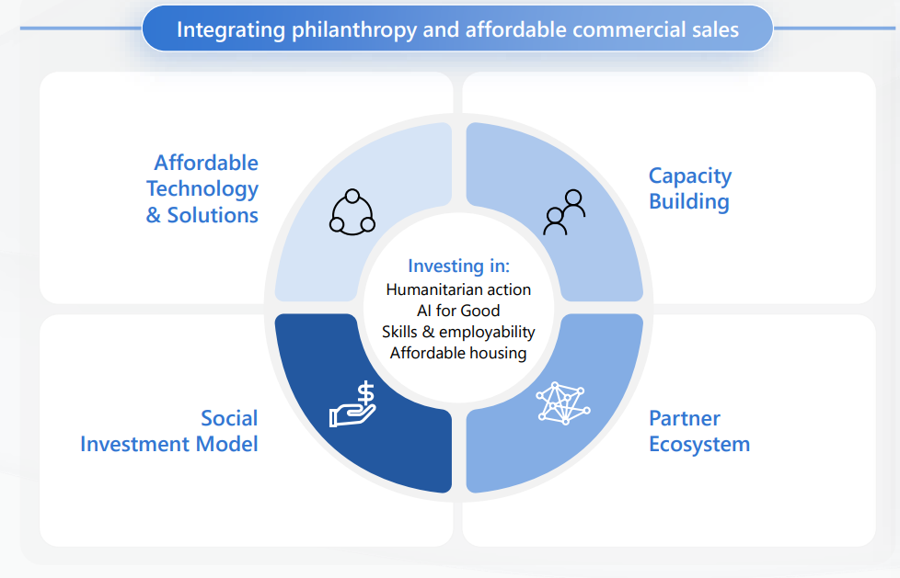
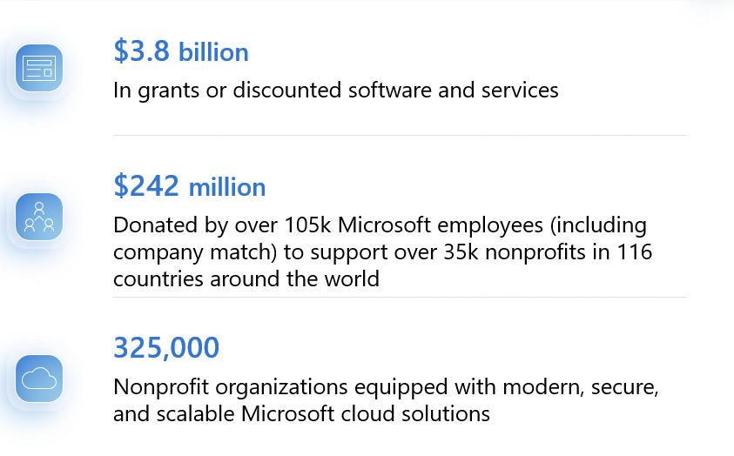
Microsoft Tech for Social Impact
In fiscal year 2023, Microsoft provided
Notes:
Microsoft Tech for Social Impact or TSI was formed in 2017.
They are part of Microsoft Phillanthropies and carry their own separate P&L. Their sole purpose is to support the nonprofit sector and the partner ecosystem around it. The TSI team continues to build a number of programs and offers especially for this sector..
For example, proving affordable solutions through nonprofit discounted offers Their business model is very unique. Essentially any profit they generate by selling licenses to larger nonprofits …….is reinvested back into the sector through grants, or discounted software and services. In FY23, Microsoft provided 3.8 billion dollars in grants and they are currently serving just over 325 thousand nonprofits worldwide. The TSI team are also investing in training and upskilling initiatives for the nonprofit sector. They are committed to bridge the technology gap. The nonprofit sector is the fastest growing sector for Microsoft ANZ…. NEXT

Slide 14
Microsoft Tech for Social Impact
Double the number of nonprofits we serve, making the Microsoft Cloud the most accessible, affordable and trusted cloud in the industry
Investing in partner initiatives
Dedicated TSI team
Notes:
And a big goal of Microsoft is to double the number of nonprofits they serve in the next 5 years. And To achieve this goal, Microsoft is investing in a number of Partner initiatives
I will showcase some of these programs in my next slides They have got a dedicated nonprofit focused team….

Slide 15
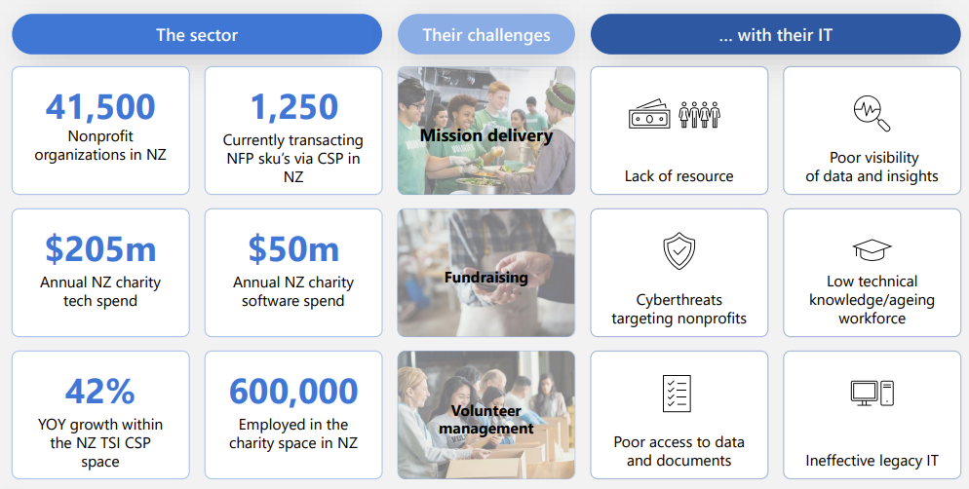
Sector - NZ
Notes:
Let’s look at the New Zealand nonprofit sector. So according to Microsoft there are just over 41 thousand eligible nonprofits orgnisations in New Zealand….. who are eligible today for Microsoft grants and discounted offer. However just over 1200 customers are currently transacting Nonprofit SKUs via CSP…. So there is a substantial number of customers that partners can serve. Microsoft is seeing a 42% Year over Year growth within the New Zealand TSI CSP business The annual New Zealand charity software spend is around 50m dollars…. So a decent size market that we can go after…..and serve…. As we know, It is a sector who really have to do…… More with less…..And often face variety of challenges from cybersecurity to legacy IT. And now by adding AI and Copilot in the mix…… the role of the partner is ever so important in elevating their data and security posture. So….Let me showcase some of the ways….. I am working with partners in reaching new customers and creating new conversations.
NEXT

Slide 16
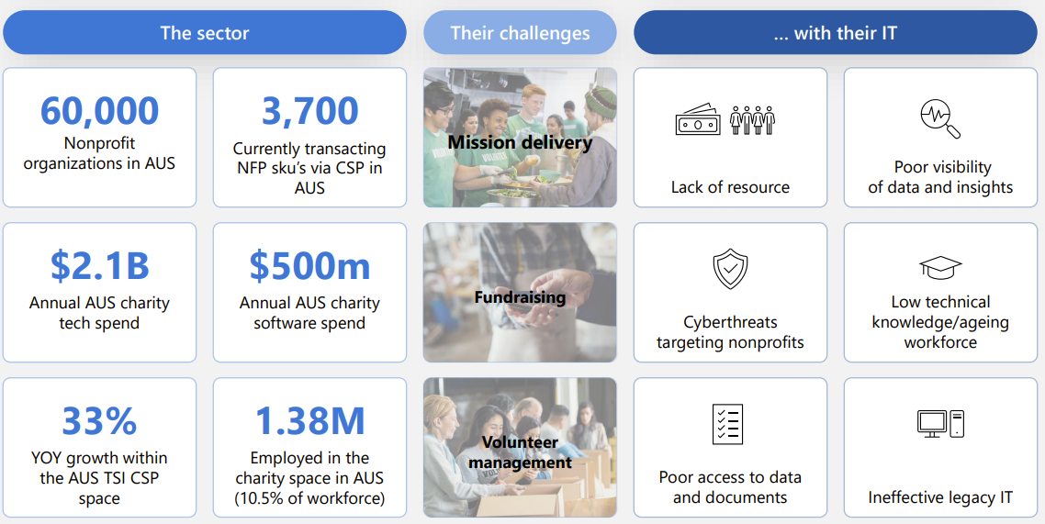
Sector - AU
Notes:
Let’s look at the Australia nonprofit sector. So according to Microsoft there are just over 60 thousand eligible nonprofits orgnisations in Australia who are eligible today for Microsoft grants and discounted offer. However just over 3700 customers are currently transacting Nonprofit SKUs via CSP…. So there is a substantial number of customers that partners can serve. Microsoft is seeing a 33% Year over Year growth within the Australian TSI CSP business The annual Australian charity software spend is around 500m dollars…….and the total tech spend is 2.1 billions dollars….. As we know, It is a sector who really have to do…… More with less…..And often face variety of challenges from cybersecurity to legacy IT. And now by adding AI and Copilot in the mix…… the role of the partner is ever so important in elevating their data and security posture. NEXT

Slide 17
Partner opportunity
Partner Services
Consulting
Migration, Deployment
Training and adoption
Managed Services
Societal Impact
Cross sector reference ability
Benefit community
Notes:
And…..There are number of benefits for partners… in serving this sector….. The obvious ones are Partner Services revenue……in Consulting, Migration, Training and Adoption, Managed Services…. However the big one….. is the societal impact…… and…..
This is a great opportunity to serve the community…… Supporting the nonprofit sector provides a good reference as well…..and you can highlight them when you are responding to tenders…..,
NEXT

Slide 18
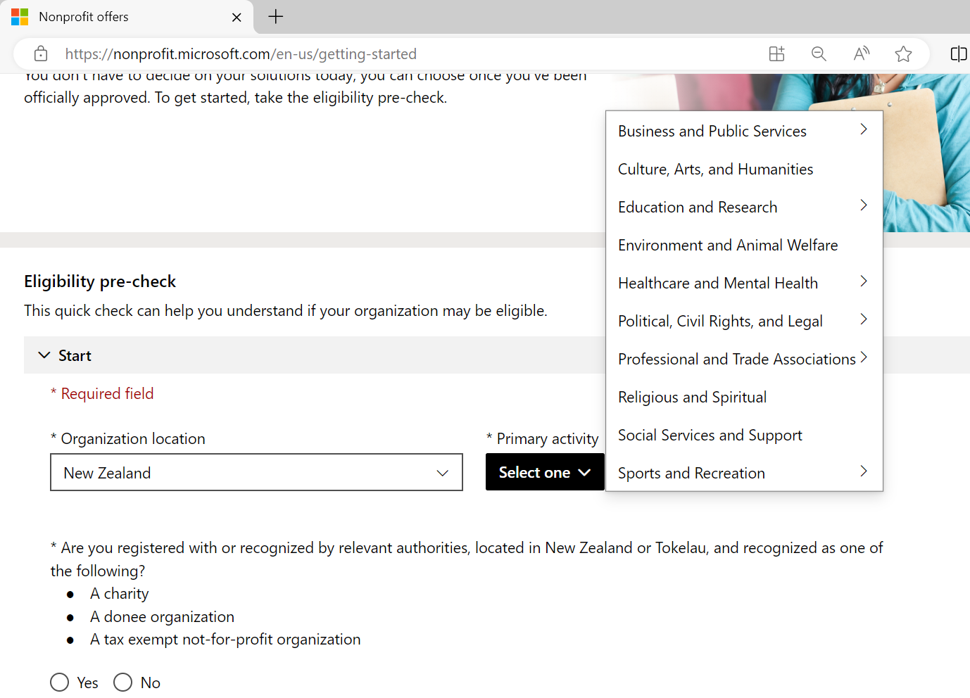
Customer eligibility pre-check
https://nonprofit.microsoft.com/en-us/getting-started
Notes:
But first, I want to quickly highlight the recently launched Customer eligibility pre-check page. I receive weekly requests on customer eligibility… so I thought I share the link that I personally use. Microsoft have made it much easier for customers and partners to get a pre-check done. If you are working with a new nonprofit customer, then I would highly recommend you to….take them through this process. Once you have done the pre-check, the customer will still need to submit their application. However, if you are stuck or if you have any questions, then please reach out to me anytime. We have got direct access to Microsoft TSI team… NEXT

Slide 19
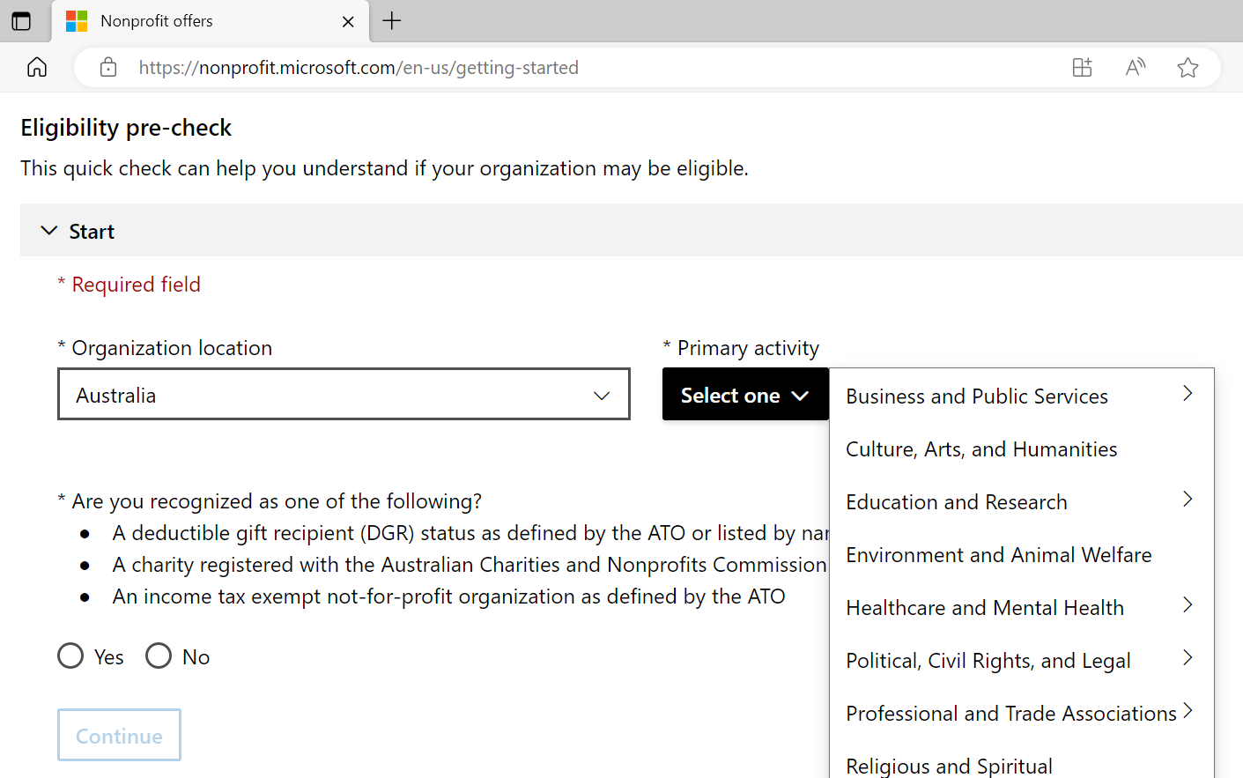
Customer eligibility pre-check
https://nonprofit.microsoft.com/en-us/getting-started
Notes:
But first, I want to quickly highlight the recently launched Customer eligibility pre-check page. I receive weekly requests on customer eligibility… so I thought I share the link that I personally use. Microsoft have made it much easier for customers and partners to get a pre-check done. If you are working with a new nonprofit customer, then I would highly recommend you to….take them through this process. Once you have done the pre-check, the customer will still need to submit their application. However, if you are stuck or if you have any questions, then please reach out to me anytime. We have got direct access to Microsoft TSI team… NEXT

Slide 20
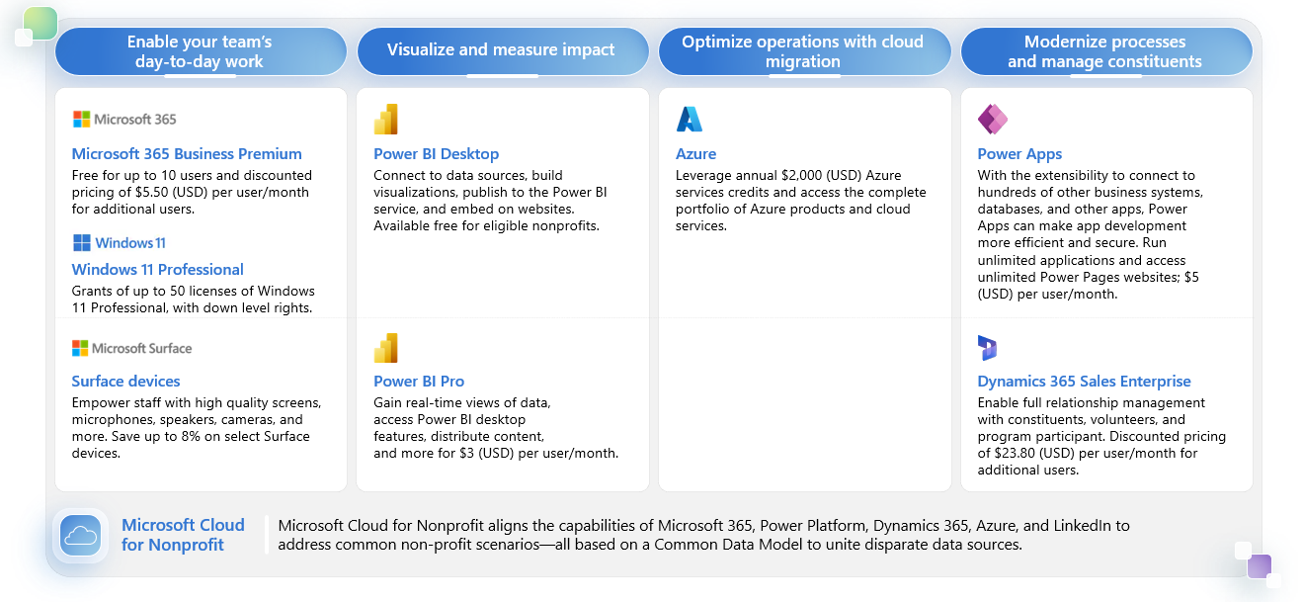
Nonprofit hero offers from Microsoft
https://aka.ms/MicrosoftNonprofitOffers
Notes:
I just wanted to add this slide here because…..often customers and partners are unsure of nonprofit discounts and offers
So….We have compiled all the hero offers into one slide… These are the most popular nonprofit offers….. that customers are taking advantage today.
I do want to address that the 2K USD Azure Grant is currently not available through CSP….it is for direct subscription only… However we do have another program called Azure Credit offer that partners are taking advantage of…. I will go through that offer in my Azure slides….
Aside from discounted offers and grants, there are number of other TSI specific programs that you can leverage. One such program is a Free Security assessment… NEXT

Slide 21
Security landscape for nonprofit sector
Nonprofit organizations are the second most common targets of nation-state actors detected by Microsoft. NGOs received 31 percent of all notifications in the past year*
Nonprofits’ access to sensitive vulnerable population data make them a Prime target as a perceived weak link
More than 70% of nonprofit organisations haven’t conducted a vulnerability assessment to understand risk exposure and 80% don’t have a cybersecurity strategy**
*Based on The Microsoft Digital Defense Report **Donorbox
Notes:
Security is a huge challenge for the nonprofit sector. They are the second most targeted sector after finance
They are often perceived as weak link…..and seen as prime targets due to the valuable data they capture… Their lack of resourcing, and cyber training…increases their risk factor. As more nonprofits adopt AI tools, they are also introducing new cyber complexities as well. Nonprofits often lack sufficient funding for robust cybersecurity measures and cyber security assessments. So, Microsoft TSI team have created…..a free cybersecurity assessment initiative for nonprofits….. NEXT

Slide 22
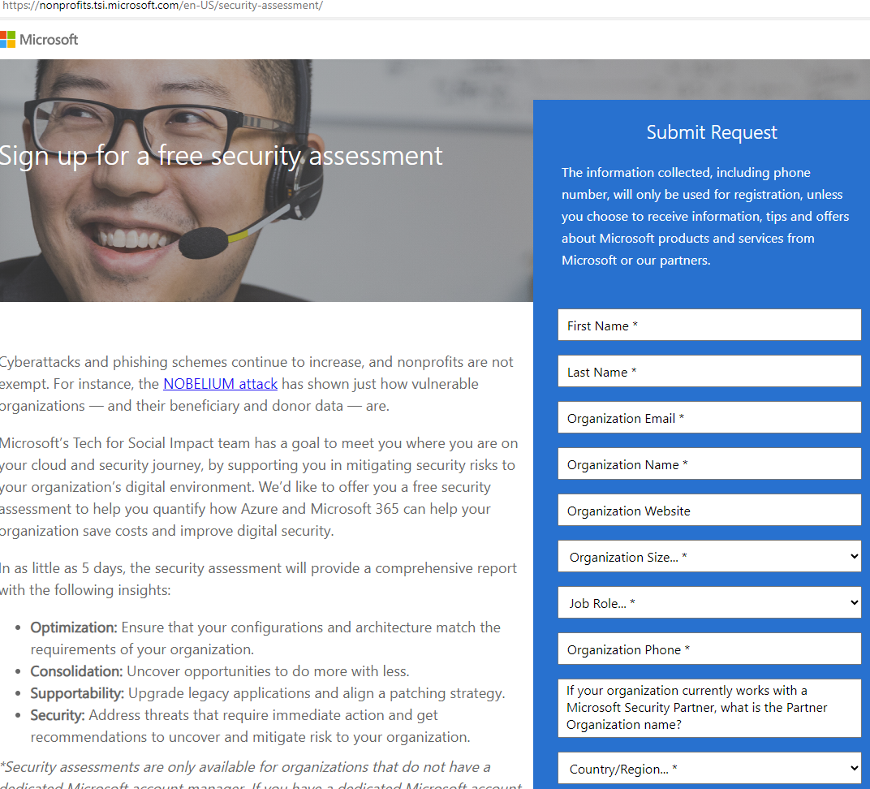
Security Assessment
Security Assessment
Free security assessments for nonprofit organisations
Evaluate your security risks and identify an action plan to better protect your organisation
Determine cloud optimisation opportunities
How to access: Sign-up for a free security assessment on our nonprofit website.
https://nonprofits.tsi.microsoft.com/en-US/security-assessment/
Notes:
It is a free Security Assessment…..just for nonprofits….. Most of you in the call would already have….. your own cyber security assessment programs in place. However this assessment is free …..and…. maybe you can potentially include it …..as part of your overall security assessment program. It’s a very easy process. Customers can simply go the link….. and fill out the form.
A key thing to remember here is…… to please ask customers to fill in…… your details in the partner section.. Once the form is submitted, a team from Block 64…..who do the assessment will reach out. NEXT

Slide 23
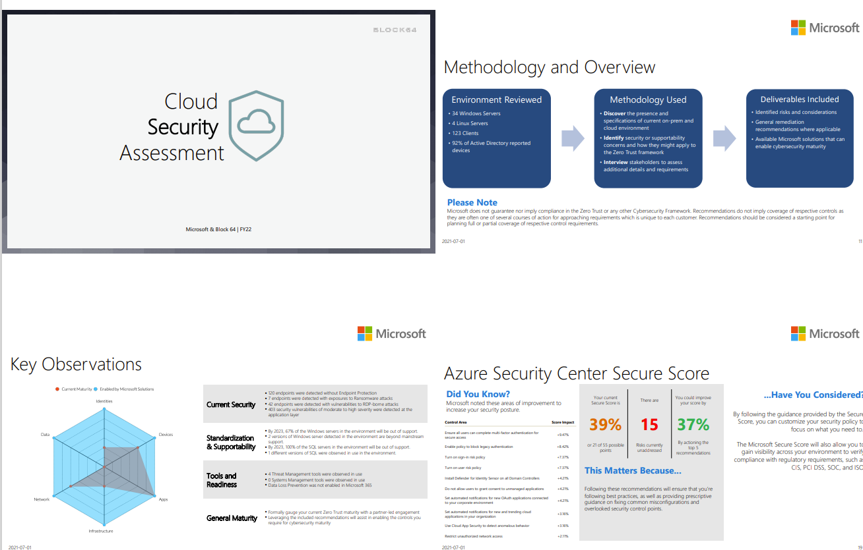
Security Assessment
Notes:
After the assessment, the customers will receive a comprehensive security assessment report. I am happy to share a sample report with you as well. Here are some of the screenshots from this sample report. As you can see it is very comprehensive report. NEXT

Slide 24
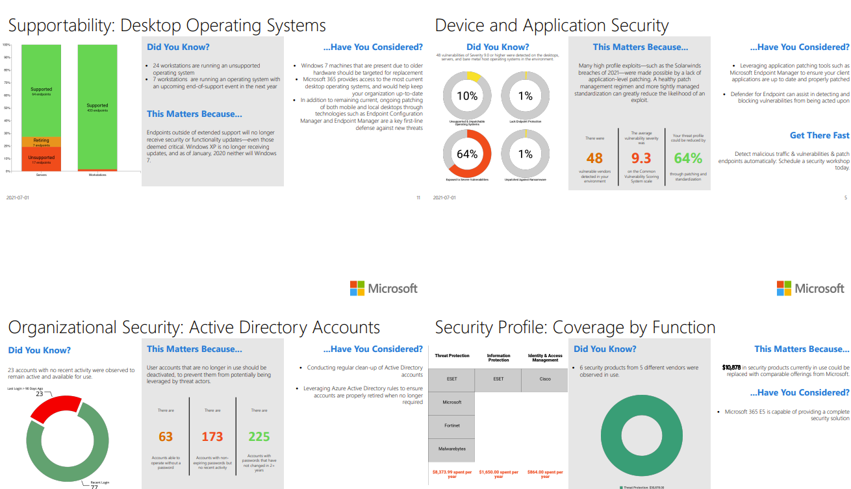
Security Assessment
Notes:
The report goes into plenty of details NEXT

Slide 25
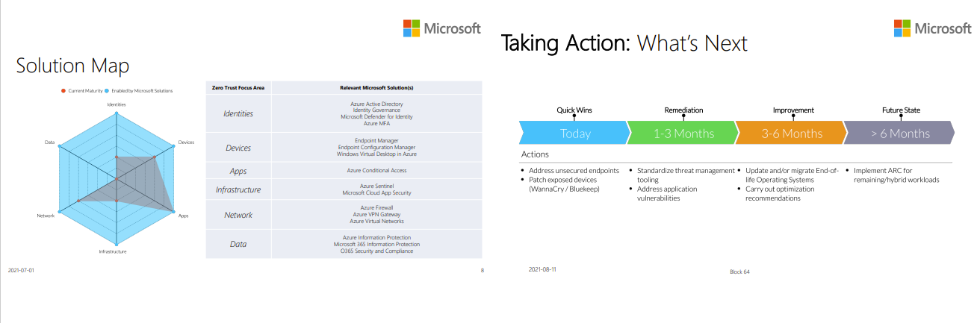
Security Assessment
Notes:
At the end of the report….. customers receive a number call to actions. This is a great list of actions that you can support your customers with. Again this is a free assessment for nonprofit customers. So, please take advantage of this offer.
NEXT

Slide 26
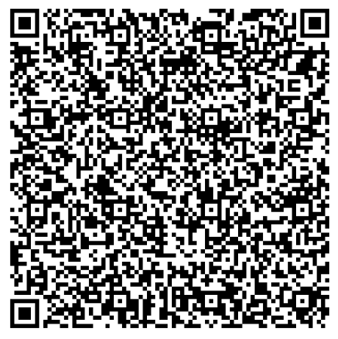
Security Assessment
9AM AEST​ Wed 17th Apr 2024​ | Security in the Nonprofit Sector – discover how partners can provide nonprofit organisations with modern work solutions. Learn more about Microsoft Security Program for Nonprofits.
Microsoft Nonprofit Community Calls (dickerdata.com.au)
Notes:
Just a quick reminder to the team…. Microsoft TSI team will be doing a 30 mins presentation on security in Nonprofit topic…… in our next TSI Community call. Please do sign up for this session by scanning the QR code.
My intent is to run these community calls monthly…. Where I will bring in a speaker from Microsoft who will share key updates…
NEXT

Slide 27
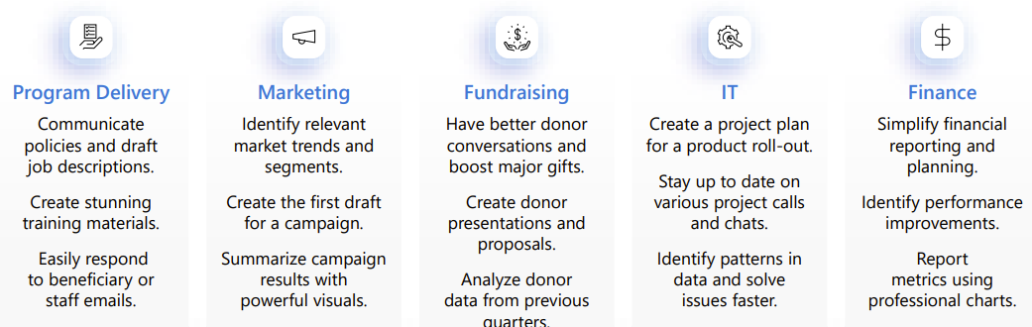
AI for Nonprofits – Potential Copilot use cases
Source: AI Nonprofits Research – Intentional Futures November 2023
Notes:
Another topic that is front and center of nonprofit customers is AI.
Nonprofits have to do more…. with less….. So, AI can play a huge role here… I know you have seen plenty of Copilot and AI slides….so I won’t go through each use cases in details… However here are some of the potential use cases that customers can think about……..when they are thinking about how to use copilot in their day to day functions.
Recently together with partners, we ran a number of customer events……. and in each event, the highlight was the Live Copilot demos. We showed Copilot scenarios in Outlook, Teams, Excel, Whiteboard…..
While showing the live demos ….a number of customers were already thinking about use cases. E.g. one of the program manager at the event was envisioning about adopting….. Copilot as part of her workflow related to the program delivery…
So…..Live Copilot demos for customers….are a big hit…. NEXT

Slide 28
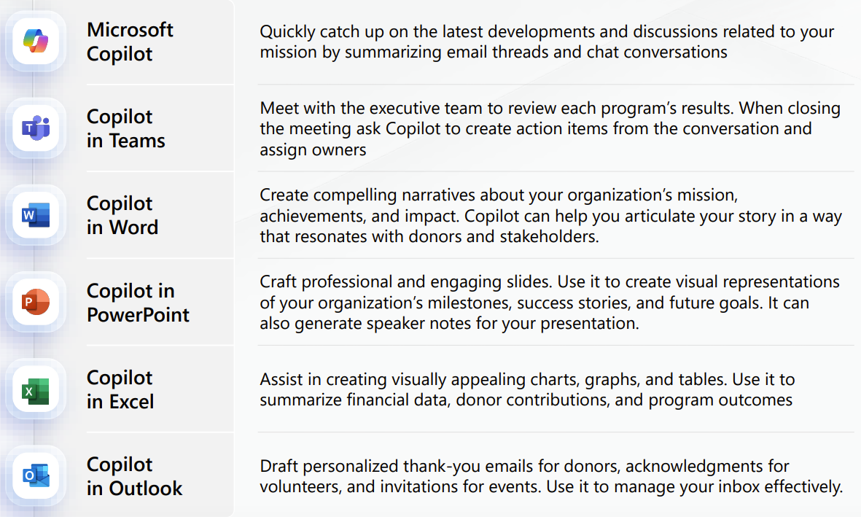
Prepare to create your annual report
Notes:
Going back to the use case…. Let’s say…. if we drill down into a specific use case… E.g. Most nonprofits have to prepare annual report for their board and stakeholders… Here is a simplified view on how different copilots can save time in preparing these annual reports. So again plenty to think about…
I would love to hear from you…. MS TSI team are always looking for partner feedback as well….
NEXT

Slide 29
Early insights
Most customers start off buying <10 seats
Average nonprofit adoption of Copilot for Microsoft 365 is 35% higher in CSP (compared with Direct) signaling that customers who choose a partner to work with are further along their AI adoption journey
Average of ~3 months for customers to realise the value of Copilot and to expand beyond an initial pilot
The Copilot Workshop is proving to be a highly effective tool to get business stakeholders involved
Notes:
Here are some early insights that Microsoft team have shared with us recently According to Microsoft TSI team, the average copilot seat size is less than 10 seats.. So a number of customers are experimenting with few use cases….. And…..trying to work out…. how they can adopt Copilot into their workflow. It is taking an average of ~3 months for customers…… to realise the value of Copilot…..
If you are able to do run…..Copilot focused events and do demos… then its’s worth considering……. as it is generating a lot of interest. And more often it’s also leading to data and security conversations for partners… NEXT

Slide 30
Azure for Nonprofits
ANZ Azure State of the Business
Azure YoY 38% compared WW at 22% YoY
Nonprofit is growing faster than our worldwide commercial business
50% split CSP and PayG ACR
3x more ACR when ANZ customers are purchasing through a CSP vs PayG
Org Size: 100-299 makes up almost 50% of the total CSP ACR
Notes:
Moving on to Azure…. Azure is one of the fastest growing category in nonprofits for Microsoft TSI team. In our recent Community call…..The Microsoft Azure lead shared a number of useful stats….
As you can see Azure is growing at 38% year over year in ANZ… It is a 50-50 split between CSP and direct Pay as you go…… in terms of the Azure consumed revenue The Azure consumption is 3 times more……… when customers are purchasing through a CSP The organisation size of 100-299 seats makes up…….almost 50% of the total CSP Azure consumption. NEXT

Slide 31
Azure for Nonprofits
ANZ Azure ACR Penetration and Top Workloads
 | ACR Penetration CSP vs PayG | Top Workloads
Infra | 98% vs 96% | Premium SSD Managed Disks Backup Blob Storage
Data and AI | 60% vs 47% | SQL Database Single Standard Azure Database for MySQL
Security | 61% vs 42% | Defender for Servers Defender for SQL Defender for Storage
Notes:
Here are some of the Top workloads for Infra, Data and AI and Security I highly encourage our partners to connect with Dicker Data Azure team. They can guide you and can go through each of these workloads,…..potential use cases……
We can take you through…..our Azure specific offers and programs. NEXT

Slide 32
TSI Azure Credit Offer program
For qualified opportunities (minimum $5,000 USD of incremental Annual ACR (Azure consumption revenue)), customers can earn 10% in Azure credits. This credit is applied in the 1st month of the ACO approval. For example, with a $5,000 USD incremental ACR, customer can receive $500 USD in Azure credits. ​
Key Benefits of Azure Credit Offer (ACO):​
Mitigate Dual-Costs: Alleviate concerns about dual-costs during migration projects, making Azure adoption smoother.​
Boost Cloud Adoption: Accelerate cloud adoption for nonprofit organisations and help them make a more significant impact.​
Competitive Edge: Stand out against other cloud providers with this compelling offer.​
Funding for POC/Test: Provide funding for a production POC/Test for a new Azure workload the customer is considering for implementation
Notes:
One such program that our partners are using today…. is the Azure Credit offer. So, If you are working on a new Azure opportunity, where you can potentially generate over 5K USD worth of incremental Azure consumption per annum,
then customers can get 10% in Azure credit. The credit is applied on the first month of the billing as well. I can guide you through the process as well. NEXT

Slide 33
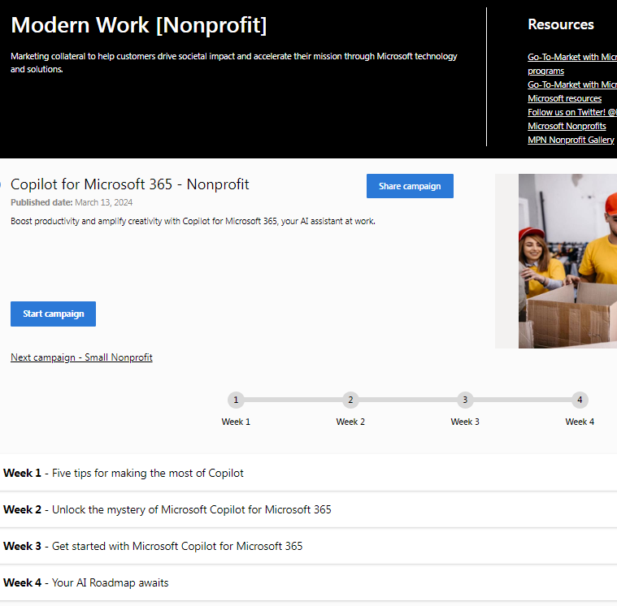
Digital Marketing Content (DMC) on demand
Turnkey, nonprofit specific go-to-market campaigns available at no cost to partners
Content provided by week for partners to build and optimise their digital marketing strategy, drive customer engagement, and capture and close leads.
Try the new Copilot for Microsoft 365
nonprofit campaign today!
https://dmc.partner.microsoft.com/product-areas/9/campaigns/656
Link: https://dmc.partner.microsoft.com/product-areas/9/campaigns/656
Notes:
OK let me shift gears now and cover marketing… Marketing is something that most partners are looking to do more of …..this year… The first initiative that I would like you to consider is your content strategy via Microsoft Digital Marketing Content on demand. There are several pre-built nonprofit specific campaigns………… available to partners at no cost.
It is very easy to activate a campaign at DMC and your get content weekly.
Content strategy is very important to boost your brand….. and lead nurturing. There is a recently launched Copilot for M365 nonprofit campaign….available now as well. NEXT

Slide 34
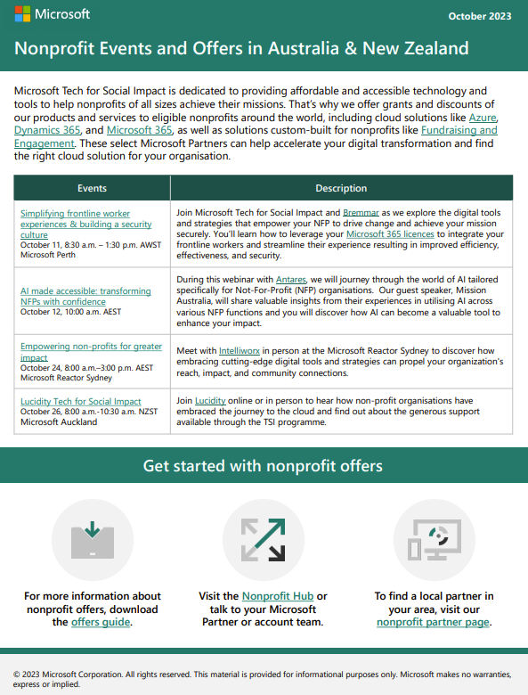
Partner Co-marketing - Events
Microsoft branded email sent from Microsoft Tech for Social Impact promoting partner activities, including webinars, roundtables, case studies, and campaigns
Microsoft communication goes out each month
Notes:
Events are another great way to generate new leads and capture new audience. Microsoft TSI team send a monthly newsletter that goes out to their ANZ customer database. We currently use it to promote partner events and webinar. It is a good way to also capture new contacts as well……because the registration page will be hosted by yourself I also have some TSI specific co-marketing funding available…..that we can support partners with. E.g. I can help with catering for an event, maybe Telemarketing, I can also help with organising a Microsoft speaker for your event. I would love to setup a 30 mins call with you……and go through your nonprofit marketing initiatives. NEXT

Slide 35
Partner Co-marketing – Learnings and recommendations
Short, straightforward event titles that demonstrate exactly what the customer will get drive strongest response. e.g., “Microsoft Copilot: Are You Ready? “Live Demo,” “Power BI for Nonprofits,”
Inclusion of “Nonprofit” in title
Top performing event topics: Copilot, AI, Security
Effective Activities: Live Demos, Customer Roundtables – Think how do I educate?
Single primary call to action w/secondary CTAs to learn, try, buy
Co-branding with Microsoft and Partner logo creates credibility
Use “Tech for Social Impact” or product names in headlines and copy only.
Notes:
And here are some of the learnings and recommendations on what is working We are seeing that short, straightforward event titles are generating strongest responses.
E.g. Live Demo ……………Microsoft Copilot:”Are you ready? ……“, “Power BI for Nonprofits” If you are running a nonprofit focused event…. then please do include “Nonprofit” in the event title Copilot, AI, and Security are the top performing event topics….. And Having a single primary call to action….. with secondary call to actions work really well. Also….running a joint event with Microsoft is a………..great way to promote your brand NEXT

Slide 36
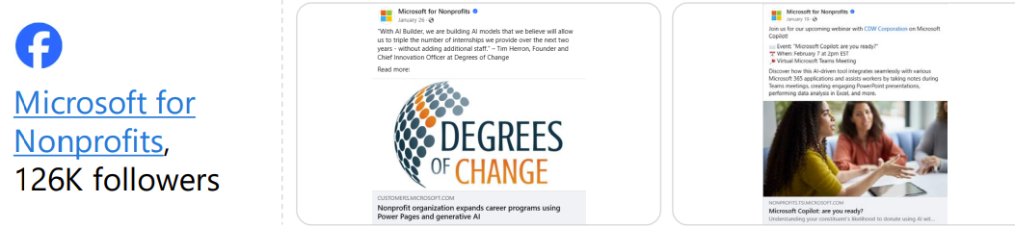
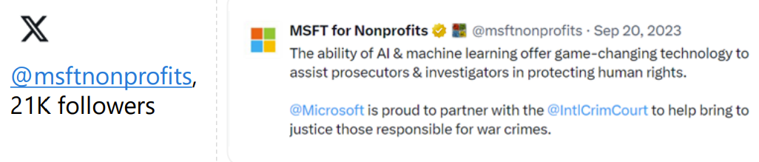
Partner Co-marketing - Amplification
Amplify partner events and customer stories through Microsoft for Nonprofits on Facebook and X.
Notes:
Microsoft TSI have recently advised that they can also promote joint events through their Facebook and X pages as well. NEXT

Slide 37
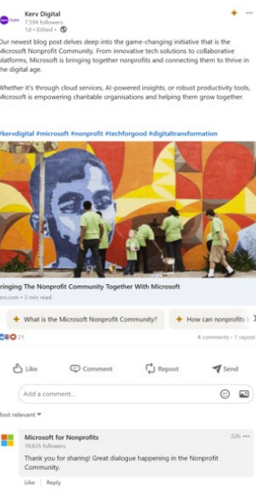
Partner Co-marketing - Engagement
Tag Microsoft for Nonprofits in your LinkedIn posts and Microsoft for Nonprofits may like or comment, helping to amplify your message
LinkedIn is https://www.linkedin.com/showcase/microsoft-for-nonprofits/
Notes:
If you are running an nonprofit Microsoft focused event or sharing a nonprofit customer success story,
then please do tag Microsoft for Nonprofits linkedin page for amplifying your message. NEXT

Slide 38
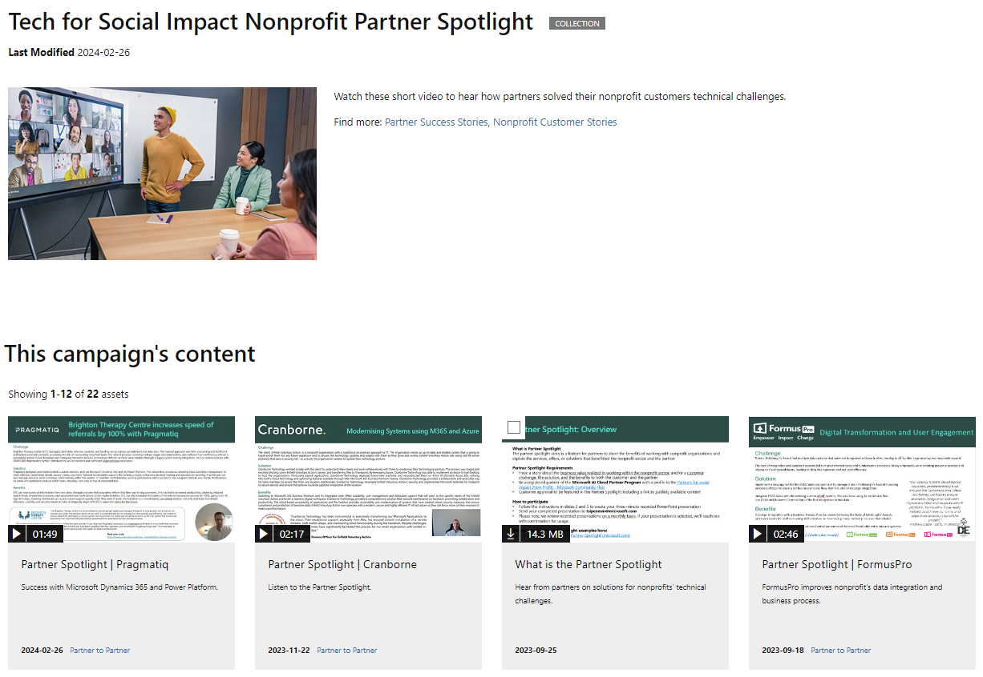
Partner Spotlight
The partner spotlight story is a feature for partners to share the benefits of working with nonprofit organisations and explain the services, offers, or solutions that benefitted the nonprofit sector and the partner.
Notes:
Last one….Microsoft are very keen to showcase your customer story at Microsoft TSI Partner page. Again a great way to promote your offering within the Microsoft partner ecosystem……and also to the Microsoft team.
NEXT

Slide 39
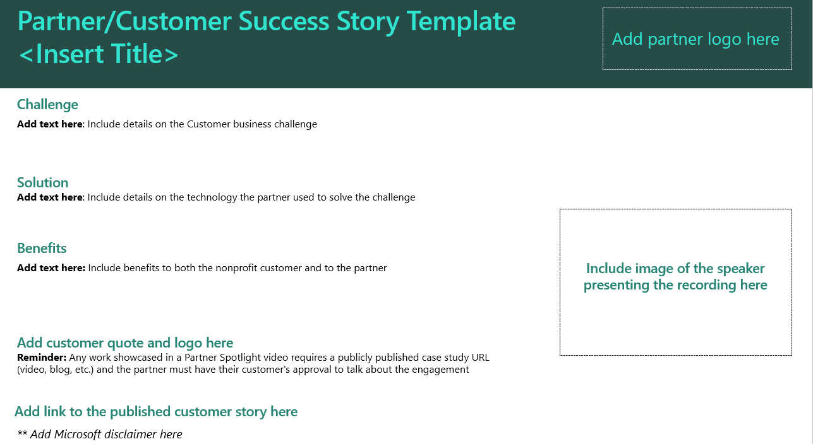
Partner Spotlight
Notes:
It is a simple template….. and we can get your story… published within 2 weeks…. So team, I shared a fair bit of information with you today.
As next steps, I would love to sit down and discuss your nonprofit sector strategy. Hope you find the content useful today. Thank you.

Slide 40
Dicker Data Webinar Thank you
Next Week Paul on Email Security
Notes:
Thank you for your attendance and if you have any questions we will stop recording. Feel free to ask in the chat window.
HOW CAN WE HELP?

