Slide 1
Dicker Data Webinar E:26 SharePoint Advanced Management
Notes:
Thank you for joining will start shortly
MAKE SURE RECORDING IS ON

Slide 2

Agenda
1
News
2
Main Topic: SharePoint Advanced Management
3
Close
5
Code of Conduct
Notes:
For those of you new to Powerpoint live. A quick familiarisation, We welcome your reactions using the emotion icon at the top right of your screens. Please ask questions in the chat window during the call. We will invite you to come off mute at the end of the call if you would prefer to ask your question out loud. During the call, please ensure you are on mute, and your video is turned off.
All links to sites are available by clicking on the link in the slide or will be posted to the chat window. We recommend you click on all relevant links and then review post call.
Calls will be recorded and made available post call, The teams generated recording will not be available external so don’t panic we will make the recording available to you later .
Participation in these calls means that you agree to Microsofts terms and conditions for digital meetings a link is available on this slide should you wish to review these. or to test the live link feature
Introduce speakers Role and location

Slide 3



News
What you need to know
Notes:
But First The News. This is the section which is a concise update of relevant information, or opportunities compiled by Dickers subject matter experts. Who attend those early morning calls, wade through endless emails, yammer messages etc so you don’t have to

Slide 4

NZ
AU

Slide 5
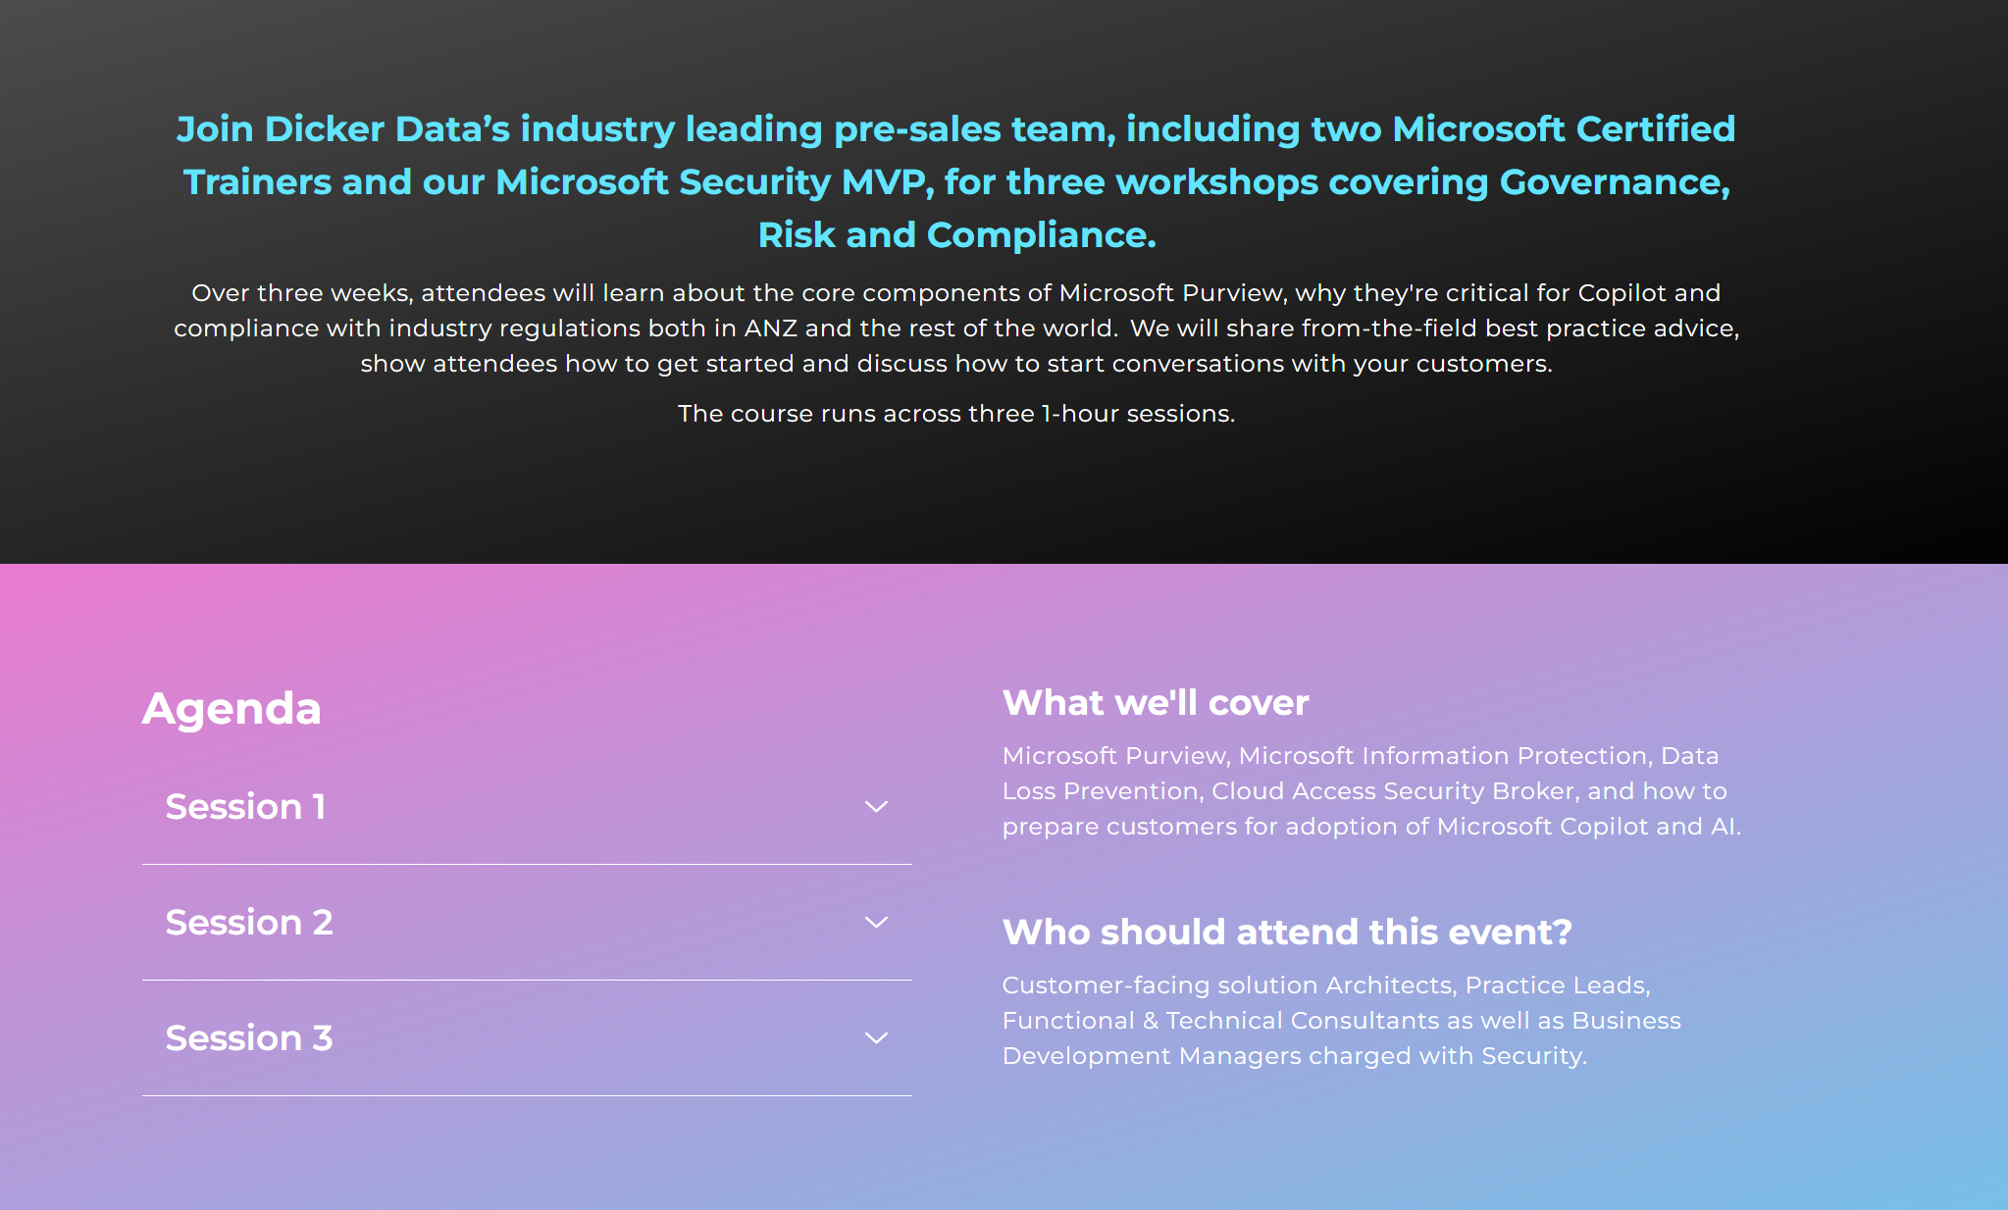
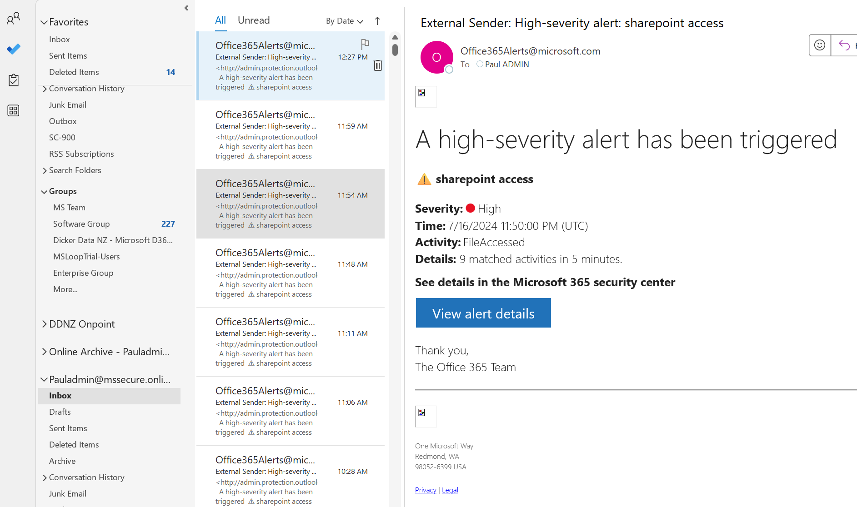
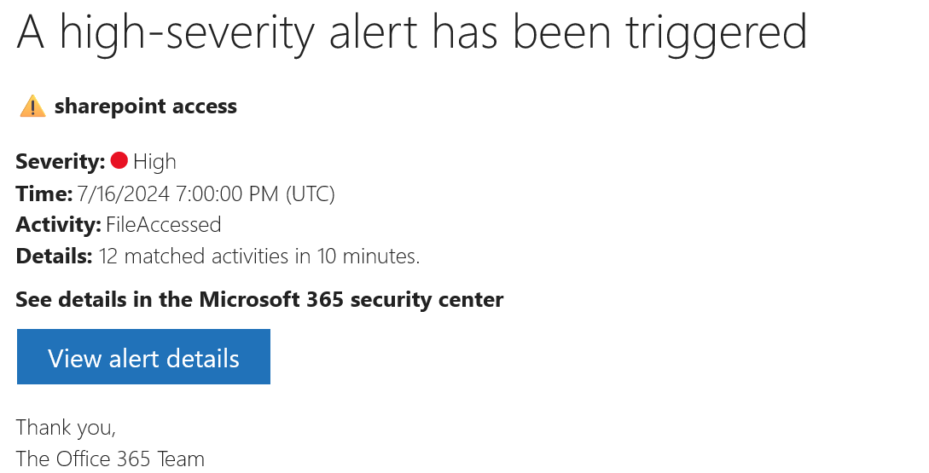
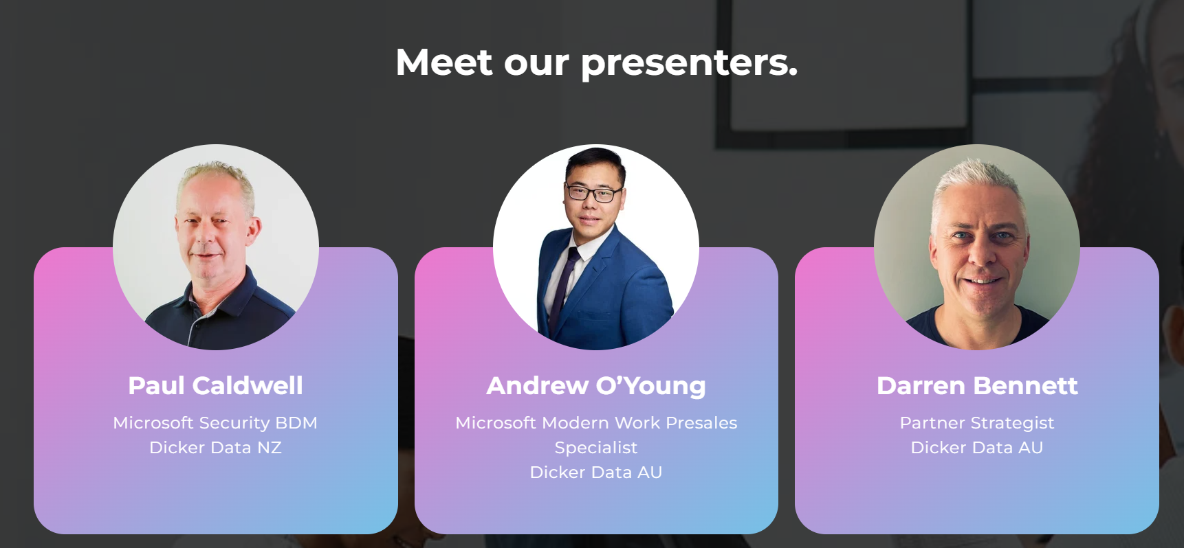
New Zealand
AU
Notes:
EDM coming soon aulink THURSDAY 4TH July
11th 18th

Slide 6

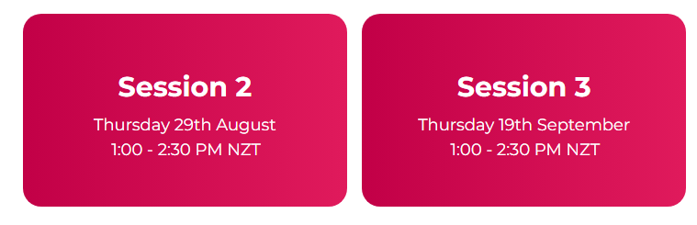
Copilot Webinars
Our next Copilot webinars is on 29th August at 1pm NZT/ 11am AEST.
Agenda:
Copilot early insights
Overview of Copilot’s
Security foundations of Copilot
Live demo
Readiness & Adoption
Register here:
NZ: Microsoft Copilot Ready (dickerdata.co.nz)
AU: https://www.dickerdata.com.au/microsoft/copilot-demo-webinar-registration

Slide 7

NZ
AU
Notes:
3 x Sessions of our new Security & AI Series : Voyager
This is a technical series aimed at engineers, analysts & architects.
These sessions are designed to provide you with a foundational understanding of key security concepts and serve as a pre-requisite for our more in-depth future events.
Kicking off tomorrow 1st of August at 1pm NZT or 11am AEST
Session 1: Microsoft Security & AI Concepts
Session 2: Foundations of Microsoft AI (15th August)
Session 3: Deep Dive into Security in Azure (29th August)
Further sessions in September, including the Cloud Workload Protection Platform
& Microsoft Defender Cloud Security Posture Management
Saeed, Mikki & Daniel

Slide 8
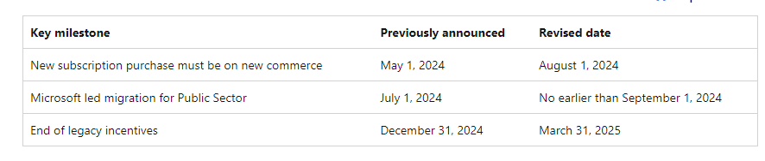
NCE for Public Sector Customers
August 1, 2024, new subscription purchases for Public Sector product offers must be on new commerce
Microsoft-led migration effort will now begin with Public Sector offers renewing no earlier than September 1, 2024, and will continue with all offers renewing throughout calendar years 2024 and 2025. We encourage partners to prioritise migrating their customers from legacy to new commerce

Slide 9
FY25 H1 Windows 365 Promos
On August 1st, 2024, Microsoft announced a special promotional offer focused on Windows 365 Business, Enterprise, Frontline for new Windows 365 customers.
Microsoft is providing a 15% discount off the Partner Net Price for Windows 365 Business, Enterprise, and Frontline Monthly and Annual subscription for all performance SKUs eligible for transactions during the promotional period.
The promotion applies to Windows 365 Monthly & Annual commitment subscriptions.
This promotion is only for new-to-SKU Windows 365 customers only. If the specific SKU of Windows 365 was ever provisioned in the customer tenant, then they would not qualify for this promo (including trials).
This promotion is valid for eligible customer transactions between August 1, 2024, through February 1, 2025, on monthly and annual subscriptions.
Promotions will automatically apply when purchasing Windows 365 for an eligible customer.
Check out the FAQ for more details - https://aka.ms/W365CSPPromoFAQ

Slide 10
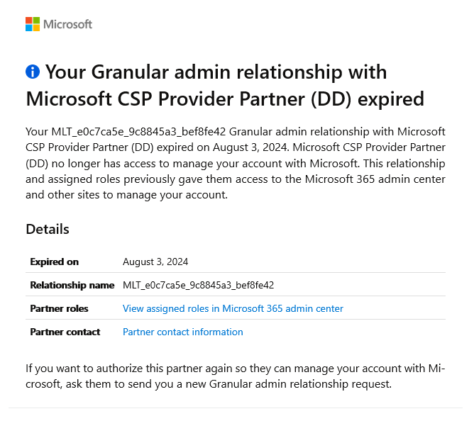
GDAP🙃
Microsoft transitioning from DAP to GDAP, Microsoft-led GDAP permissions were created last year by Microsoft, with a majority of them expiring August 2-3. The permissions which were set up as part of this migration start with MLT_ in their name (Microsoft Led Transition).
As stated in the email that you have received from Microsoft, this is a relationship between Dicker Data and the Customer.
Dicker Data requires these GDAP permissions to be able to raise tickets to Microsoft on yours’ and your customer’s behalf.
GDAP relationships do not impact licensing.
Notes:
You may have received emails from Microsoft in relation to expiring/expired Microsoft-led GDAP permissions.
With Microsoft transitioning from DAP to GDAP, Microsoft-led GDAP permissions were created last year by Microsoft, with a majority of them expiring August 2-3. The permissions which were set up as part of this migration start with MLT_ in their name (Microsoft Led Transition).
As stated in the email that you have received from Microsoft, this is a relationship between Dicker Data and the Customer.
Dicker Data requires these GDAP permissions to be able to raise tickets to Microsoft on yours’ and your customer’s behalf.
You do not have to create a new Admin Relationship for this customer if you do not want to at this time. This would only be required if you need Dicker Data to raise a ticket to Microsoft for an issue on your behalf.
However, there can be a downside to not having an active GDAP role assigned to Dicker Data. If there is no GDAP Admin Relationship existing between Dicker Data and the customer, and all GAs were to lose access to the tenancy, there would be no way to generate a request and accept it. This means we would not be able to raise a ticket to get it unlocked.
Dicker Data only requires the most basic access of Support Analyst to be able to help the customer, and it would be best practice to have an active GDAP role assigned. You can choose the length of time of the relationship from 7-days up to 180-days. By selecting 180-days, you would only need to create a new GDAP role every 6 months.
It is up to you whether you wish to have an active GDAP Admin Relationship or create one when required.
Please read the partner announcements – these are really important - Partner Center announcements - Partner Center announcements | Microsoft Learn

Slide 11
GDAP – How to Add
Please log into the Dicker Data Portal, access the tenancy, click on Tenant Management.
Select the admin relationship and days required, then click on Create.
After clicking on Create, this will then create a link that needs to be sent to the GA for the tenancy to accept (it is best to open this in an incognito window).
Once accepted, it will show under Tenant Management.
Click here for full instructions.
For more information please access GDAP FAQ

Slide 12
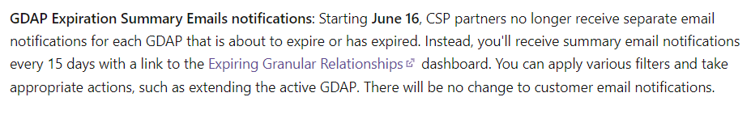
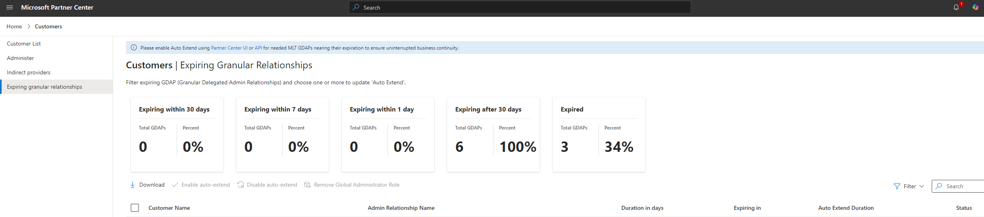
View Expiring Relationships
Partners can see details of their expired relationships in the Admin relationships section within Partner Center
Admin agent role required
Announcement - https://learn.microsoft.com/en-gb/partner-center/announcements/2024-july#available-now

Slide 13
FY25 MAICPP Benefits
Microsoft have launched three new benefit packages - Partner Launch Benefits, Partner Success Core Benefits, and Partner Success Expanded Benefits
20 in-demand product licenses added to our benefits packages – including Microsoft Copilot products, Microsoft Defender for Endpoint, and Microsoft GitHub
Microsoft will no longer sell Microsoft Action Pack, Microsoft Learning Action Pack, or legacy silver/gold benefits starting January 22, 2025.
Partners who purchase or renew these legacy benefits packages before January 22, 2025, will be able to use their benefits for 12 months from their purchase/renewal date. Those with an eligible active legacy silver/gold purchase status as of January 21, 2025, will be eligible for the remainder of the FY25 CSP incentive term (January 22, 2025, to September 30, 2025).

Slide 14
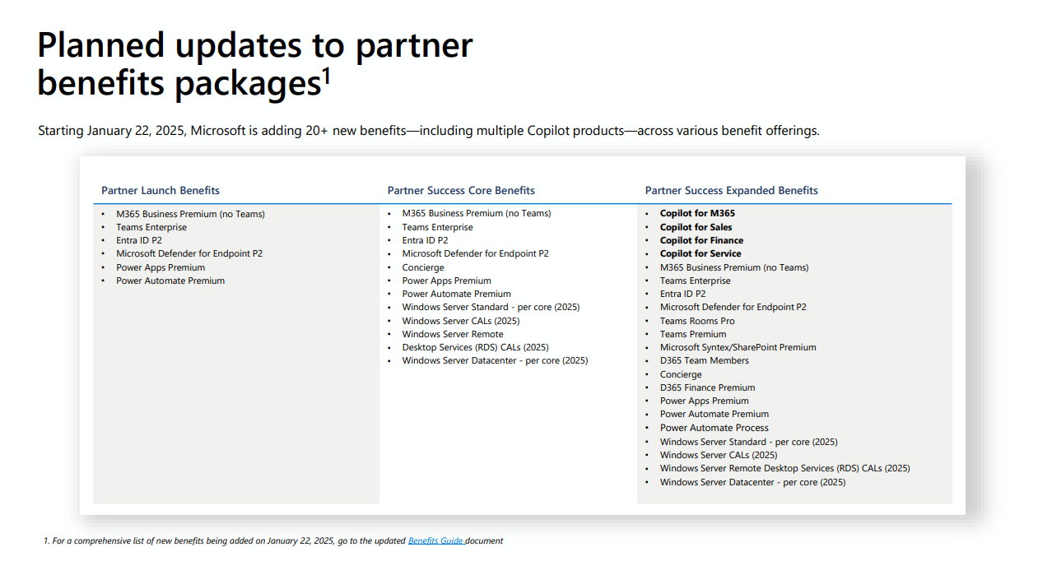

Slide 15
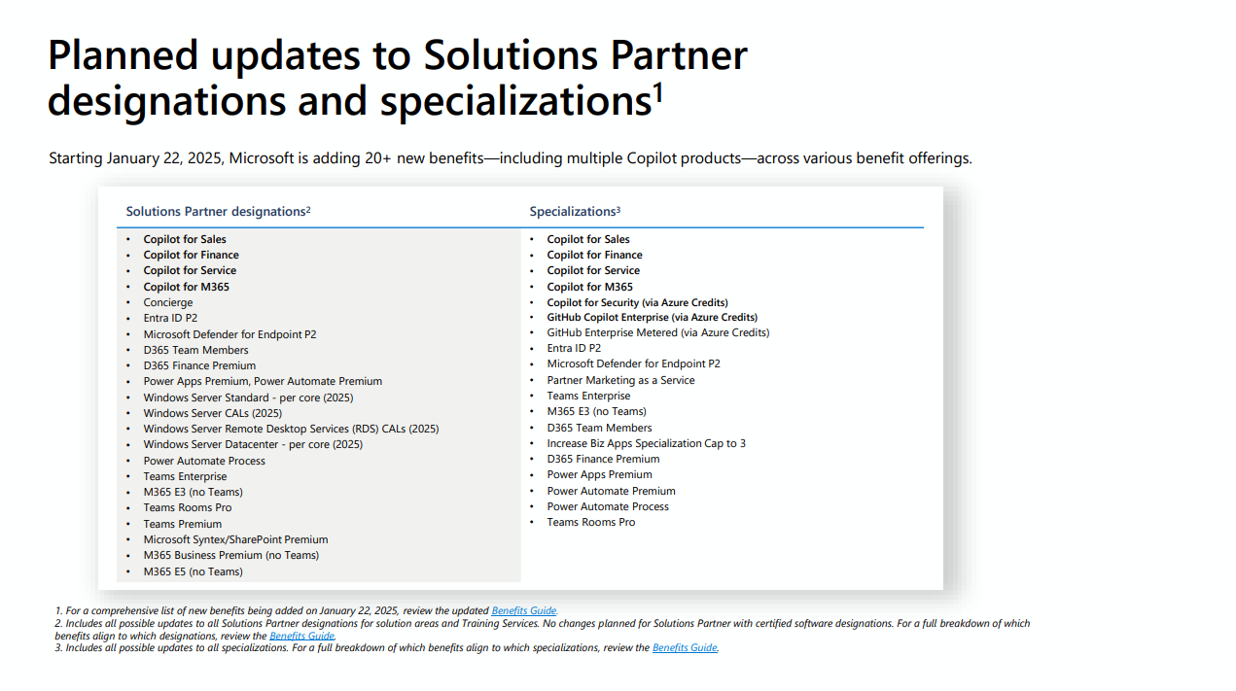
Notes:
Modern Work SPD – 5 copilot for m365 licenses! (2025) & 10 teams premiums!

Slide 16
Resources
Benefits offerings transition walking deck
Microsoft AI Cloud Partner Program Benefits guide
Compare offerings
FAQ
Announcement blog

Slide 17
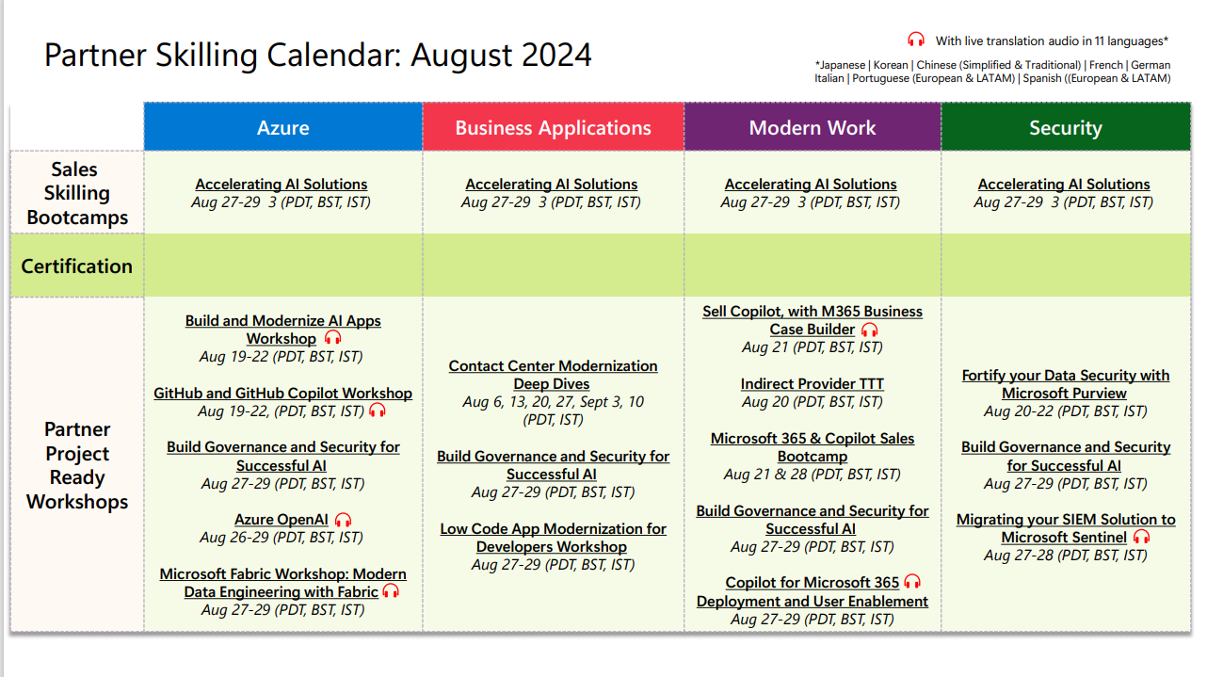

Slide 18
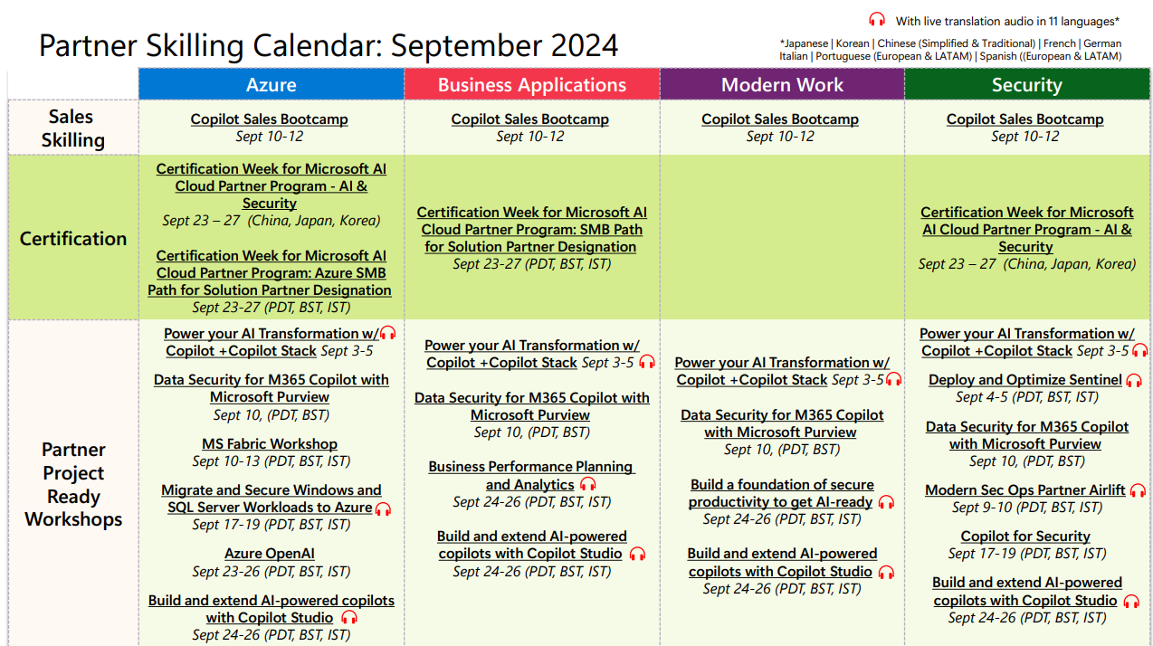

Slide 19

SharePoint Advanced Management
Lauren Nobbs

Slide 20
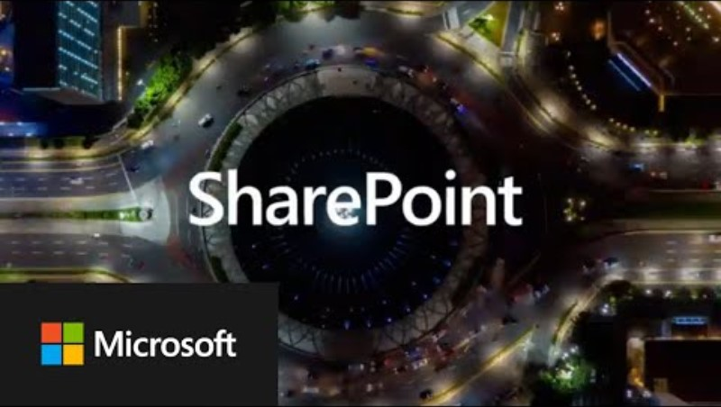
video

Slide 21

What is SAM?
SharePoint Advanced Management (SAM) is an add-on for Microsoft 365 that provides advanced security and content management capabilities for SharePoint and OneDrive.
Advanced Security and Content Management: Focuses on advanced security policies and content management capabilities
Access Policies: Allows for more stringent access controls and conditional access policies for SharePoint sites and OneDrive
Lifecycle Management: Offers advanced lifecycle management for sites and content

Slide 22
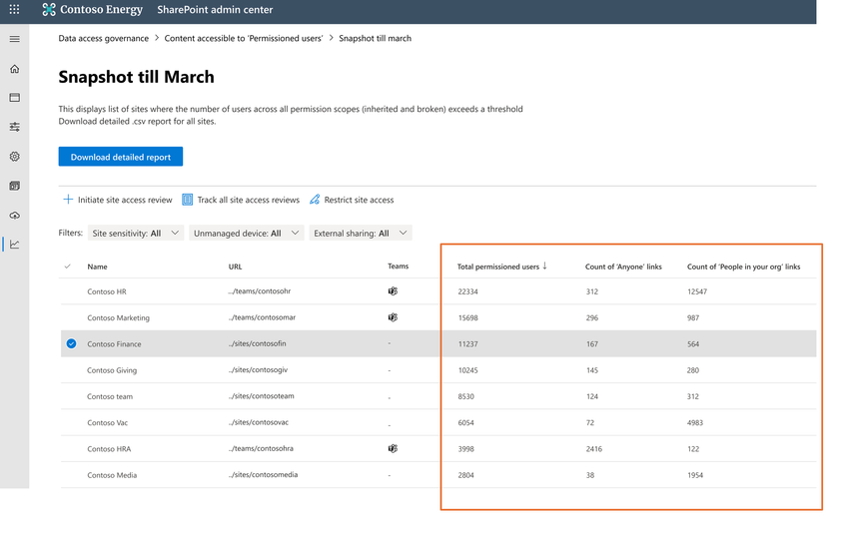
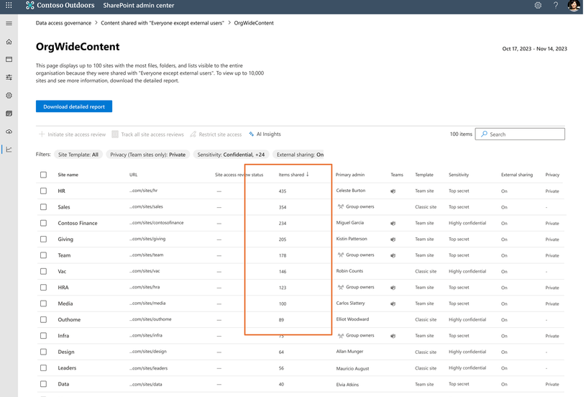
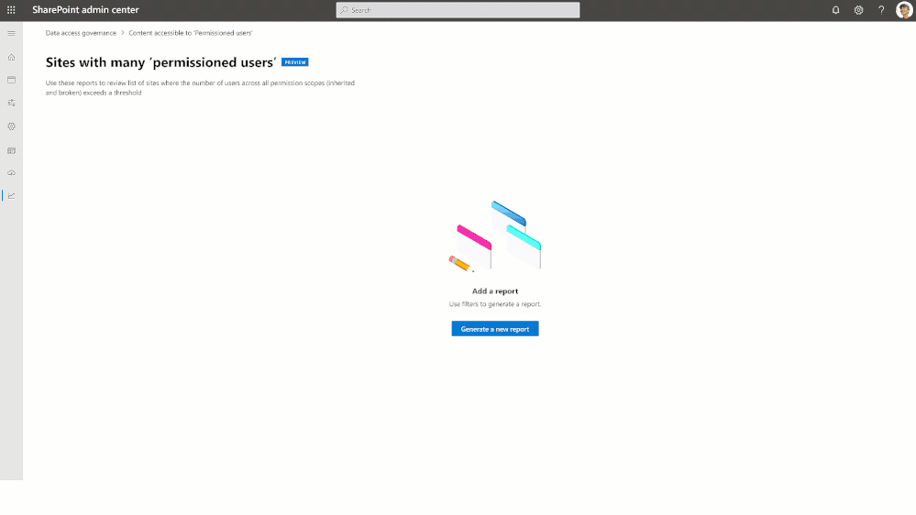
Data Access Governance (DAG)
Sharing link reports
“Anyone” links
"People in the organization" links
"Specific people" links shared externally
Sensitivity labels for files reports
What’s coming – DAG v2
Permission state report
Everyone except external users (EEEU) report
Site access reviews
Notes:
Sharing link reports
"Anyone" links - This report provides a list of sites in which the highest number of "Anyone" links were created. "Anyone" links allow anyone to access files and folders without signing in.
"People in the organization" links - This report provides a list of sites in which the highest number of "People in the organization" links were created. These links can be forwarded internally and allow anyone in the organization to access files and folders.
"Specific people" links shared externally - This report provides a list of sites in which the highest number of "Specific people" links were created for people outside the organization.
These reports can be one once every 24 hours and will show up to 100 sites with the highest number of sharing links created in the last 30 days. It will also show you policies applied to the sites (site sensitivity, site unmanaged device policy, and site external sharing policy) and the site’s primary administrator. The reports don’t include OneDrive data, but there is a separate OneDrive sharing report users can use to analyse sharing on their onedrives.
Sensitivity labels for files reports
This report helps you find sites storing office files that have labels applied. To run the report you select the label then it will create a report showing up to 10,000 sites with the highest number of labelled files and what policies are applied to the sites.
Permission state report - SharePoint admins can get details on sites that are permissioned for greater than X users, say >5000 users. This report includes files and folders that broke inheritance from site permission. This report can be run for OneDrive and SharePoint sites.
EEEU (Everyone except external users) report – One of the common sources for overshared sites is users mistakenly share content with EEEU group, which will allow all users in the organization except external users. Now with the EEEU report, you can view the list of all sites that were shared with EEEU group. This report can be run for OneDrive and SharePoint sites. Just be aware you need to clear the Display concealed user, group, and site names in all reports setting.
Site access reviews – With the new site access reviews capability, SharePoint admins initiate access review with the owners of sites that are noted in Permission state and EEEU reports. This requests site owners to review and attest that the access pattern seen in their sites is expected or requires action.

Slide 23
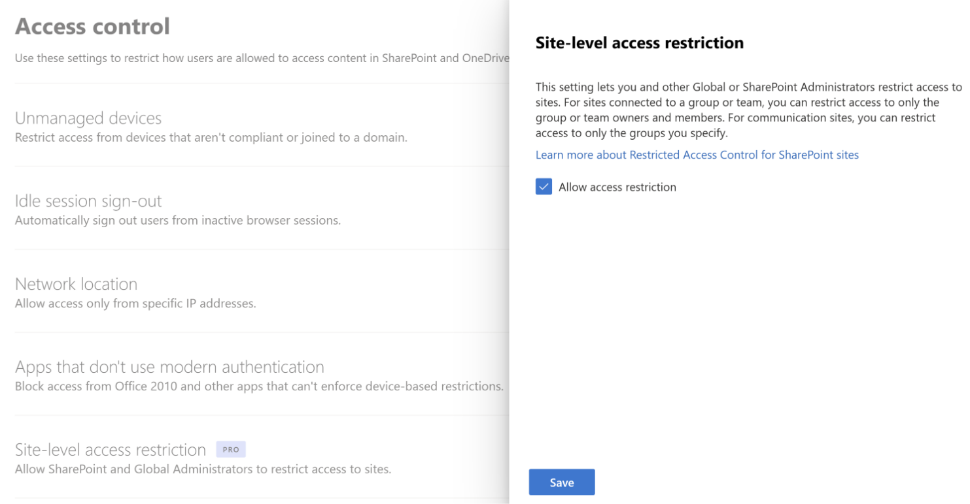
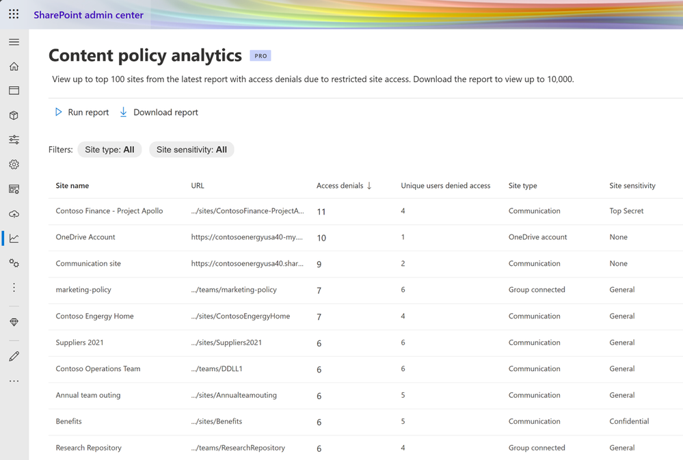
Restricted Access Control (RAC)
Restrict SharePoint site access with Microsoft 365 groups and Entra ID security groups
Restrict OneDrive content access
Restrict OneDrive service access
Features comings:
Restrict access to non-group connected sites and OneDrive sites with security groups
Content Policy Analytics for RAC sites
Notes:
Once we have used data access governance reports to identity overshared content and permissions, we can use RAC policies to control it.
Restrict SharePoint site access with Microsoft 365 groups and Entra security groups
You can restrict access to SharePoint sites and content to users in a specific group by using a site access restriction policy. Users not in the specified group can't access the site or its content, even if they had prior permissions or a shared link. This policy can be used with Microsoft 365 group-connected, Teams-connected, and non-group connected sites (soon onedrive)
Site access restriction policies are applied when a user attempts to open a site or access a file. Users with direct permissions to the file can still view files in search results. However, they can't access the files if they're not part of the specified group.
You can configure up to 10 Entra security groups or Microsoft 365 groups. Once the policy is applied, users in the specified group who have site access permissions are granted access to the site and its content. You can use dynamic security groups if you want to base group membership on user properties.
Because shared and private channel sites aren't connected to the Microsoft 365 group, site access restriction policies applied to the team don't affect them. You must enable site access restriction for each shared or private channel site separately as non-group connected sites.
For shared channel sites, only internal users in the resource tenant are subject to site access restriction. External channel participants are excluded from site access restriction policy and only evaluated per the site's existing site permissions.
Restrict OneDrive content access
You can restrict access to an individual user's OneDrive content to users in a security group by using a OneDrive access restriction policy. Users not in the specified group can't access the content, even if they had prior permissions or shared link.
The policy is applied using Microsoft Entra security groups that contain the people who should be able to access files in that OneDrive.
When the policy is applied, the people in the security group aren't granted permissions to any files directly. The OneDrive owner must share the content as they normally would. The OneDrive access restriction policy prevents anyone who isn't in the security group from accessing the OneDrive content even if it's shared with them.
Access restriction policies are applied when a user attempts to access a file. Users can still see files in search results if they have direct permissions to the file, but they won't be able to access the file if they're not part of the specified security group.
So say Paul could share OneDrive content with everyone in the dd Microsoft team except lauren, we could create a policy so that group pf people can access it. Now Paul can share his content with that group, but if he shares it with me, I still can’t access it.
Restrict OneDrive service access
This is similar to the above but at the OneDrive service level. The content access policy applies to a users onedrive, the service access policy applies to the onedrive service – so you are saying only users in the specified security groups can access ANY onedrive content.
Users who aren't members of the specified security groups will lose access to their own OneDrive and any shared OneDrive content. Sharing of content will be allowed only with the specified security group or members of the specified security group.
Content Policy Analytics for RAC sites - Once you have applied RAC policy to your sites, you can generate content policy analytics, in SharePoint Admin Center or PowerShell, to gain insights on the sites and users who were denied access due to the policy.

Slide 24
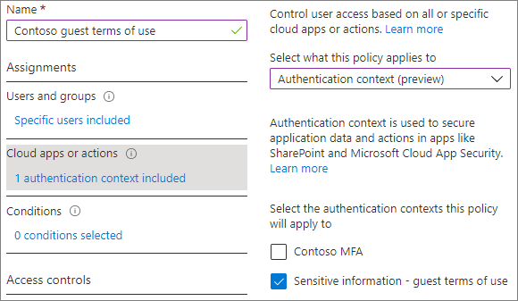
Authentication Context
With Microsoft Entra authentication context, you can enforce more stringent access conditions when users access SharePoint sites.
For example, you may have content within a SharePoint site that requires extra protection, and users who have access to those files might be required to access them from a specific device or agree to terms of use.
You can apply authentication context directly to a site via PowerShell or through sensitivity labels.
Notes:
Licensing
Using authentication context with SharePoint sites requires one of the following licenses:
•Microsoft Syntex - SharePoint Advanced Management
•Microsoft 365 E5/A5/G5
•Microsoft 365 E5/A5 Compliance
•Microsoft 365 E5 Information Protection and Governance
•Office 365 E5/A5/G5
•
Authentication context can be used to further secure data and actions in applications. These applications can be your own custom applications, custom line of business (LOB) applications, applications like SharePoint, or applications protected by Microsoft Defender for Cloud Apps.
For example, an organization might keep files in SharePoint sites like the lunch menu or their secret BBQ sauce recipe. Everyone might have access to the lunch menu site, but users who have access to the secret BBQ sauce recipe site might need to access from a managed device and agree to specific terms of use.
Limitations
Some apps don't work with authentication contexts. We recommend testing apps on a site with authentication context enabled before broadly deploying this feature.
Older version of Office apps (see the list of supported versions)
Viva Engage
Teams web app
OneNote app can't be added to channel if the associated SharePoint site has an authentication context.
Teams channel meeting recording upload fails on sites with an authentication context.
SharePoint folder renaming in Teams fails if the site has an authentication context.
Teams webinar scheduling fails if OneDrive has an authentication context.
Third-party apps
The OneDrive sync app won't sync sites with an authentication context.
Associating an authentication context to the enterprise application catalog site collection isn't supported.
The “Visualize SharePoint List in Power BI” feature doesn't currently support authentication context.
Outlook on Windows, Mac, Android, and iOS don't support communication with SharePoint sites protected by an Authentication Context.
The multiple-file download feature currently doesn't function when both the authentication context and 'Use Conditional Access App Control' in session control are enabled in the conditional access policy.
Setting up an authentication context for labeled sites requires these basic steps:
Add an authentication context in Microsoft Entra ID.
Create a conditional access policy that applies to that authentication context and has the conditions and access controls that you want to use.
Do one of the following:
Set a sensitivity label to apply the authentication context to labeled sites.
Apply the authentication context directly to a site

Slide 25
Block Download Policies
As a SharePoint Administrator in Microsoft 365, you can block download of files from SharePoint sites or OneDrive. This feature doesn't need Microsoft Entra Conditional Access policies. This feature can be set for individual sites and can't be set at the organization level.
Blocking download of files allows users to remain productive while addressing the risk of accidental data loss. Users have browser-only access with no ability to download, print, or sync files. They also won't be able to access content through apps, including the Microsoft Office desktop apps. When web access is limited, users see this message at the top of sites, "Your organization doesn't allow you to download, print, or sync from this site. For help, contact your It department."
You can block the download of Teams meeting recording files specifically if you need to.
Notes:
Download Controls
Block the download of Teams meeting recording files from SharePoint or OneDrive
Users will have browser-only access to play the meeting recordings with no ability to download or sync files or access them through apps
The policy applies to any new meeting recordings across the tenant – it does not apply to any existing recording that were uploaded by teams prior to the policy being turned on
You can exclude specific security groups from the policy
Doesn’t apply to manually uploaded meeting recording files
Block download for SharePoint sites and OneDrive
Blocks users from downloading files from SharePoint sites and/or OneDrive, without requiring CA policies
The policies can only be set at a site level, not a tenant wide level
Users have browser-only access with no ability to download, print, or sync files. They also won't be able to access content through apps, including the Microsoft Office desktop apps.

Slide 26
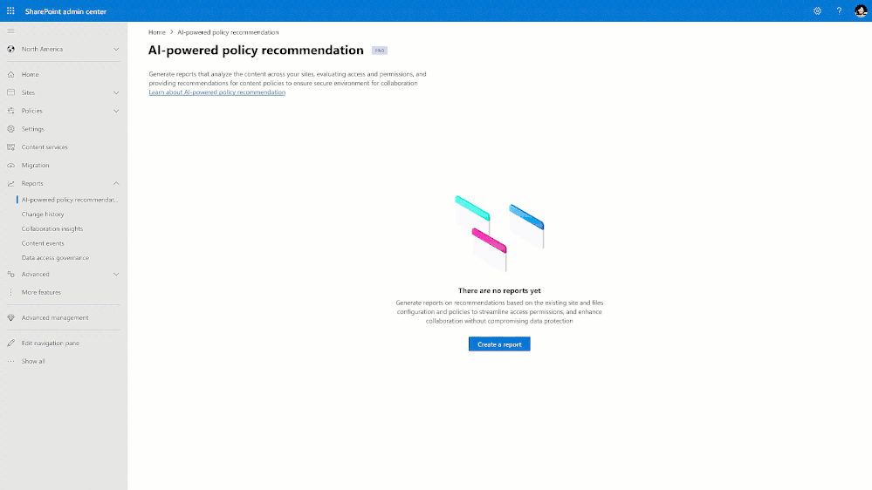
Content Policy Recommendations
AI-driven Content Policy Recommendations for SharePoint sites and OneDrive accounts
Notes:
AI-driven content policy recommendations for SharePoint and OneDrive – you provide a list of few properly policy configured sites with similar content, and then use the power of AI to scan through a target set of sites. This engine will semantically match sites from the input sites. Then it recommends policies, across external sharing, block download, restricted access control, and device policy, for those identified sites.

Slide 27
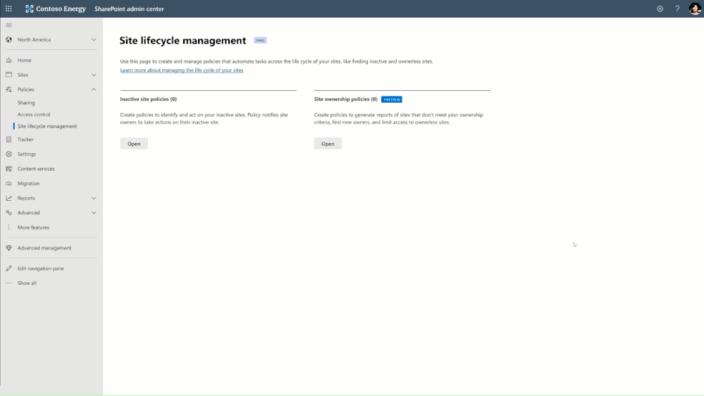
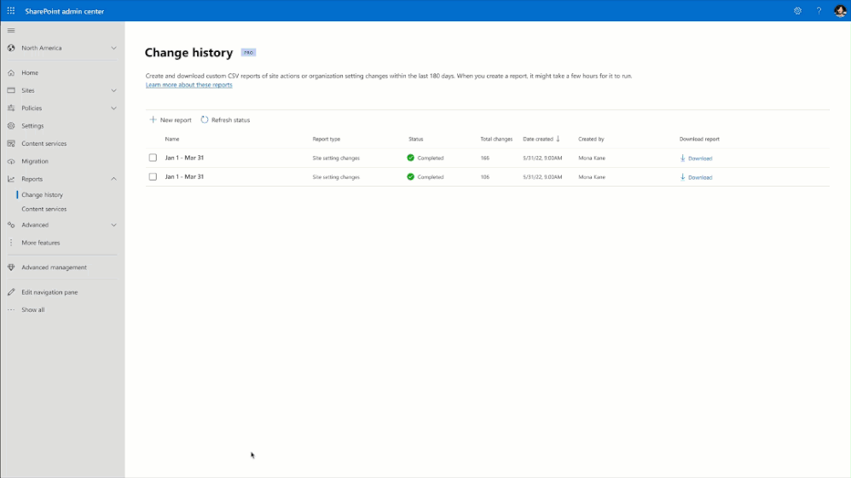
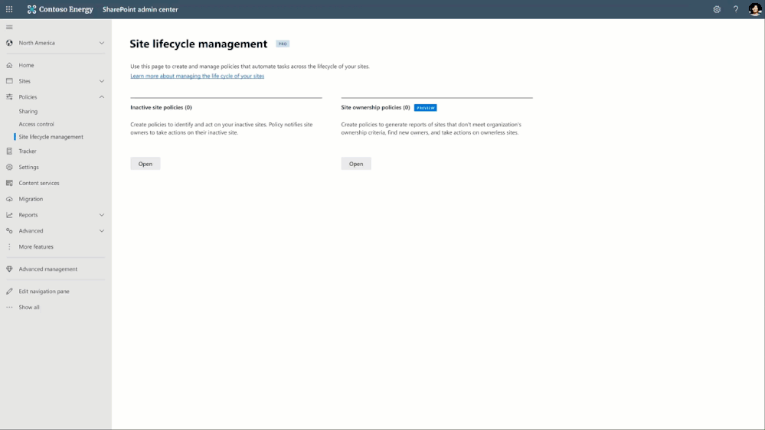
Advanced Sites Lifecycle Management
Inactive site policy – now generally available
Ownership management policy – private preview
SharePoint change history – generally available
Notes:
Inactive sites policies – now GA - SharePoint admins can create custom inactive site policies that target specific SharePoint sites, such as Teams-created sites or sites labeled as “Public” or with an information segment of Research and are untouched for specified periods of time (e.g., one year). Once these policies are in place, site owners of inactive sites will receive automated alerts and can choose to keep, delete, or archive using the Microsoft 365 Archive product as needed. You'll also have the option to apply policies to inactive sites to protect their content and remove any unauthorized access. And for sites connected to Teams, the inactivity status will be determined by evaluating user actions in both Teams and the SharePoint site. This means that Teams owners, as well as site owners, will be notified of any inactivity.
Ownership management policy – Private Preview – with this policy admins can configure a minimum number of owners for a site, e.g. 2 per site, to help prevent scenarios where there is no accountable owner for a sharepoint site who is managing permissions and site content. This policy is for all sites, including both Groups-connected and non-Groups connected sites.
SharePoint change history - enables you to view all changes made to a site's properties by other admins and site owners, for faster investigation and resolution of helpdesk tickets. With this historical view, you can quickly identify and resolve issues in a matter of hours, instead of days or weeks.

Slide 28
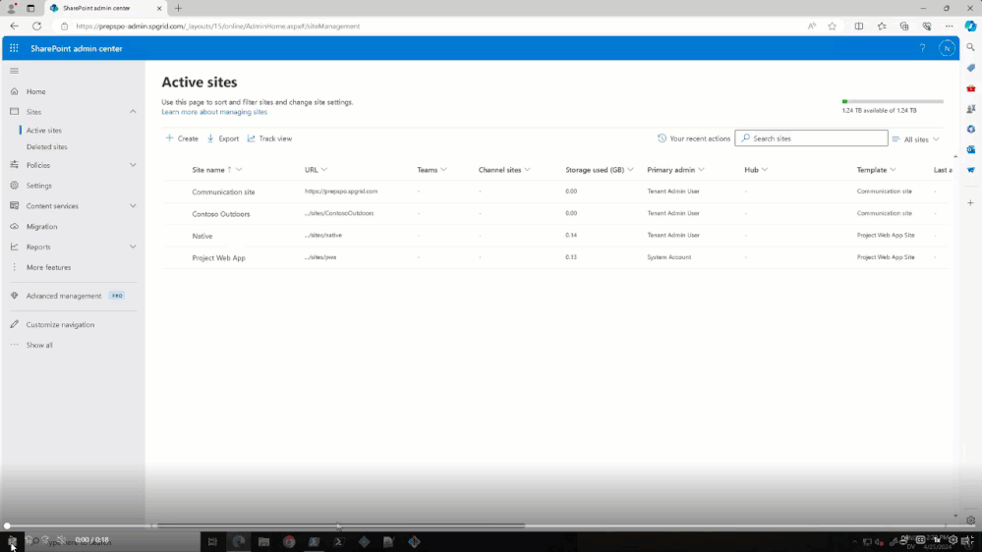
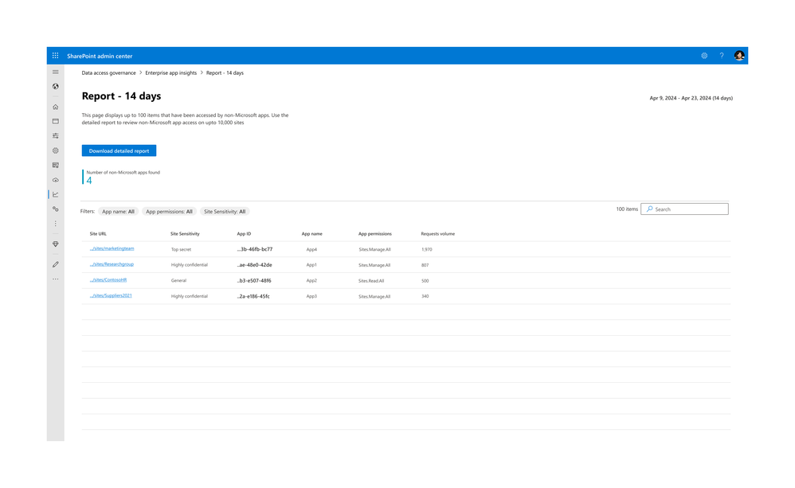
Control Sprawl Controls
Restricted provisioning control (RPC) – Private preview
Enterprise Application Insights (third-party) at SharePoint site level - Private Preview
Notes:
Restricted provisioning control (RPC) - Private Preview – allows SharePoint admins to configure groups with restricted site creation or give site creation rights to specific groups in an organization so you can better control which users in your organisation can create various types of sites to help control how data is organised.
Enterprise Application Insights (third-party) at SharePoint site level - Private Preview – a report which helps you discover all the SharePoint sites that are allowed access by third-party applications registered in your tenant. The report also provides details on the applications’ permission and requests count to help you take further action to strengthen the security of the site.

Slide 29
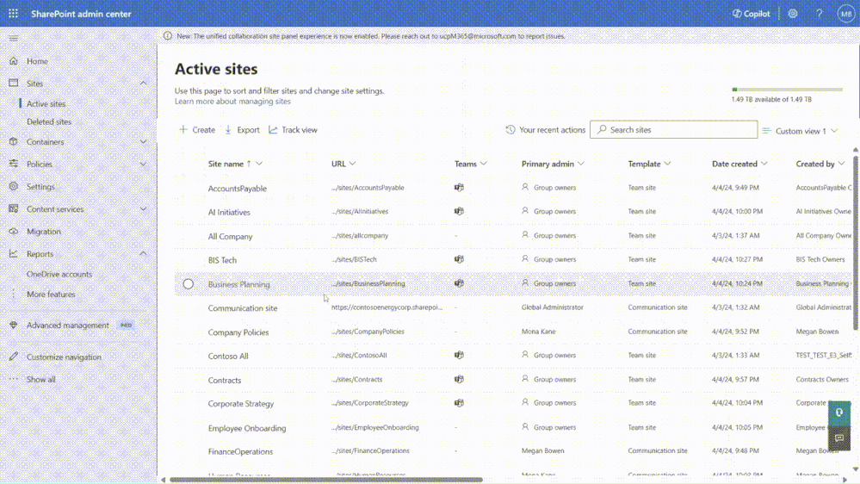
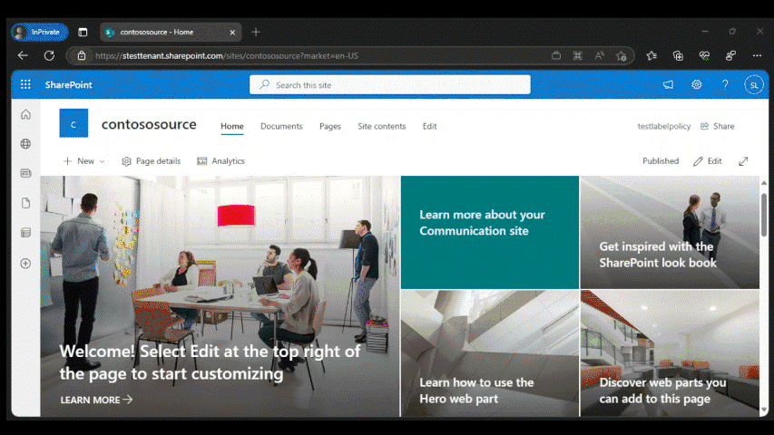
Organisation lifecycle management
SharePoint Advanced Tenant Rename – General Availability
SharePoint cross-tenant sites content migration – Public Preview
Notes:
Advanced tenant rename - now organizations with up to 100,000 total sites can perform renames with greater speed and control. This capability also allows admins to prioritize up to 4,000 sites for renaming. This allows for prioritized business-critical or high-visibility sites to complete renaming first and reduce risk of impact on business operations.
The standard version is limited to tenants with no more that 10,000 sites.
SharePoint site cross-tenant content data migration - you can now move SharePoint sites across two tenants using a simple set of SharePoint PowerShell cmdlets. This includes all kinds of sites like Communication sites, Modern team sites, Teams-connected or Groups-connected sites, etc. This was available in 2022 for onedrive and exchange online but now includes sharepoint.
One another notable capability upon site move is that the sharing links to old URLs will continue to work although the URL of the site has changed! This is made possible by the cross-tenant redirect capability that ensures any hit to old URLs is redirected to new URL.

Slide 30
Licensing
SharePoint Advanced Management is a per-user license.
You must have a license for each user in your organisation.
Guest users do not require a license.
Users must also be licensed for SharePoint K, P1, or P2 via standalone or a Microsoft 365 suite.
SharePoint Advanced Management is available for Commercial, Education, and Charity customers.

Slide 31
Dicker Data Webinar Thank you
Notes:
Microsoft Teams Prem Thank you for your attendance and if you have any questions we will stop recording. Feel free to ask in the chat window.
HOW CAN WE HELP?

